Slide 1
Module III - Case Studies
For cross-policy making and related project design and planning
In cooperation with

Slide 2
Overview of case studies
Region | Scale (local, regional, national, transboundary) | Sectors (water, agriculture, energy) | Solutions (technical, nature-based, governance, focus on challenges)
Europe
LAC
LAC
MENA Region
Niger Basin
SADC
Policy framework for WEF coordination, Germany
Hydropower in the Reventazón River, Costa Rica
Mobile solar powered irrigation systems (SPIS), Bolivia
The Sahara Forest Project, Jordan
The Lagdo Dam in the valley of the Benue, Cameroon
WEF-Nexus coordination in the lower Kafue basin, Zambia

Slide 3
The Lagdo Dam in the valley of the Benue, Cameroon
Niger Basin
Notes:
Notes:
This case study is an example for a multi-purpose dam which, as we outline in module 1, can be one solution approach to the WEF Nexus
Also chose this project as GIZ and the regional NRD programme of Niger does some activities around this case that will be reflected here
Amongst others, there is the idea to further investigate whether the Lagdo Dam could be declared a project of so called “common infrastructure” and “infrastructure of common interest” (as defined by Annex 5 of the Niger Basin Water Charter) which would essentially allow to make it a joint infrastructure and extend benefit-sharing to all countries sharing the Benue basin (including Cameroon, Nigeria, and Chad)

Slide 4
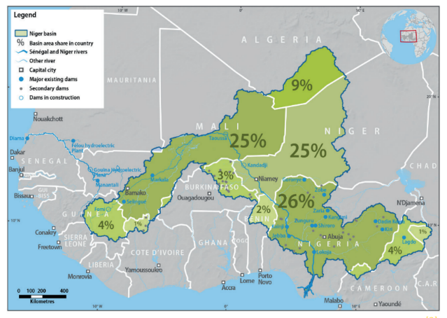
The Valley of the Benue, Cameroon
About the Benue:
Sub-basin of the Niger Basin in West Africa
The Benue River is the main tributary of the Niger River originating in central Cameroon
About Cameroon’s northern region:
Rainy season: May - September (800 mm/year)
PET of 2,500 mm/year
Deficit in PET causes water stress resulting in lower yields and greater climate risks
Trend towards deterioration: poverty has increased from 56% in 2001 to 68% in 2014
Map of the Niger Basin and the valley of the Benue
Source: NRD, 2022
Valley of the Benue
Notes:
Notes:
The Benue is a sub-basin of the Niger Basin in West Africa
The Benue River is the main tributary of the Niger River originating in central Cameroon and flowing northwards limited to the border with Nigeria
In Nigeria the Benue travels for 800 km in a substantially East-West direction before flowing into the Niger
Cameroon’s northern region is characterised by a rainy season mainly from May to September (800 mm annual) and a potential evapotranspiration (PET) of 2,500 mm per year
The permanent deficit in PET causes water stress which affects in turn the agricultural production, resulting in lower yield, and greater climate risks
Furthermore, poverty has increased from 56% in 2001 to 68% in 2014 (World Bank's Viva Benue project) which displays a trend towards deterioration
Sources:
Autorite Bassin Du Niger (2021), ‘Rapport de Mission sur le Barrage de Lagdo – Cameroun’, Niamey, Niger.
World Bank's Viva Benoué project en Autorite Bassin Du Niger (2021), ‘Rapport de Mission sur le Barrage de Lagdo – Cameroun’, Niamey, Niger.
World Bank (2020), ‘Valorization of Investments in the Valley of the Benue Project’, Report.
Image Reference:
Nexus Regional Dialogue (NRD) (2022), ‘Water resource management of the Lagdo hydroelectric dam in Garoua, Cameroon’.

Slide 5
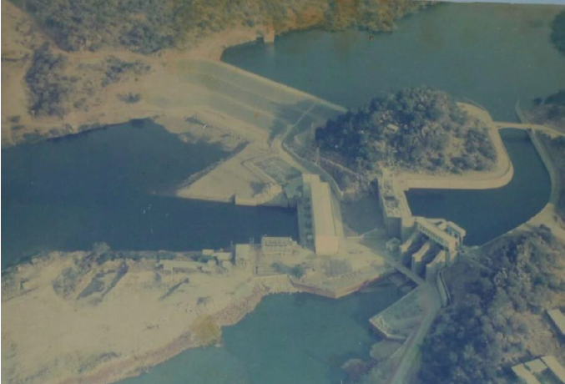
The Lagdo Dam in the valley of Benue
Catchment area: 31,000 km²
Average flow: 248 m³/s
Overview of the Lagdo Dam and associated facilities
1978-1982: Construction of the multifunctional dam
Currently managed by the ENEO company
Serves hydropower generation, irrigation, fisheries, ecosystem management and water supply
Actual irrigated land: 600 ha, operated by the agency MEADEN
Challenge: poor condition of the irrigation system
Source: World Bank, 2020
Average volume: 7,850 hm^{3/}year
Notes:
Notes:
The presented case study focusses on the Lagdo Dam in Cameroon located on the Benue River about 70 km from the city of Garoua (northern part of Cameroon)
The multifunctional dam was constructed over the years 1978-1982 and is currently managed by the ENEO company (Name of public-private partnership company that produces and distributes energy in Cameroon)
It primarily serves hydropower generation but also fisheries, ecosystem management, water supply and agricultural irrigation (although not yet at the level originally envisaged)
(on the picture you see the hydropower canal twisted to the left, the irrigation canal turned to the right).
The catchment area controlled by the Lagdo Dam is 31,000 km² with an average annual volume of 7,850 hm³, which corresponds to an average flow of 248 m³/s, mostly within Cameroonian territory
Originally, the master plan for the Benue River valley aimed to irrigate an area of 11,000 ha
Today, only 600 ha of land are irrigated
The operating agency is MEADEN (Mission for the Development of the North Province), responsible for canal operation and land preparation for more than 90% of the land
Unfortunately, due to a lack of maintenance and missing irrigation fee recovery, the system is in poor condition
Sources:
Autorite Bassin Du Niger (2021), ‘Rapport de Mission sur le Barrage de Lagdo – Cameroun’, Niamey, Niger.
World Bank (2020), ‘Valorization of Investments in the Valley of the Benue Project’, Report.
Image Reference:
World Bank (2020), ‘Valorization of Investments in the Valley of the Benue Project’, Report.

Slide 6
NBA and projects of “common infrastructure” and “infrastructure of common interest”
Niger Basin Authority
(NBA)
The Benue River is part of the larger Niger basin which is managed by the NBA
Purpose: promote cooperation and ensure an irrigated development
Key function: management of water infrastructures
Initiated the Water Charter
Water Charter
Purpose: provides a framework for the allocation of water resources between various use sectors
Establishes provisions for the recognition of “common infrastructure” and “infrastructure of common interest”
Annex 5 – Legal Status
“Common infrastructure”: infrastructure that is of common and indivisible ownership
“Infrastructure of common interest”: infrastructure in which two or more states are interested and coordinate the management
within NBA Member States
Anchor point for WEF Nexus approach
Notes:
Notes:
The Benue River is part of the larger Niger basin which is managed by the Niger Basin Authority (NBA)
NBA’s main purpose is to promote cooperation amongst the nine Niger Basin countries and to ensure an integrated development of water and related resources
The coordinated management of major water infrastructures is one of the key functions of NBA
Several policies and projects have been initiated around it, including the NBA’s Water Charter (including several annexes)
The purpose of NBA’s Water Charter is to “provide a framework to the principles and procedures for the allocation of water resources between various use sectors and the associated benefits”
Additionally, the Water Charter also established new provisions for the recognition of “common infrastructure” and “infrastructure of common interest”
“Common infrastructure” = defined in the Water Charter as infrastructure that NBA Member States have decided by legal instrument to be of common and indivisible ownership
“infrastructure of common interest” = infrastructure in which two or more NBA Member States have an interest and have decided, by mutual agreement of NBA Member States, to coordinate management
The vision of a project of “common infrastructure” and “infrastructure of common interest” goes hand a hand with the Nexus approach, which focuses on multi-stakeholder and multi-purpose solutions to water-energy-food challenges
Starting from there, the Benue Basin, including the Lagdo Dam, has enormous Nexus potential
It plays a crucial role not only for hydropower production, but also for irrigated agriculture, ecosystem management, and water supply
Thus, a successful sustainable management of the Benue River Basin across countries could provide important lessons for the use of a Nexus perspective in the entire Niger Basin and promote the common vision
Additional information (for non-West African context):
The NBA is a River Basin Organisation founded in 1980
(The River Niger Commission was first established in 1964 but later replaced by the NBA in 1980)
It aims at the coordinated cooperation in the management of resources within the Niger Basin
The NBA offers advice on the sustainable development of transboundary water resources within its nine member states: Benin, Burkina Faso, Cameroon, Chad, Côte d’Ivoire, Guinea, Mali, Niger, and Nigeria
It adopts a multilevel structure and various statutory bodies, namely the Summit of Heads of State and Government (the supreme body for orientation and decision making), the Council of Ministers (the NBA’s supervising body), the Technical Committee of Experts (prepares all meetings of the Council of Ministers and submits report recommendations to the latter), and finally the Executive Secretariat (the NBA’s executive body)
Sources:
Autorite Bassin Du Niger (2021), ‘Rapport de Mission sur le Barrage de Lagdo – Cameroun’, Niamey, Niger.

Slide 7
The Nexus perspective
Transboundary interests in the Lagdo Dam
 | Food security | Energy security | Flood management | Other
Cameroon | Water from the dam is used for agricultural irrigation | Hydropower generation is crucial for the region’s energy network | Extreme flood events create environmental and social risks | The lake has an undeveloped touristic potential
Nigeria | Relies on food imports from Lagdo |  | Extreme flood events create environmental and social risks
Chad |  | Interested in energy imports
Notes:
Notes:
The Benue Basin and thus the Lagdo Dam is not only shared by three different countries but also depicts different sectoral interests
The country's interests in the Lagdo Dam (Benue River basin):
Cameroon:
Food security: water from the dam is used for agricultural irrigation in order to safeguard the food supply
Most households depend on rain-fed agriculture and are vulnerable to climate change in the Sahelian context
More than half of the households spend more than 40% of their income on food and more than 15% are vulnerable to food insecurity (World Bank's Viva Benue project)
Energy security: hydropower generation is crucial for the region’s energy network
The hydropower plant provides electricity for the towns and villages around the lake, including Garoua
The hydroelectric dam with its 72 MW capacity is part of the interconnected northern network
This network still includes thermal power stations with a combined capacity of about 30 MW (World Bank's Viva Benue project)
Flood management: managing environmental and social risks downstream of Lagdo
The main safety issue is related to heavy and extreme floods which put especially the town of Garoua in danger
Other interests:
The lake has a touristic potential which has not been tapped as today
Nigeria:
Food security: relies on food imports
Food products like fish and rice are imported from Lagdo
During some years, within a short time, merchants from Nigeria buy up to 90% of the rice and 70% of the fish production from there
Flood management and prevention:
Floods are recognised as a high risk at the Nigerian side of the Benue Basin
The last flooding events took place in the years 2012, 2018 and 2019
Chad:
Energy security:
Interest in importing electricity from the dam through the Northern Interconnection Programme
Sources:
Autorite Bassin Du Niger (2021), ‘Rapport de Mission sur le Barrage de Lagdo – Cameroun’, Niamey, Niger.
World Bank's Viva Benoué project en Autorite Bassin Du Niger (2021), ‘Rapport de Mission sur le Barrage de Lagdo – Cameroun’, Niamey, Niger.

Slide 8
The Nexus perspective
Cross-sectotal potential of the Lagdo Dam
Food security
Potential to expand the arable land, rehabilitation of irrigation systems
Agro-industrial development as well as small-scale farmers
Options for fishing aquaculture (Hina Dam)
Energy security
The hydropower capacity is below local needs for temporary power cuts to save water for the dry season
Hydropower production is almost exclusively consumed by Cameroon
Flood management
The Lagdo Dam needs to be updated to better manage floods downstream in Nigeria
State of the dam
The effects of climate change and agricultural investments in the basin have a considerable impact on the reservoir
Notes:
Notes:
The potential of the Lagdo Dam:
Food security:
Potential to expand the available arable land and options for aquaculture and rehabilitate irrigation systems
World Bank's Viva Benue project: focusses on the rehabilitation of irrigation on the right river bank (1,090 ha) and the development of further arable land (4,230 ha) - both for small-scale farmers
On the left bank 3,628 ha are foreseen for agro-industrial development and 1,496 ha for small-scale farmers in the existing villages within the perimeter
Integrated Programme for Development and Adaptation to Climate Change in the Niger Basin (PIDACC/BN-Cameroon): aims at strengthening the population’s capacities through the construction of the Hina Dam for fishing and aquaculture
Energy security:
The hydropower capacity of the Lagdo Dam is below local needs for temporary power cuts to save water for the dry season
So far, the entire hydroelectric production from Lagdo is consumed in Cameroon’s
There is export of hydroelectricity to Chad from the Massouri Dam
Current project of the Cameroonian government: interconnection project of electric stations
Aims at ensuring energy self-sufficiency in the North as well as in the South of the Cameroon
Perspective for the Chad: with the interconnection project, energy from various sources could be connected and potentially even exported to Chad
Flood management:
The Lagdo Dam needs to be updated to better manage floods downstream in Nigeria
The state of the dam:
The effects of climate change (decrease in water availability) and agricultural investments in the basin have a considerable impact on the reservoir
Sources:
Autorite Bassin Du Niger (2021), ‘Rapport de Mission sur le Barrage de Lagdo – Cameroun’, Niamey, Niger.
World Bank's Viva Benoué project en Autorite Bassin Du Niger (2021), ‘Rapport de Mission sur le Barrage de Lagdo – Cameroun’, Niamey, Niger.

Slide 9
Potential for next steps
Food security:
Rural supply will be further coordinated by the Viva-Benue project
Improvements regarding food exports to Nigeria are recommended
Energy security:
Engage in transboundary discussions on potential power interconnection projects
State of the dam:
Development of an action plan for dam safety
International coordination:
Revilatisation of the Nigeria-Cameroon Bilateral Committee is recommended
Users of Lagdo locality:
Social infrastructures and awareness rising are recommended
Rice production at the bottom of Lagdo Dam
Hydro-Electric Station of Lagdo Dam
Source: ABN, 2021
Notes:
Notes:
The following potential next steps are made with regards to further explore the potential of making the Lagdo dam as “common infrastructure” or “infrastructure of common interest” and hence to tap the potential of transboundary/joint benefits.
Food security:
Rural supply will be coordinated by the Viva-Benue project of the World Bank
Given the importance of food exports to Nigeria, measures to improve the trade (from the Lagdo area) are recommended
Energy security:
Engage in transboundary discussions on potential power interconnection projects
There are certain anchor points to link this project with other energy projects (e.g. in Chad: the Bini project at Warak in the Lake Chad basin)
Flood prevention:
Long-term observation of the hydrology in the basin are recommended for a better understanding → especially the risks of floods and impacts of drought (in coordination with the Viva Benue project)
A better overview of information/data on the basin is useful to assess the role of the water bodies of Mayo Kebbi, Faro and Lagdo on the Benue Basin
State of the Lagdo dam:
An action plan for upgrading the dam has been developed to meet international standards for dam safety
The actions are shared between the project owner through the Viva-Benue project and the operating company ENEO
The construction of an emergency spillway equipped with fuse blocks is part of it
International coordination:
It is recommended to revitalise the Nigeria-Cameroon Bilateral Committee to exchange on common challenges in the Benue Basin and to improve data sharing (the committee was established in 2017 but never really took off)
Users of Lagdo Locality:
It is recommended to promote support in terms of social infrastructures to the Lagdo communities
It is also important to continue with raising awareness and support to users in their various activities related to the use of the dam’s water
Sources:
Autorite Bassin Du Niger (2021), ‘Rapport de Mission sur le Barrage de Lagdo – Cameroun’, Niamey, Niger.
Image Reference:
Autorite Bassin Du Niger (2021), ‘Rapport de Mission sur le Barrage de Lagdo – Cameroun’, Niamey, Niger.

Slide 10
Thank you for your time!
In cooperation with

