Slide 1







Module II - Institutions, processes and tools for institutionalizing the WEF Nexus
In cooperation with
Notes:
Notes:
After having learned about assessment tools that help to analyze WEF sectors and impacts of Nexus interventions and governance instruments that facilitate coordination across sectors and different administrative levels, we will now take a closer look at another aspect that is crucial to implementing WEF Nexus approaches: cross-sectoral investment planning and financing. ​

Slide 2

Let’s get back to Ms. Sinclair…
What financing sources are available to support this type of multisectoral programmes or projects?
What is the economic added valued of our proposed WEF Nexus solution? How can we measure this?
Notes:
Notes:
[Storytelling Intro – adjust names to local context]
Let’s get back to Ms. Sinclair.
You remember that he is the head of city administration of Mostanova where , responsible for electricity supply.
We have learned that her proposal to exploit the potential for solar energy for electricity supply of the city has raised concerns from her colleagues responsible for agriculture and water resources.
At the end, Ms. Sinclair had realized that her idea of bringing solar energy to Mostanova would require many more discussions with her colleagues.
In order to be well prepared for those discussions, Ms. Sinclair needed to assess the WEF nexus to present a convincing solution, such as the combined use of land for agriculture and solar panels as we have seen in the example of so-called Agrivoltaics in Module I – or there might be other solutions, such as stricter regulation of groundwater abstraction. Again, in order to make a convincing case for these solutions, MS Sinclair will need to carry out a comprehensive assessment to demonstrate the potential benefits of her solution - but also help Ms. Sinclair to make sure that her activity doesn’t have other unintended side-effect, such as on ecosystems, local livelihoods etc.
Besides these considerations on potential impacts and benefits of her solution, of course she will also ask herself the following important questions:
What is the economic added valued of our proposed WEF Nexus solution? How can we measure it?
What financing sources are available to support this type of multisectoral programmes or projects?
-------
This example from Mostanova brings us straight to the topic of this part of the training, which is about cross-sectoral investment planning and financing.

Slide 3
Motivation: outline the value of cross-sectoral investment planning and financing
  How can we demonstrate the economic added value of Nexus solutions?
  What financing sources are available to support multisectoral programmes or projects?
  How does the Nexus help mobilize financing for resources efficiency?
Notes:
Notes:
- The motivation behind what we deal with in his part of the training is based the recognition that so far, “there remains a lack of convincing examples to demonstrate the clear added value of nexus approaches in policymaking and investment planning, as compared to traditional, sectoral approaches.” (UNECE 2021). This point also came out of the interviews and the survey we have conducted prior to developing this training.
We will therefore ask ourselves the following questions that will guide us through this part of the training:
How can we demonstrate the economic added value of Nexus solutions? → After having introduced some definitions, we will take a look at some of the methods and tools that can help assessing this, which will be particularly relevant to guide investment planning and make out “bankable” Nexus investments.
What financing sources are available to support multisectoral programmes or projects?
How does the Nexus help mobilize financing for resources efficiency? → These two questions will be addressed in the third part of this chapter, where we will try to get an overview of which financial providers and mechanisms / instruments exist out there and how a Nexus approach will help mobilizing finance to implement Nexus solutions.
There is no blueprint to plan Nexus investments and to access adequate financing, but an important overall pre-condition, as previously stated is: greater coherence at the level of policy actions and plans as key to build common understanding and mutual trust (UNECE, 2021: 47). Moreover, capacities of institutions need to be strengthened as understanding of how the financing of multisectoral projects work may be limited, depends on how they are structured to work across sectors and overall, attention to multisectoral solutions is rather recent (UNECE, 2021:67). However, if the political will to cooperate and coordinate is given, then it can motivate investors to engage with nexus projects and thus contribute to closing financial gaps.

Slide 4
Outline
Chapter 2.1: | Assessing the Nexus – Assessment tools for decision support WEF Nexus context analyses Assessing impacts of changes Assessment of specific Nexus interventions Interactive Exercise: selecting Nexus indicators
Chapter 2.2: | Governing the Nexus Horizontal and vertical policy coordination Case studies policy coordination Policy instruments to incentivize resource efficiency Interactive exercise: policy analysis
Chapter 2.3: | Cross-sectoral investment planning and financing Introduction and definitions Demonstrating the economic added value of Nexus solutions Mobilizing finance to implement Nexus solutions Interactive exercise: pitching your Nexus project
Notes:
Notes: ​
The following presentation comprises chapter 2.3 which is divided in the following sub-chapters:​
After a short introduction and some definitions
We will look at some of the methods and tools that can help demonstrating the economic added value of Nexus solutions
We will gain an overview of mobilizing finance to implement Nexus solutions
Interactive exercise: pitching your Nexus project

Slide 5
Introduction and definitions
Chapter 2.3: Cross-sectoral investment planning and financing

Slide 6



Introduction: sectoral investments
Investments for drinking water in 2018: 0.6 trillion USD
Required investments until 2030: 6.7 trillion USD
Required investments until 2050: 22.6 trillion USD
Annual investments in agriculture between 2016-2030: 0.7 to 0.8 trillion USD
Additional annual investments needed to fulfill Goal 2 of the SDGs (until 2030): 0.14 trillion USD
Investments in the energy sector in 2020: 1.5 trillion USD
Compared to the previous year, the share of energy investments decreased by 20% as result of the lockdowns
Notes:
To introduce the topic, let is take a look at a few facts about sectoral investments in the three WEF Nexus sectors:
Water (OECD, 2018):
In 2018, the value of investments for accessible, safe and affordable drinking water accounted for about 0.6 trillion USD
In order to achieve Goal 6 of the SDGs (clean water and sanitation), further investments in water infrastructure will be needed (e.g. 6.7 trillion USD until 2030 and 22.6 trillion USD until 2050)
Energy (IEA, 2020):
In 2020, about 1.5 trillion USD were invested into the energy sector
These investments were addressed towards (1) energy end use and efficiency, (2) power sector, and (3) fuel supply
In comparison to the previous year, the share of global energy investments decreased by 20% as result of the lockdowns
Agriculture/Food security:
Prior to the COVID-19 pandemic the average gross annual investment in agriculture was estimated at 0.7 to 0.8 trillion USD in the period of 2016-2030 (FAO et al., 2015)
In order to meet the first and second Goal of the SDGs until 2030 (no poverty and zero hunger) additional annual investments around 0.14 trillion USD will be needed (FAO, 2020)
It is likely that these additional investments need to be further increased because there is a certain risk that the pandemic evolves to a hunger crisis (FAO, 2020)
Conclusion: Overall, the share of investments varies considerably between the three WEF sectors. Compared to water and agriculture, the energy sector receives the largest amount. All sectors have in common that they will need further and higher shares of investments over the next decades. Here, the Nexus offers an opportunity: Cross-sectoral investment planning and financing not only provides an enabling environment, but also opens up possibilities which would not be available for a single sector.
Sources:
FAO (2020), 'Responsible investment and COVID-19: Addressing impacts, risks and responsible business conduct in agricultural value chains', Rome.
FAO, IFAD & WFP (2015), 'Achieving Zero Hunger: the critical role of investments in social protection and agriculture', Rome, FAO. 39 pp., available at: http://www.fao.org/3/a-i4951e.pdf
IEA (2020), ‘World Energy Investment 2020’, available at: https://iea.blob.core.windows.net/assets/ef8ffa01-9958-49f5-9b3b-7842e30f6177/WEI2020.pdf
OECD (2018), ‘Financing Water: Investing in Sustainable Growth’, Policy Perspectives: OECD Environment Policy Paper No. 11, available at: https://www.oecd.org/water/Policy-Paper-Financing-Water-Investing-in-Sustainable-Growth.pdf

Slide 7
Cross-sectoral investment planning
An investment plan
  ... serves the purpose of achieving certain goals or implementing a strategy
  … brings together assessments, materials, data and recommendations developed at previous steps
  … is the basis on which implementing agencies will attract investments from financing institutions
  ... contains a wide range of possible projects, calling for prioritization according to certain criteria
In the Nexus context
  … it is essential that sectors realize the interlinkages of water, energy and food projects, shifting from sector thinking into multi-purpose and cross-sectoral thinking.
  ... robust investment planning is critically needed in order to financially sustain WEF Nexus investments and operations
  … countries need an overview of planned investments and types of projects, and of associated financing at all levels to identify opportunities and prioritize investments.
Notes:
Notes:
First, let us start with a few definitions of the notions we use when speaking about „cross-sectoral investment planning and financing“.
An investment plan
... serves the purpose of achieving certain goals (e.g. WEF security) or implementing a strategy (e.g. climate adaptation / mitigation)
… brings together assessments, materials, data and recommendations developed at previous steps
… is the basis on which implementing agencies (at all levels) will attract investments from financing institutions (of different types)
... contains a wide range of possible projects, calling for prioritization according to certain criteria for an impactful investment plan
Typically, investment plans are sectoral investment plans, meaning that they focus on their sector deliverables and they see other sectors as inputs and outputs to their sector. However, bearing in mind our Nexus approach:
… It is essential that sectors realise the interlinkages of water, energy and food projects to ensure water, energy and food security and explore synergies (for example where hydropower requires water, and energy as part of the pumping process, and provides opportunities of improving livelihoods through agriculture and other cross-cutting areas like tourism), which calls for shifting of sector thinking into multi-purpose and cross-sectoral thinking.
... robust investment planning is critically needed in order to financially sustain WEF Nexus investments and operations
… countries need an overview of planned investments and types of projects, and of associated financing at all levels (international, national and local) in order to identify nexus opportunities and prioritize investments.
Sources:
Bizikova, L., Roy, D., Venema, H. D., McCandless, M., Swanson, D., Khachtryan, A., ... & Zubrycki, K. (2014), ‘Water-energy-food nexus and agricultural investment: a sustainable development guidebook‘, International Institute for Sustainable Development (IISD), available at: https://www.iisd.org/system/files/publications/WEF_guidebook.pdf
SADC (Draft to be published 2022), Water, Energy, Food Nexus Guidelines.
Additional information:
What is investment planning?
Investment planning can be understood as a process which consists of the following two steps:
Identification of current and future key issues (through an integrated planning process, participatory methods, analytics, and more)
Development of a measures to achieve a goal or to implement a strategy (including recommendations and guidelines e.g. on projects)
Thus, it supports the transition from the project planning phase into implementation by providing an overall structure in which objectives and financial resources are reconciled
Based on: Antea Group (2017), ‘Multi-sectoral investment plan for adaptation to coastal risks induced by climate change in Benin: Final report‘, Belgium.

Slide 8
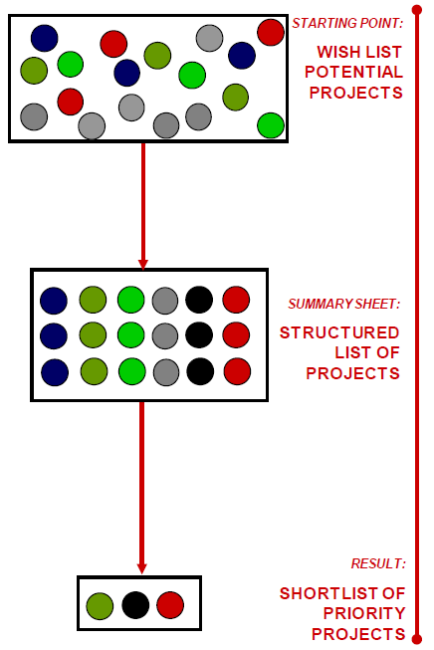
Project prioritisation: from a wish list to a short list
CBA
Selection criteria
MCA
Source: Cities Development Initiative for Asia (CDIA), 2010
Notes:
Notes:
Project prioritisation is a crucial step of investment planning in order to demonstrate the added value of a proposed solution, in our case of Nexus solutions. As public budgets are limited, we need to select the most cost-effective projects that are feasible to be implemented within a given time-frame.
This will help:
as a tool for communication on Nexus solutions, hence building knowledge and awareness in financiers so they too understand the interlinkages between water, energy and food as critical to sustainable development and in their decision-making.
Implementing agencies (ministries, private sector, international development partners) in the selection of what project to finance at what level.
Therefore, in the next chapter we will take a look at some methods which can be helpful for prioritisation and selection of Nexus solutions, in particular:
Cost-Benefit Analysis for Nexus solutions (CBA)
Multi-Criteria Analysis of Nexus solutions (MCA)
→ Please note that the criteria presented in the NIA toolkit can also be used for CBA and MCA
Selection criteria
Source:
Cities Development Initiative for Asia (CDIA) 2010: City Infrastructure Investment Programming & Prioritisation Toolkit. User Manual: From wish list to short list: prioritising urban infrastructure projects for local development.
CliFiT (2014), ‘Project Pipeline Development’. Training materials. adelphi for CliFiT: https://clifit.org/

Slide 9
Financing
Financing
  … comes from a variety of sources (e.g. public, private, blended)
  … and in different forms (e.g. grants, loans, equity, guarantees)
  … and is delivered through local, national, regional, and / or international channels
  … to a variety of recipients
In the Nexus context
  … financing is multisectoral in character
  … there may be new and additional financing opportunities
  … traditional as well as innovative mechanisms are used to finance Nexus projects
Notes:
Notes:
Now the question is: how to leverage investments for sustainable development, more particularly considering Nexus approaches as key?
WEF Nexus interventions requires adequate financing to sustain WEF investments and contribute to the SDGs. As decision for investment are made, it is important for implementing agencies to develop financial resourcing plans on how to access finance. Identification and plotting of already existing and planned main financing instruments and financing sources (including private and public, international and local sources, regional development banks) that can be eligible for the regional WEF projects will be key. Well collaborated and coordinated WEF Nexus investment plans will ensure success of the projects and ultimately ensure WEF security. (UNECE 2021)
Let‘s take a quick look at the notion of „Financing“:
… Financing comes from a variety of sources (e.g. public, private, blended), involving different types of finance providers
… Financing comes in different forms (e.g. grants, loans, equity, guarantees), meaning that there a different mechanisms to deliver it
… Financing is delivered through local, national, regional, and / or international channels
… to a variety of recipients
So, in the Nexus context, we will look at what this implies given that:
Nexus investment is multisectoral in character. The multi-sectoral character of Nexus projects requires cross-sectoral cooperation to unlock investments.
New and additional financing opportunities derive from the differences between the WEF sectors (UNECE, 2021: 47)
Traditional as well as innovative finance mechanisms are used to finance Nexus projects. Most of the financial resources are state-provided (including donor financing). However, the nexus approach favors more private and blended finance though “green” investments: "At present, most of the financial resources used to implement nexus solutions come from the state (including donor financing), despite broad recognition that the nexus approach opens up clear opportunities for more private and blended finance though “green” investments in agriculture, energy, tourism and so on." (UNECE, 2021: 68)
Sources:
GIZ (2018), ‘The GIZ Finance Guide: Navigating the world of finance.‘, Eschborn.
UNECE (2021), ‘Solutions and investments in the water-food-energy-ecosystems nexus: A synthesis of experiences in transboundary basins’, Geneva.
Additional information:
More detailed definitions on financing can be found in GIZ (2018)
Financial activities are located along three key axis: of (1) finance recipients, (2) finance providers, and (3) financial instruments/ mechanisms
Financial instrument: A financial contract between two parties, reflecting the modality by which financing is channeled to a receiving entity.
Finance providers: finance providers are defined as financial intermediaries that make financing available to finance recipients. The funds thus conveyed could originate from the providers’ own sources or through the aggregation of funds obtained from other actors in the financial sector.
Finance recipient: finance recipients are defined as entities that receive financing and put it to productive uses.

Slide 10
Demonstrating the economic added value of Nexus solutions
Chapter 2.3: Cross-sectoral investment planning and financing
Notes:
Notes:
Having set these definitions, we would now like to take a closer look at how to demonstrate the economic added value of Nexus solutions. Indeed, nexus solutions are not only innovative and support sustainable development, but they also need to be economically viable in order to be attractive for investors. We will now present different methods that can be used to evaluate and demonstrate their economic added value.

Slide 11
Evaluate the economic added value of Nexus solutions
Method | Description | Challenges
Cost Benefit Analysis of Nexus solutions (CBA) | Assesses the economic efficiency of Nexus solutions Weights costs against benefits, expressed in monetary values | Theoretical Time-consuming Lack of comparable data Estimations diminish the accuracy
Cost Effectiveness Analysis of Nexus solutions (CEA) | Costs are valued in monetary terms, and benefits quantified in ‘physical’ units Costing of different options that achieve the same objective, producing a ranking in terms of cost | Allows for cases with multiple objectives or criteria only if they are quantifiable (otherwise excludes other dimensions such as equity, feasibility or co-benefits)
Notes:
Notes:
Cost Benefit Analysis for Nexus solutions (CBA)
Description:
CBA is a common tool which can be used in the nexus context for assessing the economic efficiency of nexus solutions (UNFCCC, 2012)
It basically weighs costs against benefits (expressed in monetary terms) and thus determines whether benefits prevail over costs or not (UNFCCC, 2002)
Application of CBA is especially useful in the preparatory stage of projects for the prioritization of nexus solutions (FAO & UNDP, 2020)
The advantage of this approach is that its analysis fully relies on a single metric → a lot of different costs and benefits can be compared (UNFCCC, 2012)
Steps in assessing nexus solutions with a CBA (UNFCCC, 2012):
Agree on Nexus solutions and measures
Define a baseline and a project-line in order to economically compare the with and without scenarios
Gather the costs and benefits over specific time periods
Final comparison of the two parameters (costs and benefits)
In order to come to an conclusion weather the Nexus solution is economically efficient or not, CBA provides three indicators between which the decision-makers can decide
The net present value (NPV): expresses the difference between the present value of the benefit and of the costs → solution is acceptable when the NPV is greater than zero
The benefit-cost ratio (BCR): shows the overall value for money of a project (expressed by the ratio of the present value of the benefits to the one of the costs) → solution is acceptable when the BCR is greater than zero
The internal rate of return (IRR): describes the discount rate which zeroes the NPV → desirability of a Nexus solution rises equivalent with the IRR
Challenges:
Method is quite theoretical
Might be difficult to apply in practice due to (a) time needed to conduct analysis and (b) missing or non-comparable data
It is difficult to put a monetary value on e.g. environmental goods and services → estimations need to be made which influence the accuracy of the analysis (UNFCCC, 2012)
CBA in practice: Example from Kenya
Source: FAO & UNDP, 2020
Research conducted a CBA and analysed „[…] the financial and economic worthiness of agriculture adaptation measures (soil and water conservation and agroforestry)“ (FAO & UNDP, 2020: 1)
Results confirmed that the investigated Nexus solution does add an economic value in form of positive on-farm net benefits
Furthermore, it also generated external (public) benefits like reduced CO2 emissions, or a decrease in the siltation of dams
But the economic profitability alone is not sufficient to ensure that the Nexus solution will succeed
In the Kenyan case, the adaptation measures need further governmental support in order to get adopted
Cost Effectiveness Analysis of Nexus solutions (CEA)
Description:
A Cost-Effectiveness Analysis (CEA) will be useful especially when it comes to deciding on the preferred strategy to resolve unintended trade-offs (Altamirano et al., 2018)
Costs are valued in monetary terms, and benefits quantified in ‘physical’ units
allows for costing of different options that achieve the same objective, producing a ranking in terms of cost
Steps in assessing trade-offs (and synergies) with a CEA (UNFCCC, 2012):
Agree on measures to resolve the trade-offs
Establish a baseline (in order to evaluate if the measure was fulfilled)
Quantify the associated costs (similar to CBA)
Determine the effectiveness
Final comparison: which measure is the most cost effective one?
Challenges:
allows for cases with multiple objectives or criteria, but only if quantifiable
The focus of CEA on cost-effectiveness excludes other dimensions such as equity, feasibility or co-benefits (UNFCCC, 2012)
Sources:
Altamirano, M. A., van Bodegom, A. J., van der Linden, N., de Rijke, H., Verhagen, A., Bucx, T., ... & van der Zwaan, B. (2018), ‘Operationalizing the WEF nexus: quantifying the trade-offs and synergies between the water, energy and food sectors‘, Dutch Climate Solutions research programme (No. E--18-036). ECN.
CliFiT training materials [PowerPointPresentation], ‘Project Pipeline Development’.
FAO & UNDP (2020), ‘Assessing agroforestry practices and soil and water conservation for climate change adaptation in Kenya: A cost-benefit analysis’, Rome, FAO.
UNFCCC (2012), ‘Assessing the costs and benefits of adaptation options: An overview of approaches’, The Nairobi Work Programme on Impacts, Vulnerability and Adaptation to Climate Change, UNFCCC Secretariat, Bonn, Germany.
UNFCCC (2002), ‘Annotated guidelines for the preparation of national adaptation programmes of action’, Least Developed Countries Expert Group, available at: https://unfccc.int/resource/docs/publications/annguid_e.pdf
Main reading:
FAO & UNDP (2020), ‘Assessing agroforestry practices and soil and water conservation for climate change adaptation in Kenya: A cost-benefit analysis’, Rome, FAO.
UNFCCC (2012), ‘Assessing the costs and benefits of adaptation options: An overview of approaches’, The Nairobi Work Programme on Impacts, Vulnerability and Adaptation to Climate Change, UNFCCC Secretariat, Bonn, Germany.

Slide 12
Evaluate the economic added value of Nexus solutions
Method | Description | Challenges
Multi-Criteria Analysis of Nexus solutions (MCA) | Combines financial/economic with technical, environmental and social criteria to assess and rank Nexus solutions Each criterion is assigned with a weighting contributing to the solutions score MCA can complement CBA | Focusses not only on economic criteria: difficult to agree on weighting of criteria
Presenting the business case of Nexus solutions | Evaluates if an investment in a Nexus solution should be undertaken or not Based on CBA/CEA: assess the expected risks and costs against expected investment returns Pathway to develop a business case: (1) Setting the business rationale, (2) Specify the modes of investment, (3) Outline the value proposition | Investments are often associated with unknown risks, high costs of actions and uncertain investment returns Method limited to local scale Time-consuming
Notes:
Notes:
3. Multi-Criteria Analysis of Nexus solutions (MCA)
Description :
Source: UNFCCC, 2012
As the name suggests, MCA aims at assessing Nexus solutions through a wide range of criteria
These criteria can be economic in nature (e.g. monetary benefit, cost-effectiveness) but they also refer to environmental, social, cultural (and more) benefits that cannot be quantified and valued (e.g. preserving biodiversity)
Further, each criterion is assigned a weighting → this can be monetary but qualitative values and spans are also possible (all units are standardized for the final comparison, e.g. through a scale from 0 to 1)
The overall score of a proposed solution consists of the added weightings for each criteria it is contributing to
The resulting ranking of solutions helps to prioritize/ select the most appropriate one
The steps in assessing Nexus solutions with a MCA include:
Agree on Nexus solutions
Define the set of criteria
Juxtapose the solutions with the criteria
Apply the criteria weighting on the nexus solution (to reflect priorities)
Rank the Nexus solutions
MCA can be used in addition to CBA or CEA, especially when other than economic criteria needs to be assessed
Challenges:
Focus of MCA does not solely rely on economic criteria → it rather represents one out of many criteria
Therefore, it can be challenging to come to terms about the criteria and their weighting (notwithstanding if they are quantitative or qualitative)
→ Nevertheless, MCA is an important assessment approach which provides a ranking over proposed Nexus solutions and thus supports the decision–making on prioritizing investment projects.
Overall: Data availability will appear to be a major determinant of the method to be used. In practice, political decisions will probably determine selection and prioritization.
Presenting the business case of nexus solutions
Description:
Business cases are deployed in order to evaluate if an investment in a certain action (here: Nexus solution) should be undertaken or not (Crawford & Church, 2019)
To do so, it assesses the expected risks and costs of a Nexus solution against the expected investment returns (Crawford & Church, 2019)
The character of business cases varies strongly according to the performing entity (e.g. companies, banks), its size and the solutions approached
Nevertheless, there exist model pathways on how to develop a business case for Nexus solutions which encompass the following steps (REEEP & FAO, 2014):
Setting the business rationale: assessing the costs of the risks (e.g. via CBA/CEA) and analyzing opportunities to address these risks or to directly generate increased income
Specify the modes of investment (e.g. strategic investments in infrastructure, technology, or partnerships; efficiency measures; large scale pilot projects; and more)
Outline the value proposition (e.g. avoided costs; increased income; return on investments and investment benefits; access to capital through partnerships; financial innovation, and more)
Challenges:
Nexus solutions are strongly related to climate change adaptation measures. But arranging investments in adaptation have often been challenging because of the unknown risks, high costs of actions and uncertain investment returns associated with climate change (Crawford & Church, 2019)
Business cases are usually developed at local scale → narrows the range of the Nexus solutions for which it makes sense to develop a proper business case
Carrying out a holistic analysis for the business case is time-consuming → lack of capacity to conduct it (REEEP & FAO, 2014)
Sources:
Crawford, A. & Church, C. (2019), ‘Engaging the private sector in National Adaptation Planning Processes’, Winnipeg, Canada: International Institute for Sustainable Development. Retrieved from www.napglobalnetwork.org
The Renewable Energy & Energy Efficiency Partnership (REEEP) & the Food and Agriculture Organization of the United Nations (FAO) (2014), ‘Making the Case: How Agrifood Firms are Building New Business Cases in the Water-Energy-Food Nexus’, available at: https://www.reeep.org/sites/default/files/REEEP_Making_The_Case.pdf
UNECE (2021), ‘Solutions and investments in the water-food-energy-ecosystems nexus: A synthesis of experiences in transboundary basins’, Geneva.
UNFCCC (2012), ‘Assessing the costs and benefits of adaptation options: An overview of approaches’, The Nairobi Work Programme on Impacts, Vulnerability and Adaptation to Climate Change, UNFCCC Secretariat, Bonn, Germany.
Additional reading:
World Bank Initiative on "Quantifying Tradeoffs of the Water-Energy Nexus“: https://www.water-energy-food.org//news/nexus-interview-the-world-bank-and-the-water-energy-linkages
DeLaquil, Pat; Delgado Martin,Anna; Rodriguez,Diego Juan; Sohns,Antonia Averill. Thirsty energy (English). Water papers Washington, D.C. : World Bank Group. http://documents.worldbank.org/curated/en/835051468168842442/Thirsty-energy

Slide 13
Evaluate the economic added value of Nexus solutions
The WEF Nexus selection criteria toolbox
1. Pre-screening and WEF eligibility
Basic eligibility criteria and assessing risk factors
2. Threshold for a project to qualify as a WEF project
Selection criteria
(eligibility regarding WEF security and resource use efficiency)
3. Selecting and scoring WEF Nexus project
Selection indicators
(3.1 WEF security, environmental, climate change and gender aspects; 3.2 institutions, governance, regulations and administration; 3.3 Innovation, additionality, commercial sustainability, scalability and transferability)
4. Ranking of WEF projects
Notes:
Notes:
This slides presents the WEF Nexus selection criteria toolbox, that can be used as possible set of criteria for MCA & CBA.
The WEF Nexus selection criteria toolbox:
The WEF nexus project screening tool supports decision-maker in selecting and prioritizing among different Nexus projects
It encompasses a whole toolbox which helps to evaluate critical aspects, ensures the high quality of the project (e.g. no adverse or unintended consequences), and facilitates the decision-making progress by ranking the projects and assessing the aspects where more information may be needed
Target group: development aid agencies, NGOs, development banks, and other parties who provide (financial) support for WEF Nexus projects
In particular, the WEF Nexus selection criteria toolbox consist of the following steps:
Pre-screening and WEF eligibility
First of all, the pre-screening process strives to eliminate projects that are not WEF Nexus eligible and/or do not comply with major international safeguards
The basic eligibility criteria to which the project should respond refer to the experience of the project developer, the financial viability of the project, the commitment of the local communities and whether the personal contact is good
Second, an assessment of possible risk factors should consider negative environmental impacts or third-party users, indigenous people, biodiversity, and wider ecosystems, and/or negative WEF synergies.
Moreover, no WEF element should be compromised as a result of securing another WEF sector
If there are negative impacts or risks and if the project developer does not take sufficient action to mitigate these, the project should be discarded
Threshold for a project to qualify as a WEF project
A WEF Nexus project aims at building synergies across the three WEF sectors
Therefore, a WEF compliant project must either (1) improve a minimum of two WEF dimensions (without negatively impacting the third dimension) or (2) enhance the water or energy efficiency
To assess whether a project qualifies for WEF eligibility, a scoring system has been developed (minimum of 3 and maximum of 8 points)
It implies that the WEF nexus project has allowed for (1) enhancing at least one WEF sector in terms of efficiency or (2) that at least two WEF dimensions are enhanced simultaneously as a result
Selecting and scoring WEF Nexus project
Now, the qualified WEF nexus projects are further ranked according to several other features that may make a project more, or less, attractive
The three categories of selection indicators include:
3.1 WEF security, environmental, climate change and gender aspects (e.g. does the project allow for enhancing adaptation to climate change, are women positively impacted, does the project influence land restoration or land degradation, etc.)
3.2 institutions, governance, regulations and administration (e.g. to what extent is the project likely to be long-lived or scaled-up due to adequate attention to institutions, governance structures, etc.)
3.3 Innovation, additionality, commercial sustainability, scalability and transferability (e.g. opportunities for crowding-in private finance, etc.)
The maximum possible number of points is 24 for the selection indicators but a higher score does not necessarily imply that a given project should be favoured over another
Depending on the overall context, each project feature may have a different weighting to the evaluator
Therefore, the selection toolkit is amended with a sheet to include important contextual factors that makes one project more ‘endorsable’ relative to another (e-g- in a country where women traditionally have little participation in the economy, enhanced gender balance may be considered particularly important and therefore weigh more heavily)
Ranking of WEF projects
Based on the score of the selection criteria and the contextual weighting, a ranking over the WEF Nexus projects is provided
Sources:
NIA Toolkit, ‘Pre-selection background document’.

Slide 14


Time for some reflection!
Do you have some experience with some of these methods in your region/professional context?
Which challenges did you encounter?
Would you like to share some lessons learned?
Notes:
Notes:
Now that we have browsed through some methods to demonstrate the economic added value of Nexus solutions, it is your turn to bring in your experience from your professional/regional context:
Do you have some experience with some of these methods?
Which challenges did you encounter?
Would you like to share some lessons learned?
Additional information:
The questions to guide the participants might need to be adjusted to their specific backgrounds to help them better understand the possible answers that they could provide.
Collect the answers and, where possible, make connections to input that is still coming or aspects that have already been dealt with in previous chapters

Slide 15
Demonstrating the economic added value of Nexus solutions
Cost-Benefit Analysis Case: The Ikondo-Metembwe Project
Source: APPLYING THE WATER-ENERGY-FOOD NEXUSAPPROACH TO CATALYSE TRANSFORMATIONALCHANGE IN AFRICA
Notes:
Notes:
The Project, developed and implemented by CEFA Onlus, an Italian NGO covers an area of 8 villages, sited in five rural wards of Tanzania (Matembwe, Ikondo
Within the Njombe Rural District people rely on farming, with agriculture being the largest sector of the local economy. A share of 67% of the households has a farming activity and agriculture is crucial for their food provision and living. Agric
ulture is also the main reason for income, especially through the cultivation of local harvests such as beans, tea or maize. Another important means of livelihood for the local population is livestock.
As the population is dependent on agriculture and livestock, and still uses traditional techniques on non-irrigated land, the income generated from these activities is particularly low.
Another criticality within the target area is access to water. Access to potable and drinking water is still difficult for local population as water points are poorly managed and far from main aggregation centres

Slide 16
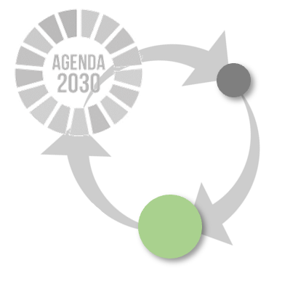





Source: Res4Africa and OPENECONOMICS
Elaboration on CEFA Onlus data
Evaluation Methodology and Tools
PRIVATE STANDPOINT COMPANY’S INDUSTRIAL PLAN
IMPACT ON STAKEHODERS PUBLIC STANDPOINT
SHOCK SETUP
MICROECONOMIC MODELING
MACROECONOMICS MODELING
POLICY BUILDING
STAKEHOLDERS ENGAGEMENT
INVESTMENT
ECONOMIC AND FINANCIAL SUSTAINABILITY CHECK
DIRECT
AND INDIRECT SOCIOECONOMIC IMPACT ANALYSIS
INTERNAL STAKEHOLDERS
SIZE
OPTIMIZATION
GOVERNMENTS AND DFIs
ASSET / INFRASTRUCTURE
CUSTOMERS, INVESTORS, NGOs
MARKET DATA
CONSTRUC. INVESTMENT
COST ESTIMATION
MODELS RUNNING
ROBUSTNESS
CHECK
LITERATURE REFERENCES STUDY
GEO DATA (GIS)
STRUCTURAL CHANGES IDENTIF.
PROJECT DATA
EXPENSES VECTOR
BENEFITS ESTIMATION
OUTCOME
PRODUCT.
REASONABILITY
CHECK
REGULATORY DATA
MULTIPLIER / IRR / OTHER KPI
SENSITIVITY ANALYSIS
INPUT DATA AND SCENARIO
COSTS BENEFITS ANALYSIS
SAM / DCGE / MONTE CARLO
OPTIMIZATION TECNIQUES
STANDARD METRICS
Source: APPLYING THE WATER-ENERGY-FOOD NEXUSAPPROACH TO CATALYSE TRANSFORMATIONALCHANGE IN AFRICA
Notes:
The microeconomic analysis is a powerful tool for empirical analysis and evaluation of certain benefits deriving from the specific project, according to the Nexus model.
An investment project is characterized by a set of productive activities that, through capital formation, is involved to certain economic-financial objectives at times deferred over time. Every time a productive input of a company is used, consequences are generated on the production or consumption of units that are different from the decision-making unit that gave rise to the production itself, thus generating external economies (or diseconomies).
These have the peculiarity of the repercussions on other companies, on consumers and also on the prices paid and received, with the possibility of generating both benefits and external costs, impacting on the environment, infrastructure and the economic system in general. In this context, a thorough analysis of the effects of the investment project becomes crucial, evoking an approach to the evaluation of the investments considering two distinct and successive moments.
The first of these consists of the identification and measurement of the effects, or rather of the physical and institutional changes that the project generates within the environment in which it is inserted. This identification will be proposed to the policy maker as a set of distinct consequences of the project.
The second moment of evaluation consists in attributing an economic value, first of all to each of the consequences generated by the project and together through appropriate homogenization and aggregation procedures.
For more detailed information about the project, the analysis and the methodology, refer of RES4Africas’ publication APPLYING THE WATER-ENERGY-FOOD NEXUSAPPROACH TO CATALYSE TRANSFORMATIONALCHANGE IN AFRICA.

Slide 17
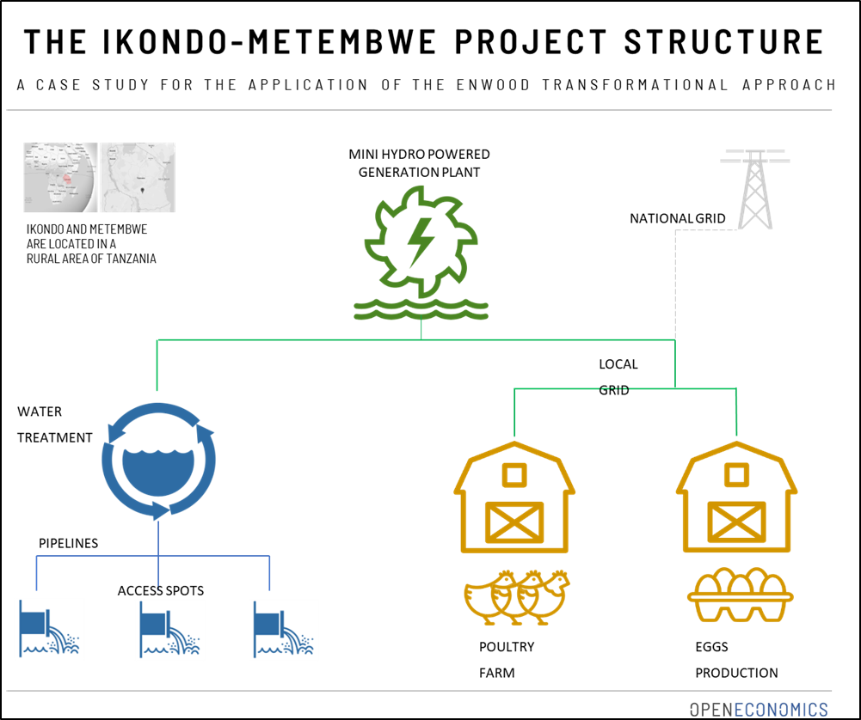
Source: Res4Africa and OPENECONOMICS
Elaboration on CEFA Onlus data
THE IKONDO-METEMBWE PROJECT
PROJECT STRUCTURE
The Ikondo-Metembwe project is set in rural Tanzania and designed as follows:
ENERGY COMPONENT: a mini-hydro plant with 550 kW of generation power
WATER COMPONENT: 7 aqueducts providing clean water to multiple local access points.
FOOD COMPONENT: production of an animal feed factory and a poultry hatchery.
PROJECT COSTS (CAPEX)
ENERGY | USD | %
Project Management | 526,456 | 17.9
Generation & distribution | 2,287,32 | 77,4
Other costs | 136,696 | 4.7
TOTAL | 2,950,472 | 100.0
WATER | USD | %
Legal and authorization | 5,600 | 1.7
Supporting activities local | 11,200 | 3.3
Pumping and distribution | 320,432 | 95.0
TOTAL | 337,232 | 100.0
FOOD | USD | %
Legal and land | 60,032 | 12.0
Supporting activities local | 33,600 | 6.8
Plant & machinery | 399,795 | 81.2
TOTAL | 493,427 | 100.0
Notes:
The Ikondo-Matembwe electric infrastructure is based on two interconnected hydro power plants that have a total generation capacity of 550 kW of electric supply and is able, through a local grid that currently counts 1,102 connections, to provide access to energy to the entire target population, approximately 890 households, 186 businesses and 26 public services. The older plant features a 120 kW turbine, whereas the newer one installed two turbines for a total capacity of 430 kW. The two plants are interconnected. The Ikondo-Matembwe mini-grid is owned and managed by the Matembwe Village Company Ltd (MVC).
MVC provides reliable and affordable clean energy to three groups of local users: households, private enterprises and public service providers.
Electricity is the crucial element within the presented WEF Nexus model of the project as it is the enabler par excellence. Thanks to electricity it has been possible to supply around seven aqueducts providing water. Water is depurated and pumped thanks to electricity. Plus, the installation of water access spots gives the possibility to supply with fresh water the entire targeted population.

Slide 18








Project Benefit
Source: Res4Africa and OPENECONOMICS
Elaboration on CEFA Onlus data
Education
Access to water
  Improvement in the quality of school facilities, more time for study, more teachers appealed to teach, higher teaching quality, students stay in school longer, and higher future income.
  Efforts to improve water, sanitation and hygiene interact with each other to boost overall health
Improved access to food
Health
  Improved sanitary facilities, enhanced family health, better indoor air quality, greater health knowledge.
  Improved farmers income from crop production benefits; Improved farmers income from poultry and egg production.
Productivity
Reduced GHGs
  Rural electrification provides better means of working, boosting productivity of small businesses in the target area.
  A shift from conventional fossil fuel sources to clean energy allows a consistent reduction of CO2 emissions.
Avoided time loss
Cost saving
  Improved access to water and sanitation can help target populations in developing a better time efficient daily life.
  A shift from fossil fuel-powered energy to renewable energy sources leads to a cost saving due to improvement in energy efficiency.
Source: APPLYING THE WATER-ENERGY-FOOD NEXUSAPPROACH TO CATALYSE TRANSFORMATIONALCHANGE IN AFRICA
Notes:
Literature has extensively shown that there are several benefits from providing access to electricity supply in non-connected rural areas, such as: improvement in people’s health, in education, in the productive processes of the communities, environmental benefits, as well as per the facilitation in communication.
BENEFIT from improved Access to Electricity
- Lightening: switch from polluting resource to a cleaner and more efficient one.
- TV and Radio
- Time savings: reduce time allocated to fuel-collection by household members and increases time allocated to other activities
- Education: Improvement of the quality of school facilities using equipment that works with electrical power; Increased time for study, thanks to lighting in homes, or in schools.
- Health: Improvement in sanitary facilities; Improvement in family’s health through the improvement of indoor air quality, thanks to the avoidance of polluting cooking fuels; Greater health and welfare knowledge thanks to the information available on television, radio and internet; Improvements in nutrition derived from greater knowledge as well as the fact of being able to refrigerate food.
- Productivity increase: Rural electrification provides better means of working, boosting productivity of small business in the target area.
- Cost Saving: A shift from fossil fuel-powered energy to renewable energy sources leads to a cost saving due to improvement in energy efficiency
- Environment
BENEFIT from improved Water Management
- Health benefits
- Time savings
- Opportunity cost of absenteeism: The opportunity cost of absenteeism measure evaluates the economic improvement among population because of water and sanitation upgrading.
- Water Consumer Surplus
BENEFIT from improved Food Production
- Improved farmers income from crop production benefits
- Improved farmers income from poultry and egg production
- Nutrition and Food Security

Slide 19
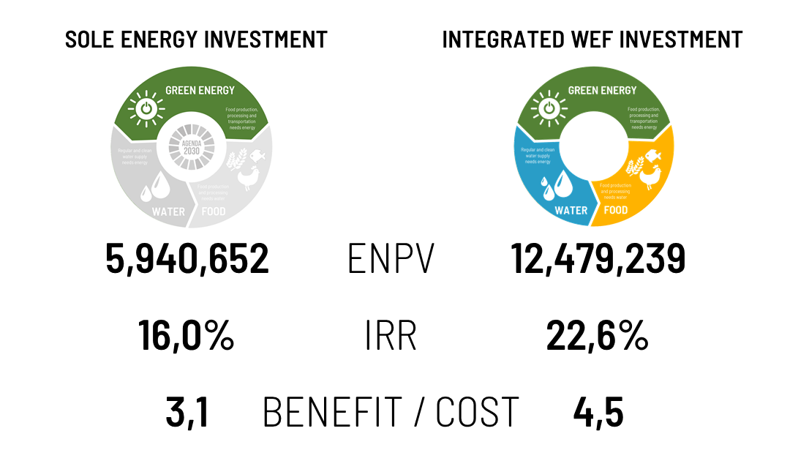
MICROECONOMIC MODEL: IKONDO-METEBWE PILOT PROJECT
NET PRESENT VALUE RESULTS
Source: Res4Africa and OPENECONOMICS
Elaboration on CEFA Onlus data
The project with the higher Economic NPV results to be the integrated project, consisting of Energy, Water and Food component.
Source: APPLYING THE WATER-ENERGY-FOOD NEXUSAPPROACH TO CATALYSE TRANSFORMATIONALCHANGE IN AFRICA
Notes:
To carry out the Economic Cost Benefit Analysis, two different scenarios have been considered for the three project’s components: (i) simultaneous implementation and, (ii) implementation at different times.
In the second scenario, the energy part alone is the main component with the major investment costs. This implies two distinct alternatives for water and livestock, consisting, respectively in the combination of (i) energy and water and (ii) energy and livestock. This scenario has been compared with an alternative case where all components are implemented together. The rational for this comparison is that energy is the activating component for the water supplied to the village, bringing about crucial economic benefits to the target population. In addition, energy is also the activating component of the livestock factor, as farmers need energy to improve their ability to use improved cultivation techniques. As per the livestock subcomponent, energy gives the opportunity to increase production through hatchery activities, through the use of electric equipment.
In terms of project results, the Energy project alone ENPV (Economic Net Present Value) turns out to be USD 5,940,652, while the Energy and Water project combination and the Energy and Food project yield respectively an ENPV of USD 10,651,791, and of USD 7,768,100. Therefore, the project with the highest Economic NPV is the integrated WEF Nexus Project, consisting of Energy, Water and Food, with an ENPV for USD 12,479,239. Simultaneous implementation of the three projects thus produces the largest impact in economic terms.
The energy component is crucial for all activities and in the absence of the energy project component, it would have to be produced at much higher costs. This conclusion can be seen also through the lenses of a project expansion; the Energy project opens the possibility to further develop the Water and Food components.
The BCR (Benefit/Cost Ratio) indicator is indicative of the peculiarity of the integrated project compared to the sole energy investment. The 1,4 points differential among the two projects has a clear explanation: energy is the enabler of the integrated project, if energy is not activated, the other two components would not be enabled. This is significant as in this case with a little investment quantified for the energy sector, it is possible to collect high benefits from the energy, water and food components.
The economic benefits of the project and the potential impact on the well-being of the population and area considered suggests that the project may be productively replicated at regional and national level. The transformative nature of a project lies in its potential to change the production technology at regional basis. The mix of technology, project dimension, business model and area considered may help to lay the basis of a structural change into the economy, that together with governmental financial support can enable the conditions for sustainable development.

Slide 20
Time for some reflection!
Do you have some experience with some of these methods in your region/professional context?
Which challenges did you encounter?
Would you like to share some lessons learned?
Notes:
Notes:
Now that we have browsed through some methods to demonstrate the economic added value of Nexus solutions, it is your turn to bring in your experience from your professional/regional context:
Do you have some experience with some of these methods?
Which challenges did you encounter?
Would you like to share some lessons learned?
Additional information:
The questions to guide the participants might need to be adjusted to their specific backgrounds to help them better understand the possible answers that they could provide.
Collect the answers and, where possible, make connections to input that is still coming or aspects that have already been dealt with in previous chapters

Slide 21
Mobilizing finance to implement Nexus solutions
Chapter 2.3: Cross-sectoral investment planning and financing
Notes:
Notes:
After having browsed through some methods available to identify some bankable Nexus interventions, we now need to turn to the question of how to finance these solutions. In the next chapter, we will therefore look at opportunities that exist for mobilizing finance to implement Nexus solutions.

Slide 22

Benefits of Nexus approach for mobilizing finance
Opens up new financing opportunities
Make the best economic use of financial resources available
Catalyses implementation of environmentally sustainable AND bankable solutions
Economies of scale
Improves coherence and de-risks investments
Coordination and long-term sustainability
Notes:
Notes:
The benefits from adopting a Nexus approach for mobilizing finance are multiple:
A nexus approach opens up new financing opportunities.
→ The WEF Nexus is an important stimulus for cooperation between different sectors and can hereby help overcoming financial constraints. The level of investments varies among the various components of the WEF Nexus, with energy tending to receive a larger proportion of financing compared to other sectors e.g. sanitation. These differences between sectors can create new opportunities for multisectoral projects, e.g. for water management that can access finance via actions of the energy sectors. The nexus approach can be helpful in designing integrated packages of investments to make the best economic use of financial resources available. We will see in a minute that in particular, the Nexus approach opens up opportunities for more private and blended finance.
By designing solutions and planning investments together across sectors, implementing institutions can catalyse the implementation of integrated solutions that are both environmentally sustainable and bankable.
In the absence of this type of cooperation, economic sectors will put in place their own solutions to solve immediate problems without building a common vision. These „silo“ solutions might be bankable, but not necessarily be sustainable.
Cross-sectoral approaches might also help to achieve economies of scale as they reduce trade-offs and increase synergies (which might be reflected in a Cost-effectiveness analysis as described before), compared to sectoral solutions.
Coordination, not just in regard of investment plans (but also in terms of macro-level, integrated planning, data and monitoring, impact assessment processes or other safeguard frameworks) is particularly important to de-risk investments of regional importance.
The political will to cooperate and coordinate, with a view to ensuring long-term sustainability will encourage investors to engage.
This is also reflected in the fact that finance providers are increasingly concerned with cross-sectoral coherence. We will show later how financing mechanisms are combined with sustainability criteria.
How does the Nexus secure more funding for sectoral projects (especially for the water sector) - can the Nexus leverage financing from say energy and agrobusiness sector to water projects?
How does the Nexus mobilize financing for resources efficiency?
In order to leverage funding for WEF Nexus projects it is important to start with a reliable information base
This includes an overview of planned investments, the types of projects and associated financing at international, national and local level
Based on this opportunities can be maximized and possible risks minimized
Between the three sectors prevail different level of investments (e.g. the energy sector tends to receive a lager share of financing than sanitation)
But exactly these differences between the sectors create new and additional financing opportunities
Unfortunately, in transboundary basins the potential and diversification of financial sources is largely unutilized because it is often associated with risks (e.g. difficult cooperation arrangements and institutional set-ups)
In order to avoid challenges like this it is important that the cooperating institutions provide an enabling environment with strong institutional capacities at national and local level
This is crucial for the successful design and management of cross-sectoral projects
Furthermore, WEF Nexus projects can contribute to cross-sectoral coherence and thus leverage further funding --> a growing number of international financing institutions attach importance to cross-sectoral coherence and provide funding therefore (e.g. World Bank, or Inter-American Development Bank)
Examples from the practice: the following mechanisms were used to mobilize (traditional or innovative) financing for WEF Nexus projects
The Zambesi River Basin: conduction of a Multi-Sector Investment Opportunity Analysis (MSIOA) to evaluate different scenarios of water resource development in economic terms and to illustrate the potential benefits of cooperation from a national and transboundary basin perspective
The Global Environment Facility (GEF) in LAC: includes a two-step process consisting of the Transboundary Diagnostic Analysis (TDA) and the Strategic Action Programme (SAP)
TDA is a rigorous diagnostic of the issues aimed at mapping the root causes that need to be addressed
SAP is a document that contains the remedial actions needed both at national and transboundary level (can be adopted at ministerial level and implemented through inter-ministerial committees)
Lower Syr Darya: prioritizing water sector investments by impact and returns via integrated investment planning combined with a bold hydro-economic analysis (provides a reliable information base for the investment planning)
Jordan’s As-Samra Waste Water Treatment Plant (WWTP): example of a public-private partnership (PPP) funded WEF Nexus project --> proofs the advantages of using private sector financing in conjunction with grant funding as part of a scheme known as Viability Gap
Sources:
UNECE (2021), ‘Solutions and investments in the water-food-energy-ecosystems nexus: A synthesis of experiences in transboundary basins’, Geneva.

Slide 23

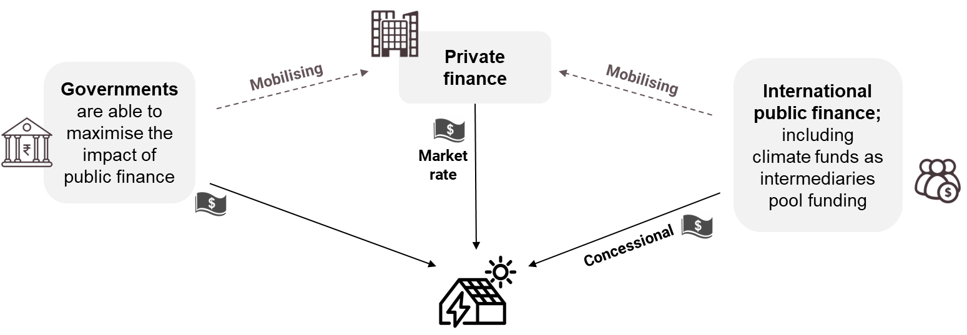
Funding sources
  International public finance
  Domestic public finance
  Private finance
Blended finance
Source: SEED Climate Finance Toolkit, 2020
Notes:
Notes:
Let‘s take a look at different sources of funding available:
International public finance typically comes in the form of loans (long-term, at concessional rates) or grants – the latter mostly for technical assistance, advisory services, project preparation; guarantees can be provided to reduce risk for commercial investors / banks.
Domestic public finance can range from dedicated grants for climate action to general public budgets
Private finance instruments can typically be summarised as debt, equity or mixed, and can be provided through loans, bonds, equity capital, venture capital, etc.
Blended finance is the “strategic use of public finance for the mobilisation of additional finance towards sustainable development in developing countries” (OECD, 2018).
Sources:
OECD (2018), ‘Making Blended Finance Work for the Sustainable Development Goals’, OECD Publishing, Paris.

Slide 24


Important features of financing mechanisms
  When evaluating funds-matching it is fundamental to consider some key features of the financing mechanisms under analysis
Type of funding
Beneficiaries
Ticket Size
Geography
Scale of the Fund / Facility
  If all the above features are in line with the funding necessities, then it is reasonable to deep dive into specific financing mechanisms / facilities
Notes:
Notes:
When evaluating funding opportunities it is necessary to analyze them from the right perspective and asking the right questions:
What kind of project am I developing?
In what phase of the project do I need support?
Does my project comply with the requirements of available funds?
Is the scale of my project in the interest of financing institutions?
Do I possess the skills and competencies to apply for funding and manage a grant/loan and other types of funding?
Being able to answer to these questions is a fundamental step to position a project in the right framework, showcasing it to the right stakeholders and enhance the most important aspects of the project by capturing donor’s interest and engagement.

Slide 25
The “right match“
  Only a small portion of the plethora of projects that need financing will overlap with funding requisites.
Type of funding
Geography
Scale
Ticket size
Beneficiaries
Plethora of available projects to be funded
Matching area
Notes:
Notes:
Indeed many of the available financing mechanisms are not directly addressed to Nexus projects, but cover a “portion” of the projects. Of course nexus elements add value to a project proposal, but not always this value is recognized as “extra score” within funding mechanisms.

Slide 26
Different Stage of Project Financing
In order to turn a project concept into action, a sustainable financial structure must be defined, which highly depends on several factors such as the type of developer, the country of intervention , the type of business model, the actors involved, the authorities involved etc. For each of the project phases some financing tools / mechanisms are more effective (or more common) than others.
T.A. and Pilot
In this phase it is more common to find examples of projects financed with partial/full grants for the implementation of pilot projects or technical assistance and Capacity building activities.
Development
In these phase financing instruments are typically addressed at developing analysis and feasibility studies, increasing the number of bankable projects with the provision of early-stage funding and/or to engage stakeholders to accelerate the process to financial closure.
Implementation
This phase is typically funded by major donors and funds via concessional or blended finance schemes (result-based financing, loans, equity instruments etc. It of course depends from the scale of the project, In case of implementation of a small project it can also be funded via full or partial grants.
Notes:
Notes:
The nexus implementation often entails a considerable amount of investments to be utilized in structural changes, policy development and capacity building: indeed in some cases budgeting and establishing financial responsibilities can be one of the most challenging issue in the operationalization of nexus projects.
The private sector participation is crucial for an effective implementation of the nexus, but in order to ensure a proactive engagement it has to be adequately attracted via robust regulations and incetivizing mechanisms.

Slide 27



Financing delivery pathways
  Project-specific funding
  Specific programme financing (e.g. climate funds)
  Adaptable programme financing
  Sector budget support
  Central budget support
Financing opportunities from the private sector
Programmatic funding
Notes:
Notes:
Funding coming from these sources reach their recipients via the following pathways:
Project specific funding: funding for a single, discrete investment (infrastructural or institutional);
Specific programme financing (e.g. climate funds): funding for a predetermined suite of investments (infrastructural and/or institutional);
Adaptable programme financing: funding for a suite of investments (infrastructural and/or institutional) that are not predetermined but have a common cascade of objectives and outputs;
Sector budget support: funding made available to line ministries or their decentralized/devolved authorities to be disbursed at their discretion;
Central budget support: funding made available to non-line ministries (economy and finance) and/or decentralized/devolved authorities to be disbursed at their discretion, or credit lines to national banks to support fast-tracked infrastructural projects.
→ The survey carried out in 2020 for the UNECE study on Solutions and investments in the water-food-energy-ecosystems nexus based on experiences in transboundary basins shows that for nexus solutions:
Project-specific delivery pathways (financed by the state, with or without development partner support) are the most common
Programmatic funding schemes are typically designed by one sector and, in less-developed regions, with strict requirements from a donor. To be effectively “nexus”, these schemes should be more adaptable and “smarter”, implying that they should stimulate competition between eligible projects.
Solutions in agriculture and energy (e.g. landscape agriculture, improved agribusiness, sustainable agricultural value chains, renewable energy or energy efficiency) constitute more likely entry points for private investments that could directly or indirectly tackle water and environmental issues. However, this potential is so far largely unutilized in transboundary basins.
This leads to the following conclusions:
Programmatic funding is an efficient way to mobilize public funding and private financing for infrastructural investments (especially if basket funding modalities are possible), circumventing the hazards cited by both the public and private sectors with respect to financing water sector infrastructure. Furthermore, programmatic financing schemes may be better suited than project specific solutions to deliver multiple benefits from a nexus perspective (reducing trade-offs and leveraging synergies). In transboundary settings in particular – where sectors are interconnected through water – these schemes can allow different sectors to co-design nexus solutions taking into account their cumulative social and environmental impact without being constrained by predefined characteristics (e.g. on siting or type of solution) that might have been decided previously by different sectors in an uncoordinated manner.
Today, public funding (including from donors) constitutes the main source of nexus investments of transboundary value. However, the nexus approach also opens up financing opportunities from the private sector that can be leveraged through public-private partnerships, blended finance solutions, indirect support (e.g. through tax incentives), green/blue bonds and basket funding. Prospects also exist to design innovative schemes (including revenue-based models) that leverage private investments for both infrastructure and institutions. These schemes for multi-sectoral projects can be crucial to access climate funds as well as environmental funds. Thus far, this potential has barely been utilized in transboundary basins where more stakeholders need to be involved.
Sources:
UNECE (2021), ‘Solutions and investments in the water-food-energy-ecosystems nexus: A synthesis of experiences in transboundary basins’, Geneva.

Slide 28
Opportunities connected to blended finance
Goals:
  Strengthen engagement of private sector in climate finance!
  Maximize the impact of public finance!
Purpose:
  Mobilise additional climate finance from private investors
  Support the local private sector
  Leveraging impact using innovative instruments
  Provide a bridge from grant and donor financing towards financially self-sustaining approaches
Mechanism: public and international climate finance providers’ involvement:
  Increase likelihood that projects will obtain commercial financing
  Decrease market barriers by de-risking banks’ involvements (e.g. via guarantees)
  Allow for longer investment / project periods (more than 20 years)
Notes:
Notes:
[Optional slide in case target group of the training is interested in blended finance.]
Blended finance:
The approach of blended finance is relatively new (OECD, 2021) but have already become a high priority for governments and development actors (GIZ, 2018)
Definition: „Blended finance is the strategic use of development finance for the mobilisation of additional finance towards sustainable development in developing countries” (OECD, 2018)
The idea behind blended finance is to use public and philanthropic funds/ commercial capital to mobilize additional (private) capital for projects contributing to sustainable development (GIZ, 2018) → the investors benefit by receiving financial returns (OECD, 2021)
Overall, it aims at increasing the (financial) resources which can be used by developing countries to supplement their own investments and ODA inflows → SDG financing gaps can be closed and the Paris Agreement fulfilled (OECD website)
The approach is guided by the five Blended Finance Principles (should guarantee that blended finance is used in the most effective way (OECD, 2018)):
Principle 1: anchor blended finance use to a development rationale
Principle 2: design blended finance to increase the mobilization of commercial finance
Principle 3: tailor blended finance to local context
Principle 4: focus on effective partnering for blended finance
Principle 5: monitor blended finance for transparency and results
Blended-finance vehicles are often set up by Development-finance institutions (DFIs) or private-sector entities (GIZ, 2018)
But the list of actors who can be involved in blended finance is even larger: foundations and philanthropic investors, commercial actors, institutional investors, commercial banks, private equity and venture capital funds, hedge funds, and companies (OECD, 2018)
Sources:
GIZ (2018), ‘The GIZ Finance Guide: Navigating the world of finance.‘, Eschborn.
Global Network (2017), ’Financing National Adaptation Plan (NAP)’.
OECD (2021), ‘The OECD DAC Blended Finance Guidance’, OECD Publishing, Paris, https://doi.org/10.1787/ded656b4-en
OECD (2018), ‘Making Blended Finance Work for the Sustainable Development Goals’, OECD Publishing, Paris.
OECD, ‘Blended Finance‘, available at: https://www.oecd.org/development/financing-sustainable-development/blended-finance-principles/

Slide 29
Nexus as a strategic means to access finance
Access to climate funding
Sustai-nability criteria
Technical support
  Finance providers are increasingly concerned with cross-sectoral coherence
Notes:
Notes:
Adopting a nexus approach can be a strategic means to access funding:
Finance providers are increasingly concerned with cross-sectoral coherence:
There are examples of such institutions providing technical support to countries to prioritize or review projects, taking into account their cross-sectoral and transboundary impact. As said before, this relates to the fact that coordination, not just in regard to investment plans but also in terms of upstream, macro-level, integrated planning, data and monitoring, Environmental Impact Assessments and Strategic Impact Environmental Assessment processes, or other social and environmental safeguards frameworks, is particularly important to de-risk investments.
Sustainability criteria: Nexus approaches fulfill sustainability criteria that will encourage investors to engage. We will take a closer look at the EU taxonomy as a green classification system that translates the EU’s climate and environmental objectives into criteria for specific economic activities for investment purposes, hereby helping economic activities to access finance.
Climate action and activities aimed at environmental protection demand close intersectoral coordination and can benefit from the prospect of co-financing for multi-sectoral projects or sectoral projects within a coherent programme across sectors and countries: there are perspectives for climate funding to support nexus projects, for instance through the Green Climate Fund (GCF). We will take a closer look at the GCF, which is the largest fund for climate finance, established to support climate change adaptation and mitigation for developing countries and implementation of their National Determined Contributions (NDC). A Nexus approach can be useful for studying the impact of climate change and investigating policy measures for adaptation and mitigation. Lastly, as we have seen before, many ways exist to finance nexus solutions/actions ranging from traditional to innovative finance mechanisms. These different sources can become decisive co-funding opportunities for GCF projects.
Sources:
UNECE (2021), ‘Solutions and investments in the water-food-energy-ecosystems nexus: A synthesis of experiences in transboundary basins’, Geneva.

Slide 30
Sustainability criteria: EU Taxonomy
  Green classification system aiming at steering investments towards environmentally sustainable economic activities
  Make a sustainable contribution AND do not significantly harm the EU’s Environmental objectives:
Climate change mitigation
Climate change adaptation
Sustainable use and protection of water and marine resources
Transition to a circular economy, waste prevention and recycling
Pollution prevention and control
Protection of healthy ecosystems
Source: own illustration based on the official Website of the European Commission
Notes:
Notes:
The EU taxonomy is a green classification system that translates the EU’s climate and environmental objectives into criteria for specific economic activities for investment purposes.
It aims at steering investments towards environmentally sustainable economic activities to enable change and encourage a transition towards sustainability.
It recognises as green, or ‘environmentally sustainable’, economic activities that make a substantial contribution to at least one of the EU’s climate and environmental objectives (which are displayed on the slide), while at the same time not significantly harming any of these objectives and meeting minimum social safeguards.
What does this mean and what does this have to do with the Nexus approach?
The technical screening criteria for ‘substantial contribution’ to an environmental objective ensure that the economic activity either has a substantial positive environmental impact or substantially reduces negative impacts on the environment, e.g. substantially reduced levels of greenhouse gas emissions.
The technical screening criteria for ‘do no significant harm’ ensure that the economic activity does not impede on the other environmental objectives from being reached, i.e. it has no significant negative impact on them.
→ Both sets of criteria together ensure coherence between the objectives in the EU Taxonomy and guarantee that progress towards one objective is not made at the expense of another. The performance thresholds in these criteria are science-based and developed on the basis of a robust
methodology and an inclusive process. They identify criteria for economic activities that can set sectors on a path consistent with the EU’s climate and environmental goals, based on currently available technologies.
So, by definition, the Taxonomy incorporates the idea that economic activities should avoid trade-offs and negative impacts on other resources and sectors, thus reflecting a Nexus approach.
Use of the EU Taxonomy: besides the mandatory use for large companies and for the development of sustainable finance tools in the EU, any companies and project promoters can choose to meet the criteria of the EU Taxonomy with the aim of attracting investors interested in green opportunities. Investors can choose to use the EU Taxonomy criteria in their due diligence for screening and identifying sustainable investment opportunities aiming to achieve a positive environmental impact.
Sectors which are addressed by the taxonomy (EU Taxonomy Compass) include: Forestry; Environmental protection and restoration activities; Manufacturing; Energy; Water supply, sewerage, waste management and remediation; Transport; Construction and real estate; Information and communication; Professional, scientific and technical activities; Financial and insurance activities; Education; Human health and social work activities; Arts, entertainment and recreation
→ For now, sectors included are those with the highest contribution to CO2 emissions (energy, manufacturing, transport, buildings), as well as activities enabling their transformation, as the Taxonomy aims to significantly increase the potential that green financing offers to support transition, in particular for carbon-intensive sectors where change is urgently needed.
Sources:
European Commission, ‘EU taxonomy for sustainable activities’, available at: https://ec.europa.eu/info/business-economy-euro/banking-and-finance/sustainable-finance/eu-taxonomy-sustainable-activities_en#compass
European Commission, ‘EU Taxonomy Compass: Sectors‘, available at: https://ec.europa.eu/sustainable-finance-taxonomy/activities/sectors_en.htm
European Commission ‚FAQ: What is the EU Taxonomy and how will it work in practice?’
Additional Sources:
The EU Taxonomy compass is a visual tool which represents the content of the EU Taxonomy
It aims to make the contents of the EU Taxonomy easier to access for a variety of users. It enables users to check which activities are included in the EU Taxonomy (taxonomy-eligible activities), to which objectives they substantially contribute and what criteria they have to meet.
For information on the very detailed set of criteria see the document on: European Commission (2020), ‘Taxonomy Report: Technical Annex’
Link to the EU Taxonomy Compass: European Commission, ‘EU Taxonomy Compass‘, available at: https://ec.europa.eu/sustainable-finance-taxonomy/tool/index_en.htm

Slide 31
Sustainability criteria: international standards
Global Reporting Initiative
For organizations and stakeholders
Reports the economic, environmental and social impacts of organization’s activities
Carbon Disclosure Project
For investors, companies, cities, states and regions
Provides a global disclosure system for managing environmental impacts
International Finance Cooperation
For developing countries
Creates new markets, mobilizes other investors, and shares expertise
From a Nexus perspective:
For organizations: Nexus facilitates the prioritization of impacts to report on
For stakeholders: Identification of risks creates an enabling environment for Nexus investments
Risk management creates an enabling environment for Nexus investments
Scoring of companies and cities incentivizes Nexus actions and identifies future partners
Important vehicle for leveraging Nexus finance by strengthening the private sector
Supports the application of blended finance
Notes:
Notes:
This slides shows how a Nexus approach can contribute to fulfilling other international standards.
Global Reporting Initiative (GRI):
The GRI Standards are a modular system of three interconnected standards: (1) the GRI Topic Standards, (2) the GRI Sector Standards, and (3) the GRI Universal Standards
Altogether they provide a tool to understand and report the economic, environmental and social impacts of an organization's activities
The GRI Standards guarantee comparability and credibility and thus increase the transparency on the impacts an organization obtains towards sustainable development
Such information are highly relevant to many stakeholders (e.g. investors, policymakers, capital markets, and civil society)
Carbon Disclosure Project (CDP):
CDP runs a global disclosure system for managing environmental impacts
It is addressed towards investors, companies, cities, states and regions
CDP is especially recognized among actors of the world’s economy --> it represents the gold standard of environmental reporting providing the richest and most comprehensive dataset on corporate and city action
International Finance Cooperation (IFC):
IFC (member of the World Band Group) represents the largest global development institution focused on the private sector in developing countries
The central goals of the IFC are (1) to advance the economic development and (2) to improve the lives of people by encouraging the growth of the private sector in developing countries
To do so, the IFC focusses on creating new markets, mobilizing other investors, and sharing expertise
How does the Nexus contributes to speak to other international standards such as GRI, CDP and IFC?
GRI:
In the case of the GRI Standards, the Nexus takes effect on the side of the organizations and of the stakeholders
For organizations:
Within the reporting process using the GRI Standards an organization has to prioritize on the impacts they want to report o
To do so, the Nexus approach can facilitate the grouping of impacts into material topics by providing guidance (e.g. the Nexus itself provides a set of indicators which can be applied to the GRI Standards)
Thus, the information gathered throughout the reporting process can be used for assessing cross-sectoral Nexus policies and strategies or to guide the decision-making of an organization
For stakeholders:
On the other hand, stakeholders like investors can use the reported information to assess how an organization integrates the Nexus approach into its strategy
Thereby, they can identify potential financial risks and evaluate the long-term success of certain activities
This helps to mitigate risks and uncertainties in order to make Nexus projects more attractive to investments
CDP:
Similar to GRI, CDP deals with Nexus relevant topics such as climate change, water security and deforestation
By supporting companies, cities, states or regions in measuring and managing their environmental risks and opportunities they create an enabling environment for Nexus investments
In addition, the CDP provides an annual scoring of companies and cities based on their journey through disclosure and towards environmental leadership
This incentivizes action on Nexus topics and helps to identify future project or investment partners
IFC:
Since the IFC aims at strengthen the role of the private sector by investing in companies, mobilizing capital and advising businesses and governments it is an important vehicle for leveraging Nexus finance
This means that the IFC gets involved at an early stage of project-development cycle in order to seed investment opportunities or creating completely new markets
Furthermore, the IFC tends to mobilize more private capital for development purposes, which can support the application of blended finance for Nexus projects
Sources:
Carbon Disclosure Project, 'About us', available at: https://www.cdp.net/en/info/about-us
Carbon Disclosure Project, 'What we do', available at: https://www.cdp.net/en/info/about-us/what-we-do
Global Reporting Initiative, 'A Short Introduction to he GRI Standards', Amsterdam, Netherlands.
Global Reporting Initiative, 'Standards', available at: https://www.globalreporting.org/standards/
International Finance Cooperation, 'About IFC', available at: https://www.ifc.org/wps/wcm/connect/corp_ext_content/ifc_external_corporate_site/about+ifc_new

Slide 32
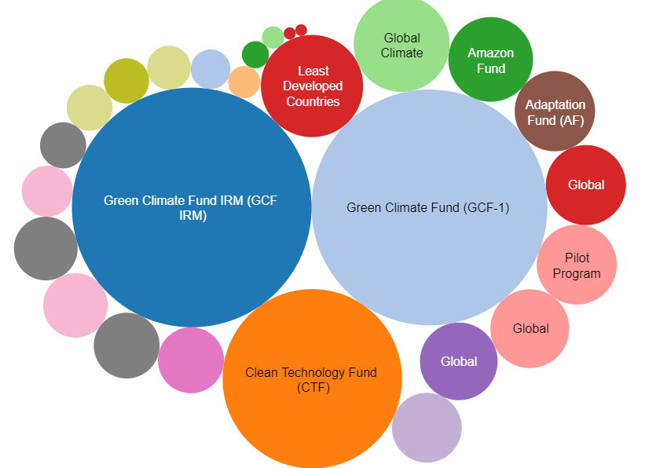
Nexus as a strategic means to access climate finance
Climate Funding
“Refers to the financial resources mobilized to fund actions that mitigate and adapt to the impacts of climate change” (Watson & Schalatek, 2020)
Funding channels:
  Multilateral channels
  Bilateral channels
  Regional and national channels and climate change funds
Change Alliance
Fund
Environment Facility 5
for Climate Resilience
Environment Facility 6
Environment Facility 4
Source: supplemented after Roberts (CFU), 2022
Notes:
Notes:
→ Adopting a nexus approach can be a strategic means for finance recipients to access funding in general, and in particular climate finance. What is the role and potential of climate finance to bring about transformative change in developing countries?
Climate Funding:
“Climate finance refers to the financial resources mobilized to fund actions that mitigate and adapt to the impacts of climate change” (Watson & Schalatek, 2020)
India is the largest recipient of climate funding (1.478 million USD), followed by Brazil (1.179 million USD) and South Africa (648 million USD) (CFU, 2022-02-04)
Out of 27 climate funds, the Green Climate Fund (GCF) is currently the largest climate fund with a total pledge of 20.321 billion USD (Watson & Schalatek, 2020)
The Green Climate Fund during the Initial Resource Mobilisation (GCF IRM) period contributes to 10.322 billion USD
And the first replenishment (GCF-1) period of the Green Climate Fund (GCF -1), started in October 2020, accounts for 9.999 billion USD
In order to make use of climate finance there exist different channels (Watson & Schalatek, 2020):
Multilateral channels: governments of developing countries have a greater voice and representation in decision-making processes compared to the rigid contributor country-dominated governance structures → e.g. Green Climate Fund
Bilateral channels: accounts for a significant share of public climate finance which is managed by development agencies/ special bilateral climate funds → e.g. Germany’s Internationale Klimaschutzinitiative (IKI, international climate initiative)
Regional and national channels and climate change funds: established by developing countries and resourced through domestic budget allocations, the domestic private sector as well as international finance → e.g. Brazils Amazon Fund, The Caribbean Catastrophic Risk Insurance Facility (CCRIF) and the African Risk Capacity (ARC)
Sources:
Climate Funds Update (CFU) (2022-02-04), ‘CFU – Climate Finance Recipients‘, available at: https://public.tableau.com/app/profile/carl.roberts/viz/CFU-Climatefinancerecipients_16068528505010/Recipientsbubblechart
Watson & Schalatek (2020), ‘The Global Climate Finance Architecture‘, available at: https://climatefundsupdate.org/wp-content/uploads/2021/03/CFF2-ENG-2020-Digital.pdf
Image Reference:
Roberts, C., (Climate Funds Update) (2022-02-04), ‚‘CFU – Status of the Funds: Fund sizes‘, available at: https://public.tableau.com/app/profile/carl.roberts/viz/CFU-StatusoftheFunds_16068500780590/Statusofthefunds

Slide 33
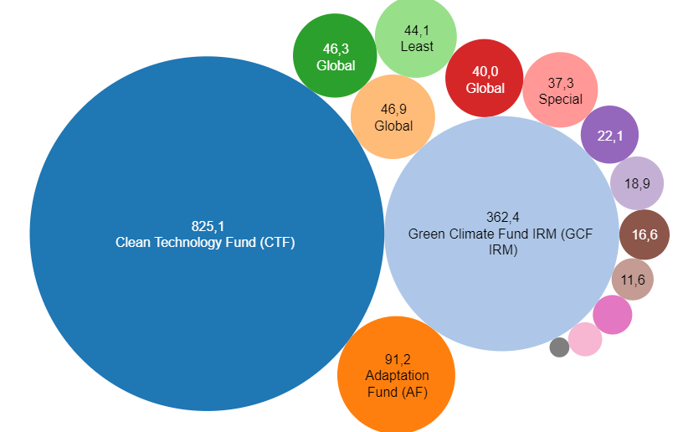
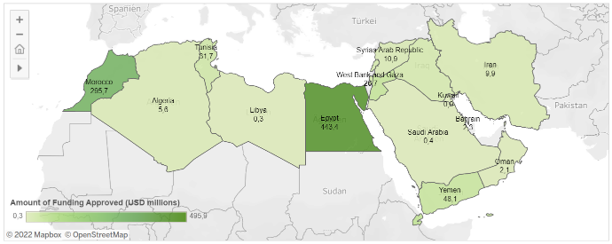
Nexus as a strategic means to access climate finance
Climate Funding in the MENA Region
Recipient countries
Operating funds
Developed Countries Fund
Environment Facility (4)
Environment Facility (7)
Climate Change Fund
Environment Facility (5)
Source: Roberts (CFU), 2022
Source: Roberts (CFU), 2022
Notes:
Notes:
[This slide is optional and can be used for a training in the MENA Region.]
Sources:
Image References:
Roberts, C., (Climate Funds Update) (2022-02-04), ‚‘CFU - Recipient countries in the Middle East and North Africa‘, available at: https://public.tableau.com/app/profile/carl.roberts/viz/CFU-MiddleEastandNorthAfrica_16068533809970/FundsoperatingintheMiddleEastandNorthAfrica
Roberts, C., (Climate Funds Update) (2022-02-04), ‚‘CFU - Funds operating in the Middle East and North Africa‘, available at: https://public.tableau.com/app/profile/carl.roberts/viz/CFU-MiddleEastandNorthAfrica_16068533809970/FundsoperatingintheMiddleEastandNorthAfrica

Slide 34
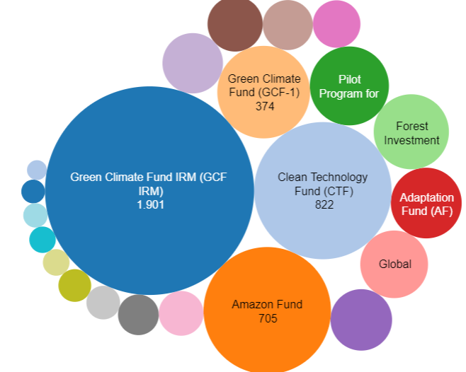
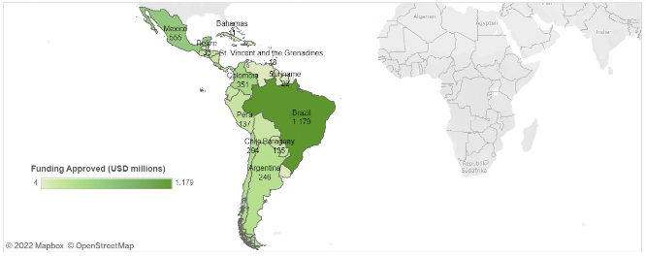
Nexus as a strategic means to access climate finance
Climate Funding in Latin America and the Caribbean
Recipient countries
Operating funds
Climate Resilience
Program
Environment Facility (6)
Source: Roberts (CFU), 2022
Source: Roberts (CFU), 2022
Notes:
Notes:
[This slide is optional and can be used for a ToT in the LAC region.]
Sources:
Image References:
Roberts, C., (Climate Funds Update) (2022-02-04), ‚‘CFU - Recipient countries in Latin America and the Caribbean‘, available at: https://public.tableau.com/app/profile/carl.roberts/viz/CFU-LatinAmerica_16068533284360/FundsoperatinginLatinAmericaandtheCaribbean
Roberts, C., (Climate Funds Update) (2022-02-04), ‚‘CFU - Funds operating in Latin America and the Caribbean‘, available at: https://public.tableau.com/app/profile/carl.roberts/viz/CFU-LatinAmerica_16068533284360/FundsoperatinginLatinAmericaandtheCaribbean

Slide 35
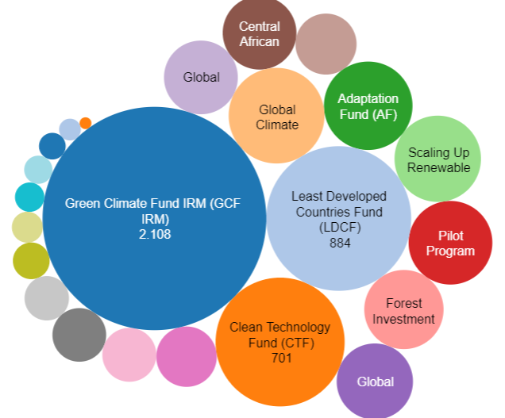
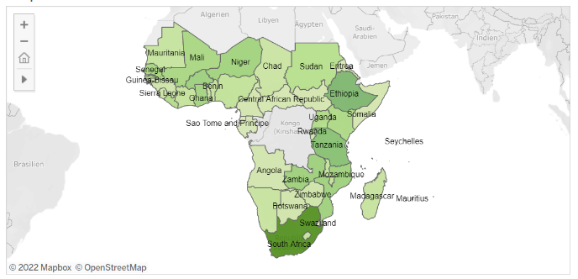

Nexus as a strategic means to access climate finance
Climate Funding in Sub-Saharan Africa
Recipient countries
Operating funds
Forest Initiative
Environment Facility (6)
Change Alliance
Energy Program
for Climate Resilience
Program
Environment Facility (7)
Source: Roberts (CFU), 2022
Source: Roberts (CFU), 2022
Notes:
Notes:
[This slide is optional and can be used for a ToT in the Subsaharan African region.]
Sources:
Image References:
Roberts, C., (Climate Funds Update) (2022-02-04), ‚‘CFU - Recipient countries in Sub-Saharan Africa‘, available at: https://public.tableau.com/app/profile/carl.roberts/viz/CFU-SubSaharanAfrica_16068535483570/FundsoperatinginSub-SaharanAfrica
Roberts, C., (Climate Funds Update) (2022-02-04), ‚‘CFU - Funds operating in Sub-Saharan Africa‘, available at: https://public.tableau.com/app/profile/carl.roberts/viz/CFU-SubSaharanAfrica_16068535483570/FundsoperatinginSub-SaharanAfrica

Slide 36
Nexus as a strategic means to access climate finance
Green Climate Fund (GCF)
GCF investment criteria:
  GCF supports developing countries in reducing their greenhouse gas emissions and in becoming climate-resilient
  Ownership over climate funding belongs to partners from developing countries
  Countries can operate through various entities to implement GCF funded projects
Impact potential
Paradigm shift potential
Sustainable development potential
Responsive to recipient’s needs
Promote country ownership
Efficiency and effectiveness
Source: own illustration based on Fayolle & Odianose, 2017
Notes:
Notes:
Definition: “The Green Climate Fund (GCF), established in 2010, is part of the financial mechanism of the UN Framework Convention on Climate Change (UNFCCC) and serves in the same function for the Paris Agreement. It aims to make an ambitious contribution for the implementation of the Paris Agreement and its mitigation and adaptation goals by supporting the paradigm shift in developing countries towards low-carbon and climate-resilient development pathways. The GCF is currently the world’s largest dedicated multilateral climate fund and the main multilateral financing mechanism to support developing countries in achieving a reduction of their greenhouse gas emissions and an enhancement of their ability to respond to climate change.” (CFU)
List of investment criteria for GCF projects:
Impact potential
Paradigm shift potential
Sustainable development potential
Responsive to recipients needs
Promote country ownership
Efficiency and effectiveness
The GCF architecture is structured as follows:
At the Fund’s heart is a balanced governance structure
That ensures consensus-based decisions between developed and developing countries
Developing country partners hold the ownership over climate funding and even include it into their own national action plans
Therefore, the use of the GCF is accompanied by the establishment of National Designated Authorities (NDAs) → seeks to ensure consistency of funding proposals from national, subnational, regional and international intermediaries and implementing entities with national plans and strategies
To implement GCF funded projects countries can work through multiple entities (international, regional or national)
Sources:
Climate Funds Update (CFU), ‘Green Climate Fund‘, available at: https://climatefundsupdate.org/the-funds/green-climate-fund/
CliFiT Training Matrials [PowerPointPresentation], ‘Module 3: Project development and the Green Climate Fund (GCF)’.
Fayolle, V. and Odianose, S. (2017), ‘Green Climate Fund Proposal toolkit 2017’, London: Acclimatise and Climate and Development Knowledge Network.

Slide 37
The Nexus and the GCF
GCF criteria | Impact potential | Paradigm shift potential | Sustainable development potential | Responsive to recipient’s needs | Promote country ownership | Efficiency and effectiveness
Nexus perspective | The character of the Nexus itself contributes to low emissions and climate resilience | Institutionalization supports scaling-up projects and strengthens the development of policies and frameworks | The Nexus itself aims at sustainable development: both within the WEF sectors and regarding economic, social and gender impacts | Nexus projects consider contextual aspects and do not compromise any WEF sector | The Nexus approach is highly adaptable to national/regional strategies, it provides guidance on selection/ implementation/ evaluation, and is a vehicle to bring together different entities | Nexus approaches can have an economic added value compared to sectoral approaches
Notes:
Notes:
How does the Nexus approach helps meeting the investment criteria of the Green Climate Fund?
Impact potential: The character of the Nexus itself contributes to low emissions and climate resilience
Paradigm shift potential: Institutionalization supports scaling-up projects and strengthens the development of policies and frameworks
Sustainable development potential: The Nexus itself aims at sustainable development: both within the WEF sectors and regarding economic, social and gender impacts
Responsive to recipient’s needs: Nexus projects consider contextual aspects and do not compromise any WEF sector
Promote country ownership: The Nexus approach is highly adaptable to national/regional strategies, it provides guidance on selection/ implementation/ evaluation, and is a vehicle to bring together different entities
Efficiency and effectiveness: Nexus approaches can have an economic added value compared to sectoral approaches
Sources:
CliFiT Training Matrials [PowerPointPresentation], ‘Module 3: Project development and the Green Climate Fund (GCF)’.

Slide 38

Q & A on Cross-sectoral investment planning and financing
Any questions on Chapter 2.3?
Notes:
Notes:
Before we move on to an interactive exercise that we prepared, we would like to take some time to answer any questions you might have on Chapter 2.3 so far.

Slide 39
Financing NEXUS project:
Private Sector and End-users finance

Slide 40
Potential Market Assessement
Before dealing with the Financing of a project, in order to define a potential market it is necessary to go beyond the assessment of current status and unmet population needs. Actual market opportunities for investments should be investigated through comprehensive country assessments taking into consideration multiple factors which could hinder the development of domestic and foreign investments:
Policies and Regulation
Macroeconomic Conditions
Political Stability
Access to Incentives and Financing
Market Size and Opportunities
Natural Resources potential

Slide 41
Financial risks for Private Sector
Risk is a core notion for investors and private developers. In addition innovative projects in emerging markets, such as Nexus’, may face issue related to system complexity: multi-actors, multi-customer types, multi-technical solutions, multi-sources of financing and multi-project dimensions (cross-cutting actions in the rural development sector)
Development Risk | Off-Taker Risk | Market Risk | Liquidity Risk | Political, regulatory Risk
Is the risk related to the costs that occur before the actual implementation and realization of the project | Credit-wordiness of the acquirers. For those projects with a relevant energy production component. when the buyer of electricity does not pay or delays the payments for energy to the supplier. | Risk arising from changes in the markets to which an organization has exposure. | It occurs when the timing of an investment does not match with that of cash flows. | Taxation regime changes and/or modification of incentives and regulatory frameworks during the implementation of the project
Notes:
Development Risk: Is the risk entailed by an early investor that its money invested in site identification, feasibility studies and impact assessments, fund raising, permitting procedures, legal agreements will be lost or paid back with significant delays. The drivers of this risk include lack of financial viability, absence of technical feasibility, no or time consuming and costly administrative procedures.
Off-Taker Risk: Credit-wordiness of the acquirers for those projects with a relevant energy production component. when the buyer of electricity does not pay or delays the payments for energy to the supplier. An anchor load, such as industrial activities or transformation activities could reduce the impacts of the risk.
Market Risk: risk arising from changes in the markets to which an organization has exposure. In relation to agricultural activities in may refer to uncertainty about the prices producers will receive for commodities or the prices they must pay for inputs. For energy production, is related to the amount of electricity that is produced and sold.
Liquidity Risk: It occurs when the timing of an investment does not match with that of cash flows. There are different ways to mitigate liquidity risk. Integration of productive uses and promotion of revenue-generating activities constitutes a good strategy. It will allow the consumer to improve its own liquidity profile to make regular payments. Another way of potentially mitigating this risk is to ask customers to make fixed payments, related to access to a certain service provided (PAYGO model e.g.: number of appliances, energy consumed, access to machinery, etc.)
Political Regulatory Risk: taxation regime changes over the lifetime of the project. taxation regime changes over the lifetime of the project. Modification of incentives and regulatory frameworks during the implementation of the project
Another Financial risk that investors and developers need to take into consideration, particularly in developing countries, is the risk related to currency exchange rate fluctuation, that can heavily affect the upfront cost and return of investments.

Slide 42
Type of Finance Available for Private Sector
In order to turn a project concept into reality, a sustainable financial structure must be defined, which highly depends on the type of developer, country of intervention and type of business model
GRANTS
Upfront Grants Result-Based Grants (RBF)
EQUITY
Impact investors Venture Capitals Multi-bi-lateral funds
DEBT
Commercial Debt Subsidized Loan Financing
Hybrid Financing Scheme
Notes:
Grant aims to reduce high upfront and capital risks, to allow for higher socio-economic impact or to provide technical assistance. Often utilized in the framework of pilot, scale-up projects and in early stage market phases where market players are fully aware when such support will be reduced or ended.
Upfront grants can be used for capital intensive and high risks operations to reduce the capital exposure and high upfront costs for the project developer. Results-based grants provide payments at certain milestones (start of operation, specific amount of costumers, number of goods produced or services provided).
Sources of Equity can be impact investors, angel investors, venture capital, investment firms and multilateral or bilateral clean energy funds, which give funds in return for the company’s partial ownership.
Source of Debt are tipically Commercial Banks, with a different level of interest based on the nature of the project and the type of loan (Junior Debt, Subordinated Debt, Senior Debt, etc). Development banks and development institutions may use dedicated and specific funds to provide commercial banks with lines of credit for loans to finance innovate projects in immature markets segments, with lower interest rates (Subsidized Loan Financing)
Direct financing can include hybrid mechanisms, such as mezzanine capital. Mezzanine financing is a hybrid of debt There is often a lack of suitable financing options from the national commercial banking system, and high transaction costs for project finance and equity financing that gives the lender the right to convert to an equity interest in the company in case of default. Senior debt is secured for a given interest rate and time period. The private company provides regular principal and interest payments to the lenders based on a set schedule. This makes the debt less risky, but gives a lower return to lenders.

Slide 43
Type of Finance Available for End-user
Customer financing is only one of the actions that can boost local development and demand for services, such as electricity, irrigation, productive uses of energy, other factors being capacity building, long-term support services, and provision of equipment and appliances.
Microcredit
Project Developer working with MFI institution in order to provide credit to finance access to services, access to energy, appliances, etc.
Pre-Pay Model
Financial Mechanism that allows costumers to pay (bills, goods or services) in advance/when the cost arise
Incentives & Tarifs
Pricing strategies, cost-reflective tariffs, and incentives could foster the development of productive activities
Notes:
Customer financing is only one of the actions that can boost local development and demand for services, such as electricity, irrigation, productive uses of energy, other factors being capacity building, long-term support services, and provision of equipment and appliances. Capacity building should focus on the technical and business skills needed by the local entrepreneurs, and can build on existing vocational training. In some contexts, training for specif target groups (woman, young.
Unfortunately, access to financing that meets end-user needs is currently rare. However, some countries have innovative technological solutions, particularly mobile money, which can contribute to empower energy consumers, particularly by reducing upfront costs and facilitating payments.
The two main financial channels that can be used to facilitate energy access are: working with MFIs to get loans to mini-grid customers, and adopting and optimizing Pre-pay Model (Pay-as-you-go) systems as an end-user financing option.
Financing options can target both the provision of energy and the financing for equipment: (to promote for example Productive Use of Energy) and access to services that can increase customer productivity and income.

Slide 44
Interactive exercise: Pitch your WEF Nexus project
Chapter 2.3: Cross-sectoral investment planning and financing
Notes:
Notes:
After having browsed through some methods available to identify some bankable Nexus interventions, we now need to turn to the question of how to finance these solutions. In the next chapter, we will therefore look at opportunities that exist for mobilizing finance to implement Nexus solutions.

Slide 45
Pitch your WEF Nexus project
Objective: Pitch your own WEF Nexus project in order to attract funding
What to do: Split into groups of 3-5 persons and read the work instructions on the handout
Timeframe: You have 45 min. for reading the instructions and discussion within the group, followed by 5-7 min presentation of each pitch in the plenum.
Notes:
Notes:
See instructions in handout

Slide 46

How to build a pitch:
Highlight the economic benefits of the Nexus Approach, the potential impact on the well-being of the target groups and areas. and its transformative effects that will allow to impact the target sector in terms economic, social and environmental values, as well as on the Sustainable Development Goals,
Vision & Value Proposition
The problem
The solution
Target market and opportunity
Business model
Traction/Validation Roadmap
Competition
Marketing & Sales Strategy
Team
Financial Model
Investment & Use of Funds

Slide 47
Thank you for your time!
In cooperation with

