Slide 1
Module I - Introduction to the Water-Energy-Food Security (WEF) Nexus
In cooperation with
Notes:
This learning unit aims at introducing to the WEF Nexus and their associated securities and is designed to be taught to professionals from a variety of academic and employment backgrounds.

Slide 2
Outline
Chapter 1.1: | Background to the Water-Energy-Food (WEF) Nexus Introduction to the WEF Nexus Interactive Exercise: your experience with sectoral interlinkages
Chapter 1.2: | Water-Energy-Food Interactions Water, energy and food security and trade-offs
Chapter 1.3: | Water-Energy-Food Nexus Solutions WEF Nexus synergies and solutions Interactive Exercise: finding solutions for trade-offs and using synergies
Notes:
Notes:
The learning unit is divided into three chapters:
Chapter 1 provides the background including justification, key characteristics and implementation questions of the WEF Nexus; and also touch upon the link between the WEF Nexus and bigger political processes such as the SDGs, NDCs
Group exercise where we will ask participants to reflect on sectoral interconnections and possible trade-offs they perceive in their own regional/national context
Chapter 2 looks into the interactions in more detail, referring to issues of bilateral interactions (Water-Food; Water-Energy; Energy-Food) as well as trilateral interactions as well as
Chapter 3 highlights potential synergies and solutions – in general as well as along several examples
In the end there will be an interactive group exercise which builds on the first – but now looking into possible solutions and synergies that could be identified

Slide 3
Outline
Chapter 1.1: | Background to the Water-Energy-Food (WEF) Nexus Introduction to the WEF Nexus Interactive Exercise: your experience with sectoral interlinkages
Chapter 1.2: | Water-Energy-Food Interactions Water, energy and food security and trade-offs
Chapter 1.3: | Water-Energy-Food Nexus Solutions WEF Nexus synergies and solutions Interactive Exercise: finding solutions for trade-offs and using synergies
Notes:
Notes:
The learning unit is divided into three chapters:
Chapter 1 provides the background including justification, key characteristics and implementation questions of the WEF Nexus; and also touch upon the link between the WEF Nexus and bigger political processes such as the SDGs, NDCs
Group exercise where we will ask participants to reflect on sectoral interconnections and possible trade-offs they perceive in their own regional/national context
Chapter 2 looks into the interactions in more detail, referring to issues of bilateral interactions (Water-Food; Water-Energy; Energy-Food) as well as trilateral interactions as well as
Chapter 3 highlights potential synergies and solutions – in general as well as along several examples
In the end there will be an interactive group exercise which builds on the first – but now looking into possible solutions and synergies that could be identified

Slide 4
Concepts of water, energy and food security and trade-offs
Chapter 1.2: Water-Energy-Food Interactions

Slide 5
Overview: Water, Energy and Food Security
Water security:
2.0 billion people lack safely managed drinking water services (2020)
Global water demand could exceed total water supply by 40% in 2030 (based on 2015 levels)
Energy security:
0.8 billion people are without access to electricity (2021)
Total primary energy demand is projected to increase by 9% in 2030 (based on 2020 levels)
Food security:
2.4 billion people are food insecure from which 930 million face a severe form (2020)
Food demand is expected to increase by 50% in 2050 (based on 2020 levels)
Notes:
Notes:
- We all know that water, energy and food security are fundamental to human development
- Unfortunately, many people in the world live without adequate access to water, energy and food
Water security:
2020: 2.0 billion people lack safely managed drinking water services (WHO & UNICEF, 2021) → 26% of the world’s population
Trends: by 2030 the global water demand could exceed total water supply by 40% (UNEP, 2015)
Energy security:
2021: 0.8 billion people are without access to electricity (IEA, 2021)
This number decreased by more than half between 2000 and 2021
Biggest decline was observed in the Asian region (about 90%)
Sub-Saharan Africa: little change; accounted for 78 percent of the global total in 2021
Trend: total primary energy demand will increase by 9% in 2030
Food Security:
2020: 2.4 billion people (30.4 % of the population) suffered from food insecurity (FAO et al., 2021; IEP 2021)
Increasing world hunger due to the COVID-19 pandemic in 2020 → estimated increase was equal to that of the previous five years combined (FAO et al., 2021)
Food demand is expected to increase by 50% in 2050 (based on 2020 levels)
So to ensure that all people across the world have adequate access to water, energy and food we need to significantly increase our development efforts
But as already outlined in the previous part, increasing these efforts in one sector often impacts other sectors and development efforts there
It is these interlinkages that we want to highlight and examine in the next slides
Additional information:
Water security:
There are a lot of different future scenarios (e.g. Burek et al. 2016 predicts an increase of 20-30% by 2050 over the current level water use; OECD 2012 estimates an increased global water demand of 55% between 2000 and 2050 → all references mentioned in UN, 2021) 2018: more than 2.0 billon people live in countries facing water stress (UN 2018; In: UN, 2021)
Water stress is more a seasonal than an annual phenomenon
2016: 4.0 billion people live in areas of severe physical water scarcity for at least one month a year (Mekonnen and Hoekstra, 2016; In: UN, 2021)
there is not enough water to meet human and environmental needs
2007: 1.6 billion people live in areas affected by economic water scarcity (Comprehensive Assessment of Water Management in Agriculture, 2007; In: UN, 2021)
these are areas where sufficient water is available but water is scarce because it cannot be accessed (e.g. lack of investments in infrastructure)
Energy security:
Future trends in electricity demand: by 2030 India will have the fastest growth followed by Southeast Asia and Africa (IEA, 2020)
2019: people lacking access to electricity per region (Our World in Data, 2021):
MENA: 12.64 million
Latin America & the Caribbean: 10.19 million
Trend: total primary energy demand will increase by 9% in 2030 following the Stated Policies Scenario (IEA, 2020)
Stated Policies Scenario (STEPS): based on today’s policy settings, total energy demand returns to its pre-crisis (Covid-19) level by early 2023
Food Security:
Regional distribution: 1.2 billion in Asia, 799 million in Africa, 267 million in Latin America and the Caribbean
→ sharpest increase in Latin America and the Caribbean (FAO et al., 2021)
Increasing world hunger due to the COVID-19 pandemic in 2020 → estimated increase was equal to that of the previous five years combined (FAO et al., 2021)
In total: in 2020 faced additional 320 million people food insecurity (FAO et al., 2021)
Gender gap: food security is about 10% higher among women (FAO et al., 2021)
Definitions:
Food insecurity is defined as lack of access to a sufficient quantity of food which is necessary for a healthy life (IEP, 2021)
Severe form of food insecurity refers to people skipping a meal/ staying without food for a day (IEP, 2021)
Food insecurity can increase the risk of various forms of malnutrition → must focus not only on quantity but also on quality
Trends: by 2050 around 3.4 billion people are expected to be food insecure (food demand will increase by 50%) (IEP, 2021)
Estimates suggest that food production needs to increase by approximately 70% to meet the demands in 2050 → primarily through yield increases (IRENA & FAO, 2021)
Sources:
FAO, IFAD, UNICEF, WFP and WHO (2021), ‘The State of Food Security and Nutrition in the World 2020. Transforming food systems for affordable healthy diets’, Rome, Italy.
Institute for Economics & Peace (IEP) (2021), ‘Ecological Threat Report 2021: Understanding Ecological Threats, Resilience and Peace’, Sydney, Australia.
International Energy Agency (IEA) (September 24, 2021), ‘Number of people without access to electricity worldwide from 2000 to 2021, by region (in millions)’, [Graph], in Statista [2021-11-08], Available from: https://www.statista.com/statistics/829803/number-of-people-without-access-to-electricity-by-region/
International Energy Agency (IEA) (2020), ‘World Energy Outlook 2020’, Paris, France.
International Renewable Energy Agency (IRENA) and Food and Agriculture Organization (FAO) (2021), ‘Renewable energy for agri-food systems – Towards the Sustainable Development Goals and the Paris agreement’, Abu Dhabi and Rome.
Organization of the Petroleum Exporting Countries (OPEC) (2021), ‘World Oil Outlook 2045’, Vienna, Austria.
Our World in Data, ‘How many people don’t have access to electricity?’, [2021-11-23], Available from: https://ourworldindata.org/energy-access#access-to-electricity
United Nations (UN) (2021), ‘The United Nations World Water Development Report 2021: Valuing Water’, Paris, France.
United Nations Environment Programme (UNEP) (2015), ‘Options for decoupling economic growth from water use and water pollution’, Report of the International Resource Panel Working Group on Sustainable Water Management, Available from: https://www.resourcepanel.org/reports/options-decoupling-economic-growth-water-use-and-water-pollution
World Health Organization (WHO) and the United Nations Children’s Fund (UNICEF) (2021), ‘Progress on household drinking water, sanitation and hygiene 2000-2020: Five years into the SDGs’, Geneva, Switzerland. Available from: https://www.unicef.de/informieren/materialien/report-sanitation-and-hygiene/250940

Slide 6
Water – Food
Water essential for food production and processing
Effects of agricultural activities on the quantity and quality of water resources
Notes:
Notes:
In this section we look at the interactions between water and food. The key questions addressed are:
How much water is needed for food production and security?
What are the implications of agricultural activities on the quantity and quality of water resources?
Trade-offs to be highlighted:
Irrigation: Food production vs. water scarcity (demand higher than availability)
Food production vs. deteriorated water quality (diffuse pollution with nutrients and pesticides)

Slide 7
Water for Food
How is water relevant for food security and production?
Water for drinking and preparation of food (cooking)
Primary food production (irrigation of crops, water for livestock, fishery production)
Production of key ingredients (livestock fodder)
Food processing operations (heating, refrigeration)
Cleaning and sanitation in food handling
Notes:
Notes:
Let's start with looking at how water is used for food production
We need water in many steps for producing food
There are broadly 4 use categories of water in the agri-food chain:
Water for drinking and preparation of food
Primary food production (irrigation of crops, water for livestock, fishery production)
Production of key ingredient (livestock fodder production)
Food processing operations (heating, refrigeration)
By far the biggest use of water is required for primary food production for irrigation of crops and livestock production

Slide 8
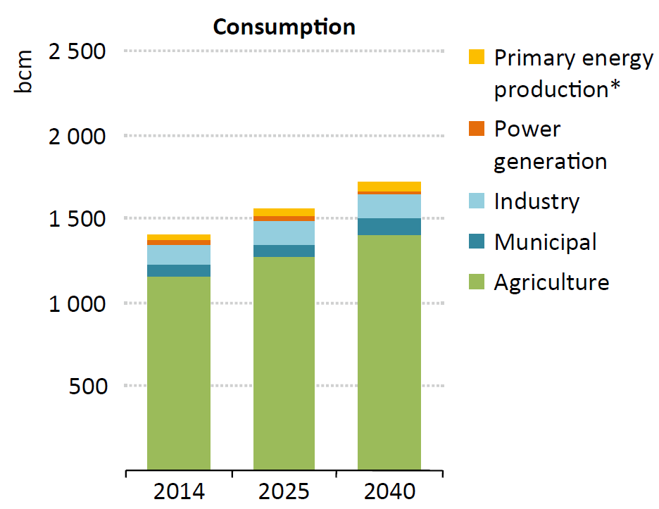
Water for Food
Global water demand by sector between 2014 and 2040
Agricultural water withdrawals by region, 2010
Region | Agricultural water withdrawal as % of total water withdrawal
Africa | 81
Americas | 48
Asia | 81
Europe | 27
Oceania | 58
World | 70
Source: own illustration based on UN, 2021
Source: IEA, 2016
Notes:
Notes:
As we can see on the two graphics on this slide, agricultural at the global level by far accounts for the largest amounts of water abstractions and consumption
It accounts for roughly 70% of global freshwater withdrawals – in Africa and Asia that number is even higher, more than 80% of total water withdrawal
So to produce food, we need a lot of water!
And to produce more food to feed a growing population and to feed those that today still go hungry we will likely need to use a lot more water – although of course some of that demand will also be met by increasing water efficiency in agricultural production and decreasing food losses and food waste
Figure: Global water demand by sector between 2014 and 2040 (IEA, 2016)
(Irrigated) agriculture: Is the primary water user
Withdrawals: account for around 70 % of global freshwater withdrawals
Water used in agriculture is used for food production but also for biofuels, cotton, etc
Industry:
Consumption: industry is the second largest water consumer (8-9%)
Water is used for processing, fabricating, washing as well as food processing
Withdrawals: about 10% refer to the industrial sector (vary between 8% and 12% in the former developing and developed countries)
Table: Agricultural water withdrawals by region, 2010 (UN, 2021)
Water is used in various ways for the food production (e.g. agriculture, livestock, inland fishery production)
Water is required for all types of agriculture (from essentially rainfed to entirely irrigated)
E.g. rainfed agriculture: covers 80% of the global cropland and contributes to 60% of the food production (Rockström et al., 2007; In: UN, 2021)
About 20% of cultivated lands is covered by irrigated agriculture and accounts for 40% of the global food production (Molden et al., 2010; In: UN, 2021)
Water withdrawals (from surface and groundwater resources) for irrigation currently (2010) amount to 2,797 km3 per year (70% of all water withdrawals in the world)
Additional Information (fig 1):
Energy sector:
Distinguishes between primary energy production* (e.g. fossil fuels and biofuels) and power generation
*Water withdrawals and consumption for crops grown as feedstock for biofuels are included in primary energy production (not in agriculture)
Water withdrawals of primary energy production and power generation together: account for 10% of total withdrawals
Water consumption of primary energy production and power generation together: account for 3% of total consumption
Municipal water demand:
Water withdrawals account for 13% (around 17% by 2040) Share of total global water consumption: only 5%
Future increase in water demand by growing urbanization and rising standards of living
Since 1980s: water demand increased about 1% per year (Aquastat; In: WWAP, 2019)
Rising water demand due to population growth, socio-economic development and evolving consumption patterns (WWAP, 2016; In: WWAP, 2019)
Expected increase in global water demand by 2050: 20 – 30% (especially in the industrial and domestic sector) (Burek et al., 2016; In: WWAP, 2019)
Sources:
International Energy Agency (IEA) (2016), ‘Water Energy Nexus: Excerpt from the World Energy Outlook 2016’, Paris France.
United Nations (UN) (2021), ‘The United Nations World Water Development Report 2021: Valuing Water’, Paris, France.
WWAP (UNESCO World Water Assessment Programme) (2019), ‘The United Nations
World Water Development Report 2019: Leaving No One Behind’, Paris, France.

Slide 9
Food and land impact on water
How does food production and land use affect the water sector?
Irrigated agriculture is responsible for the largest part of water withdrawals, especially in developing countries.
Livestock manure, fertilizers and pesticides contaminate water sources (surface water and groundwater), cause eutrophication of ecosystems relevant for water supply
Agricultural land management impacts water quality and quantity (erosion/sediments, infiltration rates, increased evaporation from soils)
Diets (consumption of animal proteins vs veganism) influence water demand for food production
Notes:
Notes:
How does food production and land use affect the water sector?
Irrigated agriculture is responsible for the largest part of water withdrawals, especially in developing countries.
Livestock manure, fertilizers and pesticides contaminate water sources (surface water and groundwater), cause eutrophication of ecosystems relevant for water supply
Agricultural land management impacts water quality and quantity (erosion/sediments, infiltration rates, increased evaporation from soils) – in the same lines, sustainable agricultural practices can improve water quality and quantity – for example, cover crops can reduce erosion and thus positively impact water quality
Diets (consumption of animal proteins vs veganism) influence water demand for food production

Slide 10
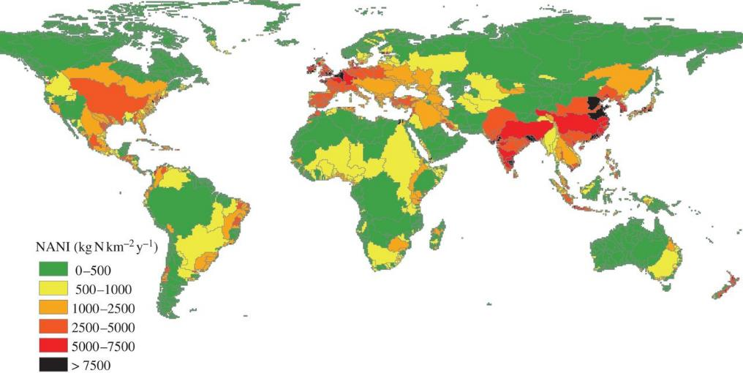
Food and land impact on water
Nitrate inputs to watersheds
Billen, Garnier & Lassaletta, 2013
Notes:
Notes:
This figure presents the global distribution of net anthropogenic nitrate inputs (NANI) at the scale of the world's watersheds, as calculated by Billen, Garnier & Lassaletta (2013).
Agricultural production worldwide leads to severe surface and groundwater water quality degradation due to diffuse source indirect pollution, for example from pesticides and nutrients (nitrate and phosphorus).
These stem from fertilisers and livestock which are leached into the water bodies, especially during wet periods.
Due to the high spatial and temporal variability of diffuse pollution, it is difficult to monitor and to manage.
85% of the net anthropogenic input of reactive nitrogen occurs on only 43% of the land area.
Sources:
Billen, G., Garnier, J. & Lassaletta, L. (2013) ‘The nitrogen cascade from agricultural soils to the sea: modelling nitrogen transfers at regional watershed and global scales’, Phil Trans R Soc B 368: 20130123. http://dx.doi.org/10.1098/rstb.2013.0123

Slide 11
Increasing food production: Main trade-offs
Growing land use
Increasing food production
Less land for energy (biomass, solar, wind)
Increase in water abstraction
Removal of woods
Decrease of water available for WASH, energy production, and environment
Declining water quality due to increase in fertilizers and manure
Notes:
Notes:
Now let's summarize again what this means from a Nexus perspective
As many people still suffer from lack of food and world population is still growing, we will need to intensify food production
Often this happens at the expense of deforestation
To increase the food production we need to use more land area to grow food and also more water for irrigation
However, this can conflict with development objectives in the water and also energy sector: If we increase water abstraction to irrigate crops, water availability for other consumptive uses decreases, such as for water and sanitation, or water we need to produce energy, and also water to maintain ecosystems
But also the water quality is affected due to the increased use of fertilizers and manure
At the same time, if we need more land to grow food, there is less land available for other purposes – such as for energy production (for growing biomass or to install solar and wind parks)
In several countries, including Germany, land used for wind and solar farms already competes with other land uses such as agriculture and this also increases costs for land
So increasing food production comes with a number of trade-offs in other sectors that need to be considered!

Slide 12
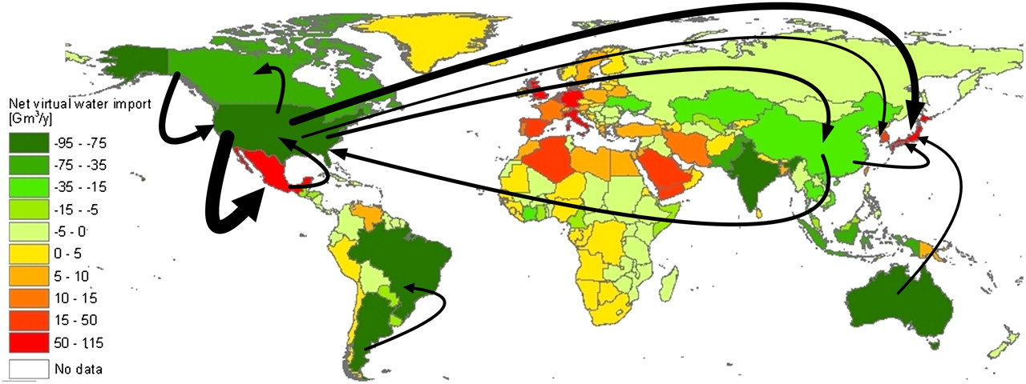
Local water uses versus global trade of agricultural products
Source: Hoekstra & Mekonnen, 2012
Notes:
Notes:
Another way of solving regional water shortages could be via trade of agricultural products – as is displayed in this graph
If water scarce countries import food from areas that have more water resources, they can save water and allocate their limited water resources to other sectors such as water and sanitation services to their population
But it can of course also work the other way round when water-scarce regions of the world produce and export large amounts of water-intensive food products: An example here maybe being the western United States which produces huge amounts of agricultural products for the world market but is actually a very water-scarce region – this increasingly creates problems in the western US where water becomes increasingly scarce, even for basic drinking water supplies
Additional information:
In this context one also often talks about virtual water trade
The total volume of international virtual water flows related to trade in agricultural and industrial products was 2,320 Gm³/y (68% green, 13% blue, 19% grey)
About one-fifth of the globally available water resources is used in agricultural production for products that are exported
Sources:
Hoekstra, A.Y. & Mekonnen, M.M. (2012), ‘The water footprint of humanity’, PNAS, vol. 109, No. 9, pp. 3232-3237

Slide 13
Water – Energy
Thermoelectric cooling
Hydropower
Extraction and refining of fossil fuels
Growing of biomass for bioenergy
Drinking water and wastewater treatment
Pumping groundwater and surface waters for irrigation
Transport of water
Desalination of seawater
Notes:
Notes:
In this section we look at the interconnections between water and energy.
Key questions addressed are:
How relevant are water resources for energy generation?
What are the implications of energy production on the quantity and quality of water resources?
Highlighted trade-offs :
Multiple trade-offs
High water requirements for fossil fuel extraction and refining, limiting water resources for other uses such as agriculture
Changes in seasonal downstream water availability due to hydropower generation impacting livelihoods and ecosystems

Slide 14
Time for a quick quiz game! How much water is needed in the energy sector?
We have seen previously that 90% of energy produced today is water-intensive, meaning that nearly all forms of energy rely on water.
Which part of the energy sector accounts for the largest amount of water withdrawals?
Notes:
Notes:
Before we continue with taking a closer look at trade-offs between water and energy, we want to do another round of quiz questions!
To participate, you need your smartphone, laptop or any other web-enabled devise [provide link and QR-code to access survey if using one of the online tools mentioned below]
Question:
Quiz: We have seen previously that 90% of energy produced today is water-intensive, meaning that nearly all forms of energy rely on water.
Which part of the energy sector is the largest source of water withdrawals? [Multiple Choice options: Primary energy production including biofuels, oil, coal & natural gas, fossil fuels (x), nuclear, renewables]
Which part of the energy sector is the main water consumer? [Multiple Choice options: Primary energy production including biofuels, oil, coal & natural gas (x), fossil fuels, nuclear, renewables]
Sources:
This survey can be realized with either menti (www.mentimeter.com), slido (www.slido.com) or any other online tool suitable for online surveys.

Slide 15
Water for Energy
Where do we need water for energy production?
Extraction and refining of fossil fuels
Production and cooling in thermal power generation
Hydropower
Biomass production
Production and cleaning of components of power plants (incl. for wind and solar energy)
Notes:
Notes:
The energy and the water sector are highly interrelated as nearly all forms of energy rely on the use of water and also often have impacts on water quality
Extraction and refining:
There are a broad range of steps that include the use of water E.g. water for coal extraction is needed to cool the cutting surfaces of mining equipment to avoid fires
Water also helps to manage the dust that is produced during the processing stage, when coal is crushed and ground
For refining crude oil water is used as a heating medium (water steam) and also for cooling processes (to cool oil components after heating)
Production and cooling for thermal power generation:
Thermal power generation is based on a process where water is heated and the produced steam to run turbines
Most water however is need for cooling processes – cold water from a river or other resources is extracted to absorb excess heat that is produced during the process; the water is afterwards released back to the river
Hydropower:
Water is mostly stored in a dam and then released through turbines which generate electricity
Depending on the climatic conditions, more or less water is lost through evaporation in the water reservoir behind the dam
Bioenergy/ Biomass production:
Most water used here is the water that is required to irrigate plants that are then turned into biofuels
The only forms of energy that do not directly need any water are wind energy and photovoltaic solar panels (as opposed to thermal solar power generation which also requires water for cooling) – but of course the components of any energy generator need water during their production or for cleaning, e.g. PV panels

Slide 16
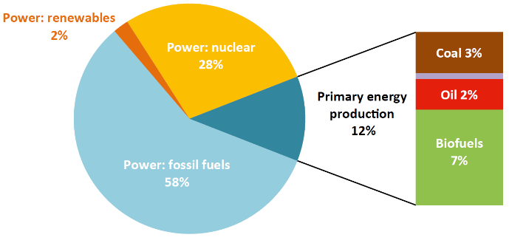
Water for Energy
Water withdrawals and consumption in the energy sector, 2014
Total water consumption: 48 bcm
Total water withdrawals: 398 bcm
Primary energy production
64%
Natural gas <1%
Source: IEA, 2016
Source: own illustration based on IEA, 2016
Notes:
Notes:
The largest amounts of water withdrawals are used to generate power from fossil fuels – 58% in 2014, water here is mainly used for cooling processes in thermal power plants
This is followed by water withdrawals for nuclear power generation (28%) and then primary energy production (12%)
If we look at the actual water consumption, the pictures changes: Primary energy production from biofuels, oil, natural gas and coal together account for 64% of water use
So overall, we find that the energy and water sectors are highly interrelated as nearly all forms of energy production rely on the use of water – many of them on extensive water use
Additional Information:
The energy sector is constituted by the power sector as well as by the primary energy production (IEA, 2016)
The power sector is the largest source of water withdrawals
The primary energy production is the main water consumer (accounts for 2/3rds)
Water Withdrawals:
mainly stem from surface water sources
The huge water demand in the power sector stems from fossil fuels which are responsible for 58% of water withdrawals
The key component regarding the water withdrawals are the types of cooling technology used in thermal power plants → the type determines, how much water is withdrawn and finally consumed (IEA, 2012; IEA, 2015; In: IEA; 2016)
The largest source of water withdrawals within the primary energy production are biofuels (IEA, 2016)
Water consumption:
The total water consumption by the energy sector in 2014 accounted for 48 bcm which represents only 12% of the energy-related water withdrawals
By 2040: it is estimated that the consumption of the energy sector will increase to over 75 bcm (following the New Policies Scenario) (IEA, 2016)
2% of water used for irrigation is needed for the biofuel production (WWAP, 2012; In: IEA, 2016)
By 2040: it is estimated that the total water withdrawals of the energy sector will rise from 398 bcm (2014) to over 400 bcm (1.5%) (following the New Policies Scenario) (IEA, 2016)
Main driver of the increase is the demand for biofuels in the transport sector (average growth per year between 2025 and 2040: 3.5%)
Sources:
Howes, T. (IEA) (2021-05-18), ‘Water data for the energy sector. Climate impacts on hydropower’, Presentation.
International Energy Agency (IEA) (2016), ‘Water Energy Nexus: Excerpt from the World Energy Outlook 2016’, Paris France.

Slide 17
Water for Energy
Energy-related water consumption
Region | Consumption (bcm)
 | 2014 | 2025 | 2040
OECD | 21 | 24 | 22
Eastern Europe/ Eurasia | 4 | 4 | 4
Asia | 15 | 23 | 37
Middle East | 2 | 2 | 3
Africa | 1 | 2 | 2
Latin America | 4 | 4 | 7
World | 48 | 59 | 76
Source: own illustration based on IEA, 2016
Notes:
Notes:
The current and projected water consumption for power production varies significantly between regions of the world
Largest current and also projected shares fall on OECD countries and Asia
Overall, water consumption for the production of energy is expected to increase until 2040
Additional Information:
The New Policies Scenario (IEEFA, 2018):
Scenario developed by IEA
Try to reflect where today's policy ambitions seem likely to take the energy sector
Assumptions: the world‘s countries will not take significant action to act on carbon emissions in line with the Paris Agreement
Table: Energy-related water consumption in the New Policies Scenario (IEA, 2016)
The projected increase in water consumption by 2040 is expected to be 30-times greater in non-OECD countries than in OECD countries
In the latter is the consumption predicted to remain almost unchanged
Asia accounts for 70% of the energy-related consumption
Within Asia: India will take the first place before China regarding the water demand for energy
Sources:
Institute for Energy Economics and Financial Analysis (IEEFA) (2018), ‘Fact Sheet: IEA‘s „Sustainable Development Scenario“ best reflects our global energy future‘.
International Energy Agency (IEA) (2016), ‘Water Energy Nexus: Excerpt from the World Energy Outlook 2016’, Paris France.

Slide 18
Potential trade-offs with climate policies
Political aim to decrease CO2 emissions
More Hydropower
Climate change/ global warming
Changes in ecosystem functioning
Evaporation
Impacts on livelihoods (fisheries, tourism)
Water is not released at times when it is needed
Less Water for agriculture
Notes:
Notes:
Let's look at what these interlinkages between water and energy mean from a climate perspective
In the context of climate change we have global and also national ambitions to decrease greenhouse gas emissions such as CO2
Many countries have therefore committed themselves to increase renewable energy productions such as hydropower to decrease CO2 emissions
However, there are often significant trade-offs:
Large-scale storage of water in hydropower dams often has significant impacts on ecosystems through changes in flow patterns, water temperatures, possibilities for fish to migrate - also impacts on livelihood sectors that depend on ecosystem functioning such as fisheries or tourism
More storage of water in hydropower dams can also mean less water for agriculture (loss through evaporation, or lack of availability of water at time when needed/depending on release patterns)
So, interlinkages between water and energy also play out significantly when we look at climate change policies

Slide 19
Energy for water
Where do we need energy in the water sector?
Water extraction
Water treatment
Desalination
Water transfer
Water distribution
Wastewater treatment
Water re-use
Notes:
Notes:
It is not only water that is an important factor in energy production, but also vice-versa: Energy is needed to extract, transport and treat water resources
We need energy for the following 7 water-related activities:
Water extraction:
Energy is needed to extract water from surface sources (e.g. lakes, rivers and oceans) as well as from groundwater sources (e.g. pump groundwater from aquifers)
Water treatment:
Processing and treating of water to meet drinking water standards requires energy
The treatment includes processes of mechanical screens and sedimentation, filtration, disinfection and pressurization
Desalination:
Desalinated water is an important water source in countries under high water stress (e.g. in the MENA region)
During the desalination process saline water (seawater or brackish water) is separated into freshwater and concentrated salt – this process often requires large amounts of energy
Water transfer:
Large-scale water transfer projects intend to make water available where it is a rare commodity (also over long distances)
Especially needed in water-stressed areas
Water distribution
Water is pumped from the treatment plant to the end-user via a pressurised distribution systems
Wastewater treatment:
Energy is needed to collect, transport and treat the wastewater
Thus it can be safely discharged in order to prevent damage to health and the environment
The energy consumption for wastewater treatment is influenced by various factors (e.g. the share of wastewater, the level of groundwater infiltration and rainfall into the sewage system, the treatment level, the contamination level, and the energy efficiency of the operations)
Water re-use
Sources:
FAO (2016). Energy, Agriculture and Climate Change. Towards energy-smart agriculture, available at: https://www.fao.org/3/I6382EN/i6382en.pdf
International Energy Agency (IEA) (2016), ‘Water Energy Nexus: Excerpt from the World Energy Outlook 2016’, Paris France.

Slide 20
Time for a quick quiz game! How much energy is used in the water sector?
What share of the global electricity is consumed in the water sector (in %)?
Which part of the water sector uses most electricity?
Which part of the water sector is projected to use most electricity 20 years from now?
Notes:
Notes:
Before we now take a closer look at how much energy is used in the water sector, it is time again for some quick quiz questions!
To participate, you need your smartphone, laptop or any other web-enabled devise [provide link and QR-code to access survey if using one of the online tools mentioned below]
Question:
What share of the global electricity is consumed in the water sector (in %)? [Multiple Choice options: <2%, 2-5% (x), 5-10%, >10%]
Which part of the water sector uses most electricity? [Multiple Choice options: Transfer, Wastewater treatment, Reuse, Desalination, Distribution, Supply (x)]
Which part of the water sector is projected to use most electricity 20 years from now? [Multiple Choice options: Transfer, Wastewater treatment, Reuse, Desalination (x), Distribution, Supply]
Sources:
This survey can be realized with either menti (www.mentimeter.com), slido (www.slido.com) or any other online tool suitable for online surveys.

Slide 21
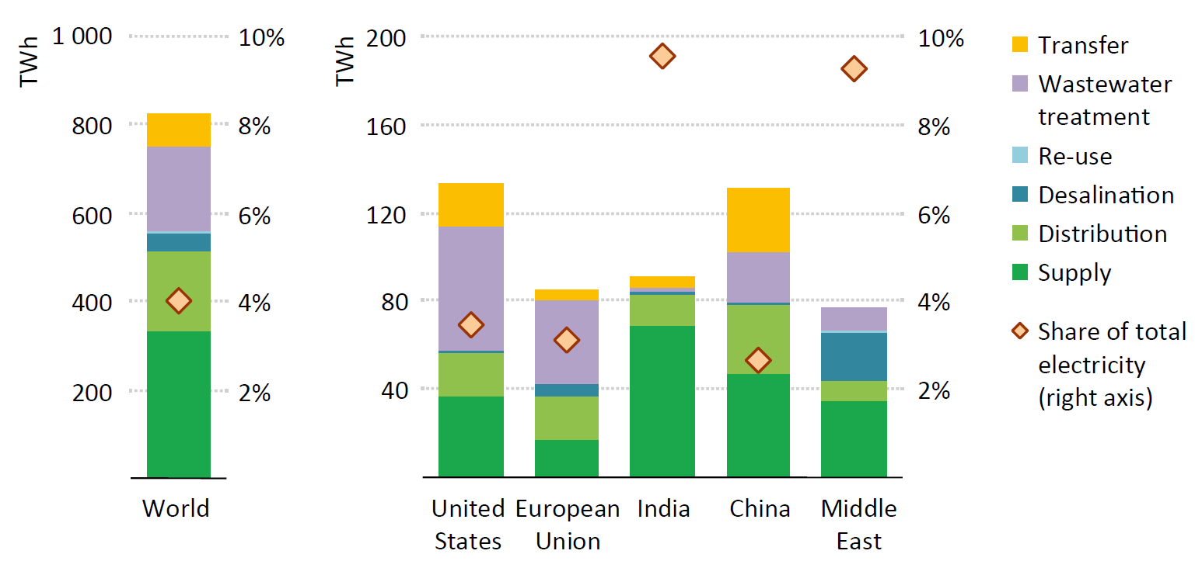
Energy for Water
Electricity consumption in the water sector by process and region, 2014
Source: IEA, 2016
Notes:
Notes:
The share of total electricity consumed in the water sector amounts to roughly 4%
If you look at the very left column here the labelling on the left side refers to the share of TWh used by each sub-sector whereas the right label (5) refers to the overall percent of energy used by the water sector
The largest consumer of electricity globally falls on supply, including groundwater extraction and surface water (40%)
This is followed by wastewater treatment is the second largest electricity consumer (25%)
The third place falls to water distribution to consumers (20%)
Desalination only accounts for 5% of electricity on a global level but shares are of course much higher in the Middle East (about 25%)
From IEA, 2016:
In 2014 the global water-related energy use accounted for a total of 120 Mtoe (million tonnes of oil equivalent)
60% (or 820 TWh) of this total energy use in the water sector stem from electricity consumption
The largest consumer of electricity is represented by the supply, including groundwater extraction and surface water (40%)
Wastewater treatment (and collection) is the second largest electricity consumer (25%)
In former developed countries is the percentage even higher (42%)
In former developing countries wastewater treatment plays a minor role
The third place regarding electricity consumption falls to the distribution to the consumers (20%)
Desalination only accounts for 5% on a global level but in North Africa and the Middle East is represents ¼ of the consumption
Through the use of non-traditional resources as desalination and re-use, countries facing water stress try to augment their natural water supplies
The remaining 10% of energy consumption is accounted for by large-scale inter-basin water transfer, (freshwater treatment) and water re-use
The United States is the leading water consuming country (40% for wastewater treatment)
China is in second place by accounting for 15% of global water-related electricity needs
The Middle East consumes 9%, mainly for desalination
In India: 60% of their electricity share in the water sector is consumed by groundwater extraction which represents 40% of the global groundwater use
Sources:
International Energy Agency (IEA) (2016), ‘Water Energy Nexus: Excerpt from the World Energy Outlook 2016’, Paris France.

Slide 22
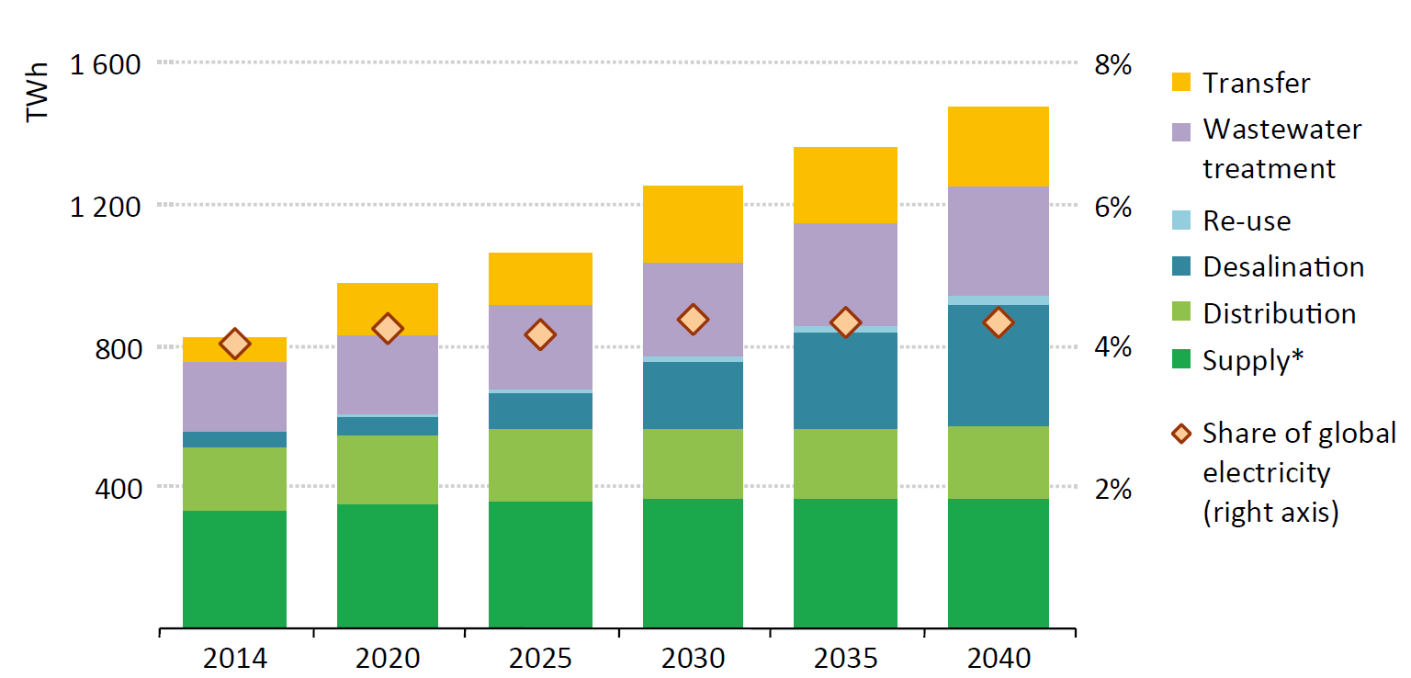
Energy for Water
Electricity consumption in the water sector by process, 2014 - 2040
Source: IEA, 2016
Notes:
Notes:
If we now look at future projections – we see that the water-related electricity consumption is expected to rise significantly in the coming 2 decades – will increase by over 60% compared to 2014
However, the share of global electricity consumption will remain almost the same
The largest share of electricity consumption in 2040 will still fall on the water supply sector (25%)
This will be closely followed by desalination which will account for more than 20%
This is certainly the most prominent change in projected developments
Additional information:
The water-related electricity consumption is expected to rise annually by 2.3% → increase of 80% by 2040 (total of 1470 TWh)
Equivalent to nearly twice of the Middle East today’s electricity consumption
The largest increases are projected for desalination, water transfer and re-use
Desalination:
Within this sector, the largest increase in energy consumption is projected because of increased reliance on it, especially in water-scarce regions (e.g. North Africa and the Middle East) (IEA, 2018)
Today’s energy consumption of 5% will increase to 20% by 2040
Transfer:
Large-scale water transfer projects cause the second largest increase in water consumption (after desalination)
Water re-use:
Also growing importance of this sector
Electricity consumption for water re-use will quadruple until 2040
The largest increase is expected in the United States, China, India, North Africa and the Middle East
Non-traditional water sources: desalination and re-use combined account today for 0.7% of the water supply and will rise to 4% by 2040
Wastewater treatment:
Electricity consumption will increase by over 60% from 2014 to 2040 (IEA, 2016) due to rising quality standards (IEA, 2018)
Two counterbalancing trends concerning the energy intensity of wastewater treatment: (1) global energy intensity will increase due to higher wastewater treatments in former developing countries; (2) the treatment efficiency will improve and thus mitigate this growth
Groundwater extraction:
Electricity needs will rise by 30 TWh until 2040 due to increased extraction and the use of more efficient electric pumps
Share of the water sector in the global electricity consumption:
Overall: stays almost at the same level around 4%
But there exists strong regional divergence
EU and the United States will remain around 3%
India’s share will decrease from 10% to 4% because other electricity uses will growth faster
The Middle east: share will increase from 9% to 16% because of the strong growth of the desalination capacity
China: share will rise from 3% to 4% because of large-scale water transfer projects (e.g. South-North Water Transfer Project)
Sources:
Howes, T. (IEA) (2021-05-18), ‘Water data for the energy sector. Climate impacts on hydropower’, Presentation.
International Energy Agency (IEA) (2018), ‘World Energy Outlook 2018’, Paris, France.
International Energy Agency (IEA) (2016), ‘Water Energy Nexus: Excerpt from the World Energy Outlook 2016’, Paris France.
World Bioenergy Association (WBA) (2013), ‘Biofuels for Transport. Fact Sheet.’, Stockholm, Sweden.

Slide 23
Energy – Food
Food production and supply chain makes up approximately 30% of total global energy demand
Agricultural land is used for
biofuel production
Notes:
Notes:
- In this section we look at the interlinkages between the energy and food sectors
- The key questions addressed are:
Where in the food production chain do we need energy and how much?
What is the role of agriculture for energy production (keyword “bioenergy”)? How much agricultural land is used for production of bioenergy?
Highlighted trade-offs:
Using land for growing food vs. energy production

Slide 24
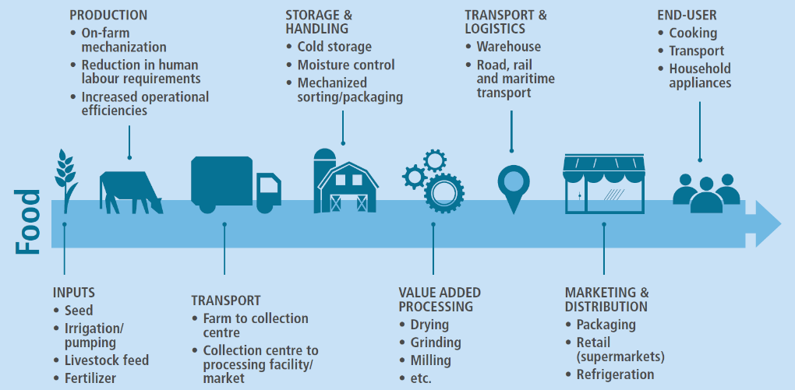
Energy for Food
Where do we need energy for food production?
Source: FAO, 2016
Notes:
Notes:
Energy is required for the following inputs: seeds, irrigation and pumping, livestock feed and fertilizers
Also at the production level energy is fundamental: for the on-farm mechanization, the reduction in human labour requirements and also to increase the operational efficiencies
Furthermore, energy plays a major role for the transport of agricultural products: from the farm to the collection centre and from there to processing facilities and markets
Energy is also needed for storage & handling: for cold storage, moisture control, and the mechanized sorting and packaging
Within the step of value-added processing, energy is required for drying, grinding, milling and more
Energy is also connected to transport & logistics: for warehouses as well as road, rail and maritime transport
In the area of marketing & distribution energy is required for packaging, retail (supermarkets), and refrigeration
Finally, the end-user also uses energy for cooking, transport, and household appliances
Sources:
FAO (2016). Energy, Agriculture and Climate Change. Towards energy-smart agriculture, available at: https://www.fao.org/3/I6382EN/i6382en.pdf

Slide 25
Time for a quick quiz game! How is energy used in agri-food systems?
We have previously seen that agri-food systems account for about 33% of global energy demand.
Which segment of the agri-food chain needs the most energy (globally)?
Notes:
Notes:
Now we want to take a closer look at how energy is used in agri-food systems.
Before we present some information, it is time again for you to try to answer a quiz question!
To participate, you need your smartphone, laptop or any other web-enabled devise [provide link and QR-code to access survey if using one of the online tools mentioned below]
Question:
We have heard previously (in the first presentation) that agri-food systems account for 33% of global energy demand. Which segment of the agri-food chain needs the most energy (globally)? [Multiple Choice options: Cropping production, Livestock, Fisheries production, Processing and distribution (x), Retail, preparation and cooking]
Sources:
This survey can be realized with either menti (www.mentimeter.com), slido (www.slido.com) or any other online tool suitable for online surveys.

Slide 26
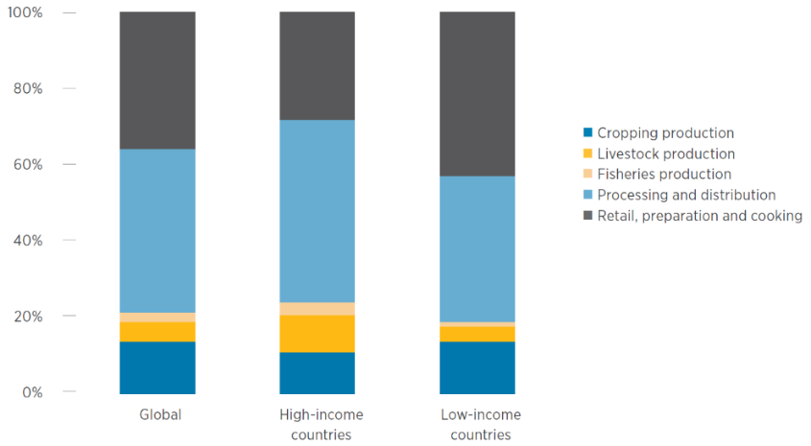
Energy for Food
Share of total energy consumption globally and in high- and low-income countries, by segment of agri-food chain
Source: FAO, 2011
Notes:
Notes:
Globally, most energy in the agri-food chain is used for processing and distribution (slightly over 40%)
Processing and distribution includes post-harvest processing and storage (e.g. drying, cutting, heating, cooling, etc.) as well as transport and distribution to markets
However, there are differences between high and low-income countries
In low income countries the largest share of energy use falls on retail and food preparation/cooking (energy here mainly involves food storage and inputs for cooking meals),
At third place we see cropping production: includes fuel for tractors/ machinery, operating irrigation infrastructure, but also the energy used to produce fertiliser and feed
Overall, energy is needed among all steps of the agri-food chain → it plays a fundamental role
Sources:
International Renewable Energy Agency (IRENA) and Food and Agriculture Organization (FAO) (2021), ‘Renewable energy for agri-food systems – Towards the Sustainable Development Goals and the Paris agreement’, Abu Dhabi and Rome.

Slide 27
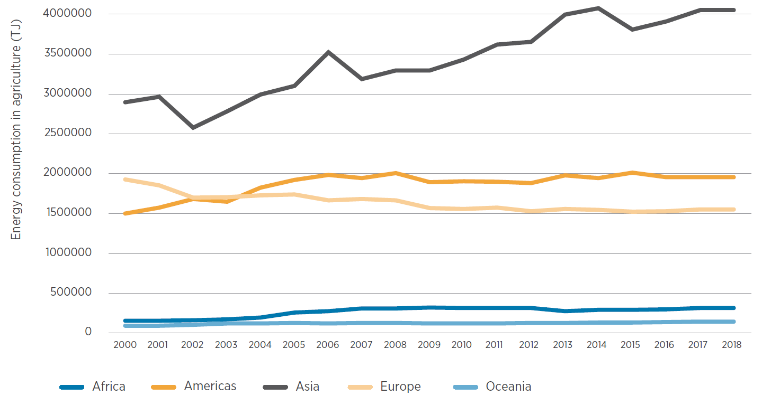
Energy for Food
Energy consumption in agri-food systems by region, 2000-2018
Source: FAOSTAT, 2021
Notes:
Notes:
This graph shows past trends in energy consumption within the agri-food chain: you can see that energy demand has remained unchanged in most parts of the world except for Asia
The sharp increase here can be explained by the fact that agriculture became more and more mechanised; and with the use of irrigation pumps, farm machinery and other processing equipment energy consumption grew rapidly
Americas and Europe: production has also grown (e.g. increased efficiencies, agronomic processes) → energy consumption remains stable
Africa: growing food demand → energy consumption still remains constant
Additional information:
Potential for integrated food-energy-systems: combining the production of renewable energy and food
Optimising land use by cropping systems that integrate energy and food crops (e.g. agro-forestry systems: trees are used for bioenergy)
Optimising the biomass use by employing by-products/ residues as inputs in the production process (e.g. biogas from manure)
Use of agri-voltaics or the combinations of agriculture and the generation of solar power
Sources:
International Renewable Energy Agency (IRENA) and Food and Agriculture Organization (FAO) (2021). Renewable energy for agri-food systems – Towards the Sustainable Development Goals and the Paris agreement’, Abu Dhabi and Rome.

Slide 28
Agriculture for Energy
How are agriculture and energy linked?
can be obtained from
Bioenergy
can be used
Agricultural plants
Fast-growing wood grown on agricultural land or from the forestry
Biogenic waste and residual materials from agriculture, forestry, households and industry
As fuel in transport
As thermal energy in households or as industrial process heat
For industrial power generation
For industrial CHP generation
Notes:
Notes:
We do not only need energy for agricultural production, but agriculture also plays a big role for producing energy
Bioenergy plays an increasingly important role for the energy sector
The term ‘bioenergy’ is widely used and it refers to any energy source based on biological matter
But more specific, bioenergy can be obtained from (Umweltbundesamt, 2020):
Agricultural plants (e.g. corn, wheat, sugar beet, rapeseed, sunflowers, oil palms)
Fast-growing wood grown on agricultural land (short rotational plantations)
Wood from the forestry
Biogenic waste and residual materials from agriculture, forestry, households and industry
Bioenergy encompasses gaseous forms (e.g. biogas, biomethane, biofuels) as well as liquid forms (e.g. biofuels)
Due to the diversity of feedstocks and diverse conversion technologies, bioenergy can be used in all energy-related sectors:
As fuel in transport (e.g. for gasoline, diesel, gas, and electric vehicles)
As thermal energy in households or as industrial process heat
For industrial power generation
For industrial CHP (combined heat and power) production also possible (“Kraft-Wärme-Kopplung”)
Sources:
The Guardian (2011-09-23), ‘What are bioenergy and biofuels – and are they a good idea?’, available at: https://www.theguardian.com/environment/2011/sep/23/bioenergy-biofuels-climate-change-faq
Umweltbundesamt (2020-06-26), ‘Bioenergie’, available at:
https://www.umweltbundesamt.de/themen/klima-energie/erneuerbare-energien/bioenergie#bioenergie-ein-weites-und-komplexes-feld-

Slide 29
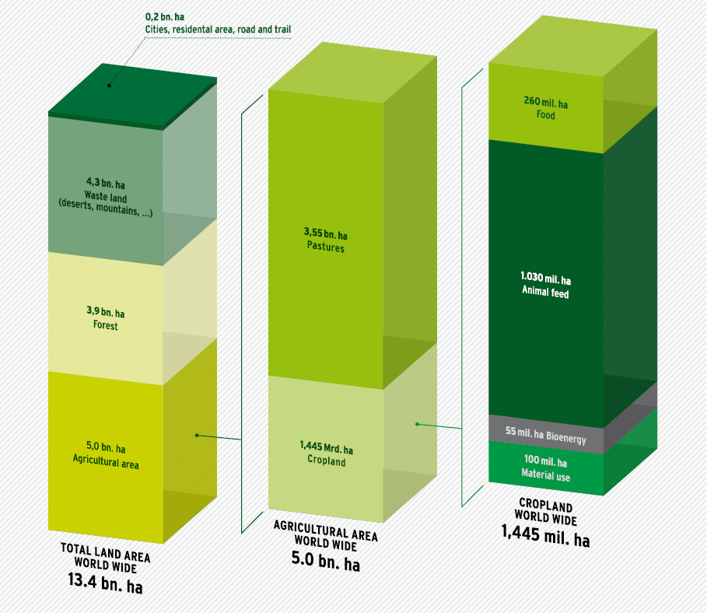
Agriculture for Energy
Global land use for food and renewable raw material production 2008
18%
2%
71%
32%
Source: Raschka et al., 2012 in Umweltbundesamt, 2013
29%
29%
37%
7%
Source: own illustration based on Raschka et al., 2012
Notes:
Notes:
Of all the land available on our planet, 37% was used for agricultural production in 2008
Of this land that is used for agriculture, about 1/3rd is used for growing crops
The use of this cropland is presented in the figure on the right side of this slide: : 71% animal feed, 18% food, 7% material use and only 4% bioenergy
Besides the 55 million (4%) hectares of cropland used for the production of bioenergy, almost 2 billion hectares of forests were dedicated to the supply of biomass for energy use in 2008
For the production of bioethanol, wood plays a major role, followed by maize and sugar cane
Bamboo is used as a fuel
Oil palm fruit is needed for biodiesel production
In 2009, renewable energies met a sixths of the global final energy demand
Within the renewable energy sector, biogenic fuels are the dominant resource → they account for 12.3% of the worldwide final energy consumption,
Nevertheless, the increasing demand for bioenergy feedstocks (in the form of cultivated biomass) is provoking land use conflicts
It is difficult to estimate the potential of bioenergy by 2050 but following the IPCC’s Special Report on Renewable Energy Sources (2011) it will be at least the double of the status from 2008 (taking into account increasing land use competition and non-compliance with essential international sustainability standards with regard to land use)
Sources:
Umweltbundesamt (2013), ‘Sustainable use of Global Land and Biomass Resources‘, Dessau-Roßlau.

Slide 30
Potential trade-offs due to land use changes
Growing demand for bioenergy
Less cropland for food and animal feed
Shortages increase the price for agricultural products
Land use change
Land use intensification
Increasing GHG emissions
Endangers livelihoods
Habitat and diversity loss
Notes:
Notes:
Growing demand for bioenergy leads to a change of agricultural production patterns and the forestry (land use change)
Impact pathway 1:
Cultivation of agricultural commodities dedicated for the production of bioenergy reduces the cropland available for food and animal feed
Shortages increase the price for agricultural products (especially food and animal feed, but also biofuels) and cause price fluctuations
Shortages (e.g. harvest failures) as well as increased prices endanger the livelihoods of economically vulnerable sections of the population as well as whole countries
Impact pathway 2:
Due to land use changes in favor of bioenergy, the available cropland remaining will face an intensification
This can not only cause the displacement of indigenous communities but also replaces traditional extensive land uses
Land use intensification is usually accompanied by the use of fertilizers and pesticides
This pollutes water bodies, soils and the air (environmental pollution)
Habitat and diversity loss are the consequence (e.g. eutrophication, destruction of carbon sink systems, etc.) and livelihoods are endangered (again)
Impact pathway 3:
Land use change for the production of biofuels also increases indirectly greenhouse gas (GHG) emissions
Summary:
Increasing food prices cause supply shortages and can put poorer countries in crisis situations (harvest failure)
Farmland is expanded (land use changes) into areas which should be under protection → causes conversion of forests, drainage of peat soils, ploughing up of grassland and species-rich habitats, etc.
Intensification of existing land uses affects climate, environment and biodiversity in a negative manner
Sources:
Umweltbundesamt (2013), ‘Sustainable use of Global Land and Biomass Resources‘, Dessau-Roßlau.

Slide 31
Discussion on WEF Interconnections
Any questions so far? (use chat function)
Which further trade-offs within the WEF Nexus or beyond are you aware of, from your own professional context or from your country/region? (mentimeter)
Notes:
Notes:
We would now like to open the floor to questions. Please use the chat function if you haven't done so already...
Questions:
Any questions on WEF linkages so far?
Which further trade-offs within the WEF Nexus or beyond do you know, from your own professional context or from your country/region?

Slide 32
Summary of chapter 1.2: Water-Energy-Food Interactions
WEF demands need to be taken into account equally because they interact with each other
Primary food production, cleaning and sanitation, processing, etc.
Supply, treatment, desalination, transfer, distribution, re-use
Bioenergy
Hydropower, extraction of fossil fuels, cooling, production of bioenergy, etc.
Inputs, production, transport, storage & handling, value added processing, transport & logistics, marketing & distribution, end-user
Impacts on water quality (contamination) and quantity (large withdrawals)
Notes:
Notes:
WEF demands need to be taken into account equally because they interact with each other.
Water – Agriculture: primary food production, cleaning and sanitation, processing, etc.
Water – Energy: hydropower, extraction of fossil fuels, cooling, production of bioenergy, etc.
Energy – Water: supply, treatment, desalination, transfer, distribution, re-use
Energy – Agriculture: inputs, production, transport, storage & handling, value added processing, transport & logistics, marketing & distribution, end-user
Agriculture – Energy: bioenergy
Agriculture – Water: impacts on water quality (contamination) and quantity (large withdrawals)

Slide 33
Thank you for your time!
In cooperation with

