Slide 1
Module III - Case Studies
For cross-policy making and related project design and planning
In cooperation with

Slide 2
Overview of case studies
Region | Scale (local, regional, national, transboundary) | Sectors (water, agriculture, energy) | Solutions (technical, nature-based, governance, focus on challenges)
Europe
LAC
LAC
MENA Region
Niger Basin
SADC
Policy framework for WEF coordination, Germany
Hydropower in the Reventazón River, Costa Rica
Mobile solar powered irrigation systems (SPIS), Bolivia
The Sahara Forest Project, Jordan
The Lagdo Dam in the valley of the Benue, Cameroon
WEF-Nexus coordination in the lower Kafue basin, Zambia

Slide 3
WEF-Nexus coordination in the lower Kafue basin, Zambia
SADC

Slide 4
WEF-Nexus coordination in the lower Kafue basin, Zambia
Sectors and scale
Parameters |  | Description
Sectors | Water | Zambia has abundant water resources Local and temporal water stress due to prolonged droughts and increasing demand
 | Land/ agriculture | The Zambian Government aims to increase small and large-scale irrigated agriculture throughout the country to: improve food security create income & employment increase resilience towards climate change
 | Energy | Hydropower generates the majority of Zambia’s electricity through dams distributed across the Zambezi and the Kafue
Scale | National/ local | The Lower Kafue is a sub-basin of the Zambezi River Basin which is important for: Livelihoods (agriculture, fishing) Hydropower generation Water supply for Lusaka Environmental integrity (maintaining important wetlands)
Notes:
Notes:
- Focus of this case study is the water-land/food nexus in Zambia, an the lower Kafue basin in particular and how nexus challenges are coordinated between actors from different sectors and different government levels
Zambia is a relatively water rich country, however, water stress is a growing phenomena in selected sub-basins, including the Kafue Basin
Reasons include: growing populations and increasing water demand, climate change (recurring droughts)
The Zambian Government aims to increase agricultural irrigation across the country to improve food security, create additional income & employment and increase resilience towards climate change
Current estimates assume that Zambia has a potential to develop about 2.75 mill. ha of land (of which only 200,000 are currently irrigated)
Hydropower generates the majority of Zambia’s electricity through dams distributed across the Zambezi and the Kafue
Reduced river flows, especially in the summer months, negatively impact energy production (especially in times of drought); this is expected to increase with climate change which is expected to bring more frequent droughts
The Lower Kafue basin is a sub-basin of the Zambezi River which Zambia shares with several neighbouring countries (the Kafue however is only situated in Zambia)
It is a very important basin as it provides the livelihoods for approximately 900,000 people (that engage in agriculture, fishing), it hosts 2 hydropower stations, provides the bulk water for the capital city Lusaka, and supports the productive functioning of several important wetlands (the Kafue Flats) which require a minimum flow in the river to be upheld
Sources:
Phiri, G. & Scheumann, W. (2018). Coordination – the Key to Governing the Water-Land-Food Nexus in Zambia? Discussion Paper 20/2018, German Development Institute.

Slide 5
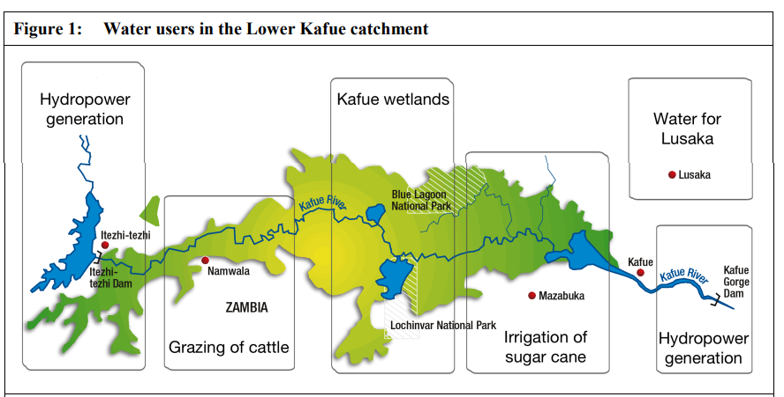
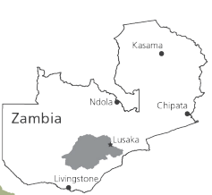
WEF-Nexus coordination in the lower Kafue catchment, Zambia
Source: Phiri & Scheumann 2018
Notes:
Notes:
This slide shows a map of the Lower Kafue and its location within Zambia
As you can see there are two major hydropower dams/facilities within the upstream (Itezhi-tezhi) and downstream (Kafue Gorge) of the basin; Kafue Gorge is the largest power statin in Zambia (capacity of 990 MW)
The middle part is primarily used for agricultural purposes: grazing of cattle, smallholder cultivation and the production of sugarcane and maize (for domestic use and export)
But also for tourism (it attracts about 30% of national tourism) and sustains one of Zambia‘s most productive wild fisheries
The downstream users – primarily sugarcane growers as well as the ecological functioning of the Kafue Wetlands depend on water releases by operators of the Itezhi-tezhi dam which regulates the river flow
In turn, water used by sugarcane growers and others affects downstream river flows and hence the water supply to the capital of Lusaka and the hydroelectricity generation at the Kafue Gorge plant
Source:
Phiri, G. & Scheumann, W. (2018). Coordination – the Key to Governing the Water-Land-Food Nexus in Zambia? Discussion Paper 20/2018, German Development Institute.

Slide 6
WEF-Nexus coordination in the lower Kafue catchment, Zambia
Nexus challenges
During times of drought, the energy plants, agricultural producers and the environment compete over limited amounts of water resources
Sinking water levels in dams → decreasing hydropower production
Water
Water supply to consumers disrupted
Energy
Notes:
Notes:
There are two major nexus challenges in the lower Kafue catchment:
The first one including the water and energy sectors
During times of drought, the energy plants and water supply sector as well as the environment compete over limited amounts of water resources
Droughts occur regularly
During the drought in the summers of 2015 and 2016 for example, water levels in the hydropower dams were so low that the Zambia Electricity Company had to cut supplies to companies and urban consumers which were left without electricity supply for 8 to 16h per day
This affected urban water supplies as pumps could not work without power and also industries such as the mining industry which had to lay off workers
Sources:
Phiri, G. & Scheumann, W. (2018). Coordination – the Key to Governing the Water-Land-Food Nexus in Zambia? Discussion Paper 20/2018, German Development Institute.

Slide 7
WEF-Nexus coordination in the lower Kafue catchment, Zambia
Increased water abstraction for irrigation → limiting water and land resources for other small-scale farmers
Nexus challenges
Planned large-scale, commercialised irrigation would increases water stress and compete with water for hydropower generation and water supply to growing urban population (partciularly during times of drought)
Water
Water supply to consumers disrupted
Less water for urban population
Land/ Agriculture
Energy
Less water for hydropower generation
Notes:
Notes:
The next nexus challenge exists between all WEF sectors: the water, food/land and energy sectors - As the graph on the right side illustrates: Planned large-scale, commercialized irrigation would limit water and land resources for other small-scale farmers
Water abstraction for irrigation purposes would also mean that there is less water available for water supply to urban population as well as for (at least downstream) hydropower production
As happened in the past, this could in turn also mean that there were energy cuts that disrupt water supply to urban populations (and industry)
But it is not only water and the allocation of this resources to different stakeholders that poses a challenge: Large-scale commercialized irrigation is planned primarily on land that is currently under customary land tenure
Conflicts between commercial investors and existing land users are also likely – as this has already been reported in the past
For instance a planned irrigation scheme in Mbeza (located in the Kafue River) several years ago sparked protest by local residents which objected the scheme
Sources:
Phiri, G. & Scheumann, W. (2018). Coordination – the Key to Governing the Water-Land-Food Nexus in Zambia? Discussion Paper 20/2018, German Development Institute.

Slide 8
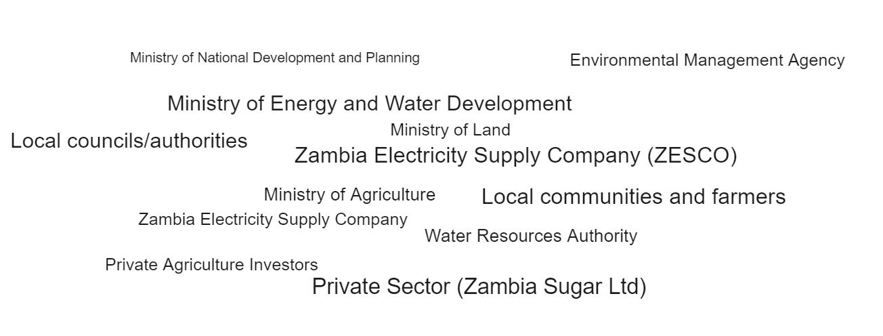
WEF-Nexus coordination in the lower Kafue catchment, Zambia
Key stakeholders
Notes:
Notes:
Before we turn to the question how these different interests around land, water and energy are coordinated in the existing governance framework, we need to look at the different stakeholders that are involved and that represent the WEF sectors
The stakeholders presented here are only the major ones
Some have already been mentioned like the Zambia Electricity Supply Company and the Zambia Sugar Ltd
Amongst the major government stakeholders are
Ministry of National Development Planning
Leading the development process of the 5-year National Development Plans which are the key planning documents that formulate strategic development goals across all national sectors
Ministry of Energy and Water Development (today 2 separate ministries)
Ministry of Agriculture
Responsible for all policies around agricultural planning, including planning of irrigation projects and issuing investment licenses
Water Resources Authority
The authority grants water abstraction permits
Permits are usually given for 5 years
Local Councils
Traditional authorities which represent local communities (usually includes also headperson of a village)
They need to be involved by regulatory authorities when it comes to transferring land and water tenure rights – they need to approve land transfer to investors as well as granting water permits
How are these different actors that represent different WEF sectors at various administrative levels actually coordinating their work and different interventions in the Lower Kafue Basin, especially with regard to the 2 major Nexus challenges that we mentioned?
Sources:
Phiri, G. & Scheumann, W. (2018). Coordination – the Key to Governing the Water-Land-Food Nexus in Zambia? Discussion Paper 20/2018, German Development Institute.

Slide 9
WEF-Nexus coordination in the lower Kafue catchment, Zambia
Coordination approaches at the national level
5-year National Development Plans
Key cross-sectoral planning document outlining strategic development goals (e.g. expansion of agr. irrigation for development)
All other sectoral policies have to be aligned with objectives and activities of the NDP
Inclusion of national sectoral views by using „Sector Advisory Groups“
Notes:
Notes:
This is what we want to look at by examining two specific examples
While this is not enough to address the full complexity of WEF nexus dynamics, it will help us to better understand some governance coordination mechanisms that are employed
5-year National Development Plans
Key cross-sectoral planning document outlining strategic development goals (expansion of agr. irrigation for national development has been a key goal across plans over the last decades)
All other sectoral policies (such as the National Water Policy or the Irrigation Policy and Strategy) have to be aligned with the objectives and activities outlined in the National Development Plans
The planning process for the plans involve consultations with key stakeholders including government units from different sectors as well as those at the provincial level, academic and research organisations, civil society, faith-based organisations, the private sector, traditional leaders, the general public and cooperating partners
A specific institutional instrument in the past were the so called “Sector Advisory Groups”
chaired by the Permanent Secretary of the then Ministry of Energy and Water Development
other ministerial stakeholders were members of the sub-committees
The Infrastructure and Development sub-committee e.g. was chaired by the Director of the Department of Agriculture the Water Resources Management sub-committee by the Water Ministry etc.
This rather sectoral approach was not used anymore for the last NDP – instead a more “integrated multi-sectoral approach” was favored [but no information available how that looked like beyond consultation of stakeholders as outlined below]
In addition, NDP include a broad consultative process with the public which uses both a top-down and bottom-up approaches
The top-down approach entailed analyzing the national developmental trajectory with a view to determine common development challenges and opportunities that all structures could address and/or maximize.
The bottom-up approach comprised sub-district, district and provincial levels that make assessments of their prevailing conditions, to formulate their own development plans for functions devolved to them and for input into the national planning process.
Stakeholders are engaged through a broad set of platforms, including workshops, meetings, roundtable discussions and solicited written submissions.
Sources:
Ministry of National Development Planning (2017). 7th National Development Plan 2017-2021
Phiri, G. & Scheumann, W. (2018). Coordination – the Key to Governing the Water-Land-Food Nexus in Zambia? Discussion Paper 20/2018, German Development Institute.

Slide 10
WEF-Nexus coordination in the lower Kafue catchment, Zambia
Coordination approaches at the national level
Inter-sectoral planning group
To coordinate activities around the national „Farm Block Development Programme“ (commercialization of over 1 Mio ha of land into largely irrigated agricultural land)
Requires investments in infrastructure such as roads and electricity to create an attractive infrastructure package for investors and to manage cross-sectoral conflicts
→ Horizontal coordination to overcome infrastructure deficits for agricultural investments and to address potential conflicts
Notes:
Notes:
- One cross-sectoral initiative that has been developed (and outlined in the last National Development Plan) ist the so-called
country-wide Farm Block Development Programme
This program has the ambitious goal of driving agricultural commercialisation on over one million hectares of land, a considerable proportion of which will be irrigated
It covers nine farm blocks in all provinces and has about 100,000 hectares per block.
For the realisation of the Farm Block Development Programme the government has set-up an inter-sectoral planning group
The idea here was that in order to realize Zambia’s full development potential for irrigation, the county would need to invest in the construction of access roads the construction of dams, weirs, boreholes and irrigation systems, and in the electrification of the schemes
The inter-sectoral planning group supports the implementation of the Farm Block Development Programme since this is a large, special government program for which coordination is essential to provide an attractive – infrastructure – package for investors
It was also set up to address potential conflicts over water use that may arise with other sectoral uses (energy, urban water deliveries) as well as between commercial investors and existing land users (which primarily hold customary water tenure rights)
This inter-sectoral planning group is basically an institution for horizontal coordination to overcome infrastructure deficits for large-scale agro-investments including water works
Sources:
Ministry of National Development Planning (2017). 7th National Development Plan 2017-2021
Phiri, G. & Scheumann, W. (2018). Coordination – the Key to Governing the Water-Land-Food Nexus in Zambia? Discussion Paper 20/2018, German Development Institute.

Slide 11
WEF-Nexus coordination in the lower Kafue catchment, Zambia
Coordination approaches at the local level
Coordination between Zambia Electricity Supply Company (ZESCO) and Zambia Sugar Ltd.:
Interlinkages and flow dependencies between upstream (hydropower, irrigation) and downstream users (hydropower)
→ Data exchange on water withdrawals for irrigation (Zambia Sugar Ltd.) and water release by ZESCO on daily basis
Notes:
Notes:
We now want to look at two examples of coordination at the local level
Coordination between Zambia Electricity Supply Company (ZESCO) and Zambia Sugar Ltd
- In the beginning we mentioned the nexus between hydropower production and irrigation for sugarcane farming in the Lower Kafue Basin
The downstream sugarcane growers depend on water releases by operators of the Itezhi-tezhi hydropower dam which regulates the river flow
In turn, water used by sugarcane growers affects downstream river flows and hence the water supply for hydroelectricity generation at the Kafue Gorge plant
Coordination is happening through:
Data exchange:
The Zambia Sugar Ltd and the Zambia Electricity Supply Company (ZESCO) have therefore come up with an agreement: Zambia Sugar Ltd reports on a daily basis to ZESCO the amount of water they withdraw. In turn, ZESCO provides data on water releases from the upstream Itezhi-tezhi dam.
[note that the Sugar Ltd itself is relatively independent from the national power grid as it produces most of the electricity it needs itself from sugarcane residues]
Sources:
Phiri, G. & Scheumann, W. (2018). Coordination – the Key to Governing the Water-Land-Food Nexus in Zambia? Discussion Paper 20/2018, German Development Institute.

Slide 12
WEF-Nexus coordination in the lower Kafue catchment, Zambia
Implementation: Success factors and challenges
Success factors:
Prospect of attracting foreign investments can incentivize cross-sectoral coordination
Challenges:
Lack of technical and administrative capacities at all levels, including provincial and district level make vertical coordination difficult
Limited data and information (either incomplete, unreliable or withheld)
Absence of mechanisms that protect non-commercial water user rights
Notes:
Notes:
So, what can we learn from the case study?
Success factors:
- Prospect of attracting foreign investments can incentivise cross-sectoral coordination
Challenges:
- Lack of technical and administrative capacities: limited staff positions in key departments such as provincial and district offices of Agriculture and Water, making vertical coordination very difficult
- Limited data and information (either incomplete, unreliable or withheld): e.g. on water (availability, allocated water rights, water withdrawals etc.)
- Absence of mechanisms that protect non-commercial water user rights, since they do not rely on water permits → their use-rights are not formally registered and hence not legally recognized
-
Sources:

Slide 13
Thank you for your time!
In cooperation with

