Slide 1
Module III - Case Studies
For cross-policy making and related project design and planning
In cooperation with

Slide 2
Overview of case studies
Region | Scale (local, regional, national, transboundary) | Sectors (water, agriculture, energy) | Solutions (technical, nature-based, governance, focus on challenges)
Europe
LAC
LAC
MENA Region
Niger Basin
SADC
Policy framework for WEF coordination, Germany
Hydropower in the Reventazón River, Costa Rica
Mobile solar powered irrigation systems (SPIS), Bolivia
The Sahara Forest Project, Jordan
The Lagdo Dam in the valley of the Benue, Cameroon
WEF-Nexus coordination in the lower Kafue basin, Zambia

Slide 3
The Sahara Forest Project, Jordan
MENA Region

Slide 4
“The idea is to use what we have plentiful – seawater, desert land, CO2 and sun – to produce what we need more of – food, freshwater and clean energy.”
Sahara Forest Project (SFP)
Sahara Forest Project Vision
Pilot projects in:
Qatar (completed)
Jordan (initiated)
Tunisia (initiated)
Notes:
Notes:
The idea for the SFP was developed over a decade ago aiming to produce fresh water, food and renewable energy in very hot and arid regions of the world and to simultaneously re-vegetate these areas of uninhabited desert land – as beautifully visualized in the graphic on this slide
The concept was designed by a team of private companies together with the Norwegian Bellona Foundation
The principle idea of the project is to us what we have plentiful of, namely seawater, desert land, CO2 and sun, to produce what we need more of, namely food, freshwater and clean energy
The project uses a set of existing and proven technologies, but (and this is new) aims to integrate these technologies in one system, to make use of „waste“ products
It has so far been applied in Qatar, Jordan and more recently in Tunisia
We will here look at the case of Jordan
Sources:
Image Reference:
Sahara Forest Project, Website available at: https://www.saharaforestproject.com/

Slide 5
The Sahara Forest Project, Jordan
Sectors and scale
Parameters |  | Description
Sectors |  | Freshwater is a scarce commodity in the country (amongst countries with lowest water availability/capita in the world)
 |  | Land suitable for food production is very limited and declining (10%) Desert land (75%) is plentiful Food insecurity is growing (high dependence on imports vulnerable to fluctuations in global market prices)
 |  | Large dependence on non-renewable energy sources with high GHG emissions Sun for solar power production is plentiful but requires water (for cooling technologies and cleaning of solar panels), competing with other needs (drinking and food production)
Scale | Local | 1350 m² area North of Aqaba Location is close to Read Sea and low altitude to minimize pumping energy
Notes:
Notes:
Water, energy and food systems are inextricably linked in Jordan and the broader Arab region, perhaps more so than in any other region in the world
Generally, the country is known to be very water-scarce, food-deficient, energy-intensive and economically and environmentally vulnerable to climate change
Water: is a scarce commodity in the country (amongst the countries with the low (amongst countries with lowest water availability/capita in the world)
Land/agriculture: land that is suitable for food production is very limited and declining (about 10%)
Desert land on the other hand is plentiful, however not very suitable for food production
Food insecurity is high (about 80% of food is imported, high vulnerability to fluctuations in global market prices for food)
Agriculture sector also consumes most of the countries water resources (about 50%) but contributes little to economy and employment)
Energy: Jordan is very dependent on imported, non-renewable energy sources (oil and gas) which produce high GHG emissions
In this context, the Sahara Forest Project (SFP) has been set up as a technological test case to address these various challenges with regards to water, food and energy security
The project is located North of Aqaba, relatively close to the Red Sea and in an area of low altitude which is important to minimize energy required for pumping

Slide 6
WEF Nexus Interactions in Jordan
Water is largest single energy consumer (e.g. abstraction, desalination)
Water use for energy (mostly for thermal cooling) competes with other sectors
Agriculture using largest amount of water resources
Overexploitation of water resources
Increase of water salinity and pollution levels
Increasing energy consumption in agriculture because of modernisation
Notes:
Notes:
Water security, energy security and food security are inextricably linked in Jordan, more than in other regions of the world
This slide only provides a very brief overview of the NEXUs linkages, scarce water resources being at the center
Water-Food:
Agriculture is the largest water-demanding sector in Jordan, being responsible for approx. 50% of total water use
Today, most of the water provided by wadis and rivers is already used; groundwater aquifers are largely over-exploited (resulting in increased salinity, intrusion of pollutants and lowering water tables)
Because of high water scarcity and increasing demands, due to population growth and development needs, agriclture competes over limited water resources with other sectors (industry, water for households/drinking, energy)
- The use of treated wastewater in agriculture has increasingly been established to decrease pressure on water resources
Water-Energy:
The water sector in Jordan is the largest single energy consumer (using 15% of the electricity for abstraction, transportation, distribution, irrigation, treatment, desalination), electricity costs account for 50% of annual operating costs in the water sector → stark difference to most other regions of the world!
Water use for the production of energy in Jordan is primarly required for cooling for thermal power generation [as of 2022 there are no exact numbers of how much water is used here]
Water used for energy production competes with other sectors, including agricutlrue and WASH
Food-Energy:
Energy consumption in the agricultural sector has steadily increased due to improved techologies → this has lead to higher productivity and water efficiency (e.g. through drip irrigation) but also increased energy needs (with impacts on GHG emissions and water required for energy production)
Sources:
González, Alberto Belda (2018). The Water-Energy-Agriculture nexus in Jordan – A case study on As-Samra wastewater treatment plant in the Lower Jordan River Basin. Master Thesis. KTH Industrial Engineering and Management.

Slide 7
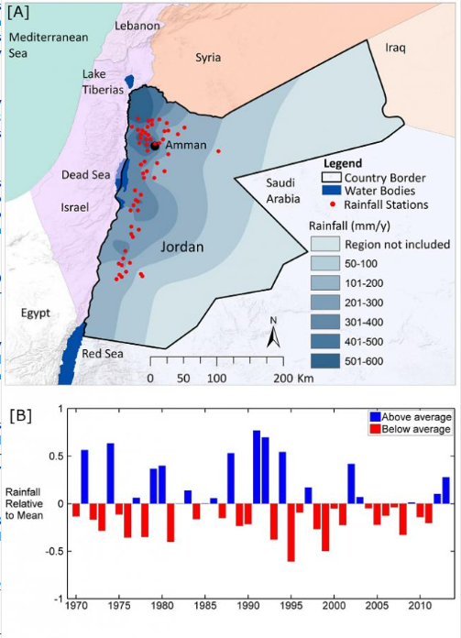
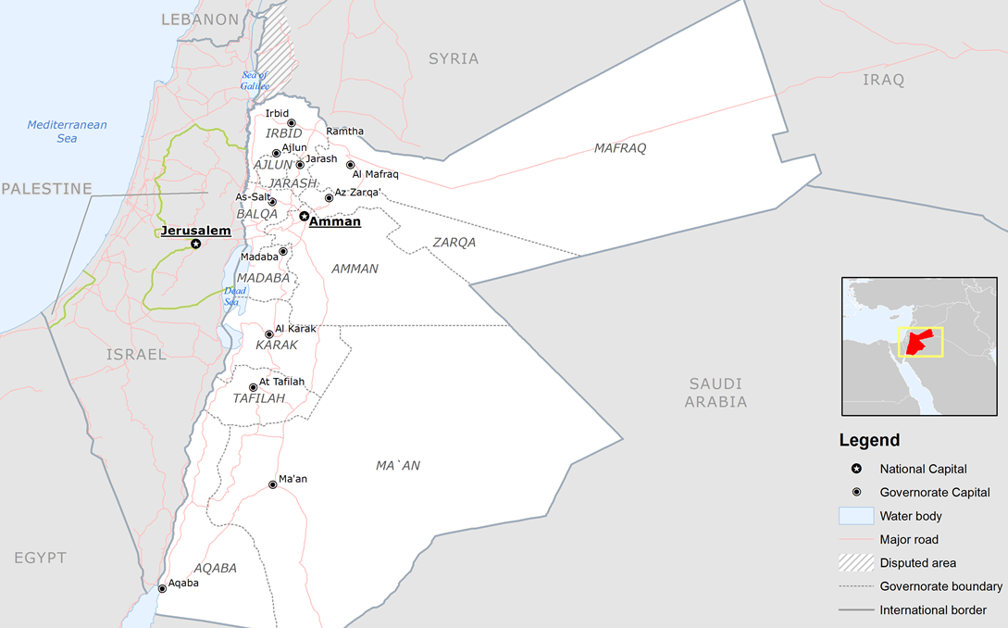
Impacts of climate change in Jordan
Annual average rainfall, 1970-2013
Sahara Forest Project
Source: Joint Research Centre, European Commission (2013)
Source: Rahman et al. (2015)
Notes:
Notes:
The mentioned interlinkages and trade-offs between the water, agriculture and energy sectors are expected to increase with climate change putting increasing pressure on Jordan‘s natural resources
Especially water scarcity is expected to be exacerbated by climate change, which has already decreased rainfall levels and increased temperatures
The map and graph on the left side show the annual average rainfall in the country based on 58 stations between 1970-2013
It shows that there has already been a drop in rainfall amounts
It also shows that years depicting below average rainfall since 1995 have started to outnumber the years of above average rainfall (before 1995 the number was roughly equal)
Population growth is adding to this problem of increasing water scarcity (large influx of refugees from Palestinian territories, Iraq and Syria)
Food imports have grown as a result of climate change and population growth → increasing Jordan‘s vulnerability to global food price fluctuations
Considering this background of WEF interlinkages and climate change pressures, the SFP tries to provide solutions to these challenges by combining different established technical solutions – the map on the right indicates the location of the SFP just north of Aqaba
Sources:
Map/Data:
Rahman, K., S. M. Gorelick,P. J. Dennedy-Frank, J. Yoon, andB. Rajaratnam (2015), Declining rainfalland regional variability changes inJordan,Water Resour. Res.,51, 3828–3835, Available at: https://agupubs.onlinelibrary.wiley.com/doi/full/10.1002/2015wr017153
Base map of Jordan. ECHO Jordan Editable A4 Landscape. (2013). Available at: https://commons.wikimedia.org/wiki/File:Jordan_Base_Map.png

Slide 8
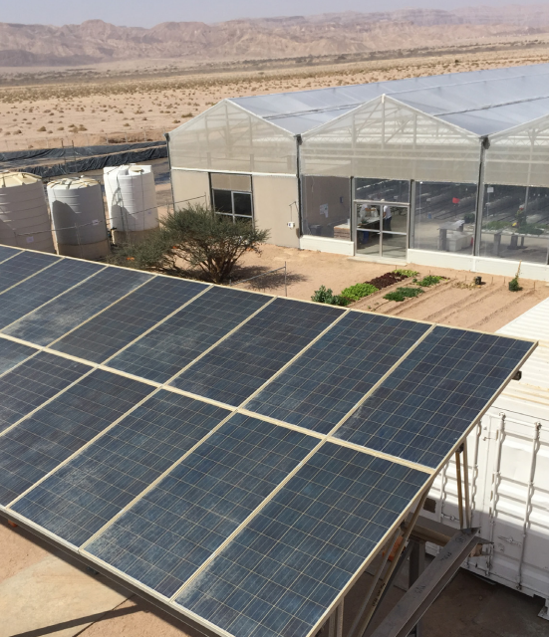
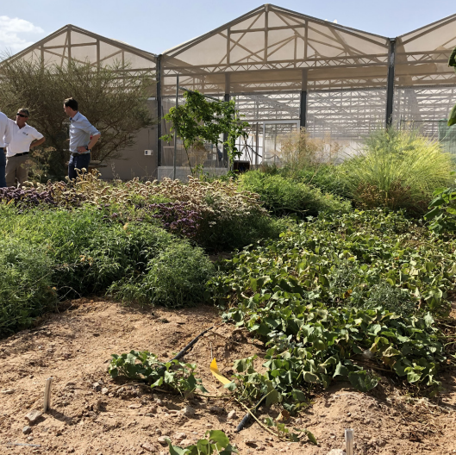
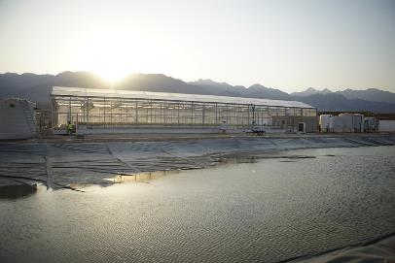
The Sahara Forest Project, Jordan
Three core technologies
Saltwater-cooled greenhouse technologies
Solarpower technologies
Technologies for growing vegetation in arid-environmnets
Notes:
Notes:
In the context of this WEF Nexus and the different trade-off that exist, the idea of the SFP is to use seawater, desert land and sun to produce freshwater, food and clean energy – and by doing so lowering pressures on competing demands over primarily water and energy resources
The approach here is a primarily technological one
The SFP integrated three sets of technologies
Saltwater-cooled greenhouses technologies
saltwater-cooled greenhouses utilizing saltwater from to Red Sea to provide excellent conditions for production of high-quality vegetables
Solarpower technologies
Photovoltaic panels provide power for electrical installations like the irrigation systems in the greenhouse as well as for desalination
Technologies for growing vegetation in arid environments
-
Sources:
Image Reference: Sahara Forest Project
Photo 1: https://www.saharaforestproject.com/photos/
Photo 2, 3: Sahara Forest Project (2019). Enabling Restorative Growth. Available at: https://www.saharaforestproject.com/wp-content/uploads/2019/12/Folder_liggende-A5_2019_v2_TE.pdf

Slide 9
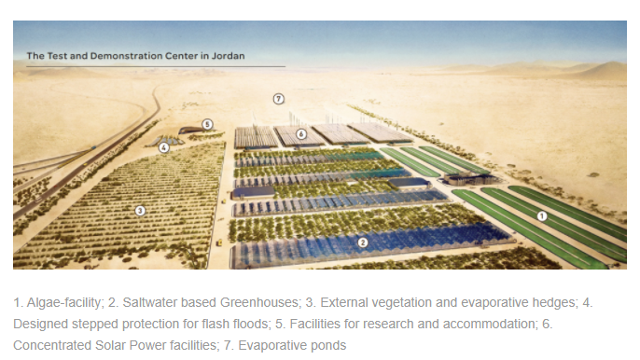
The Sahara Forest Project, Jordan
Set-up of the project site
Notes:
Source:
Image Reference:
Photo: https://www.saharaforestproject.com/jordan/

Slide 10
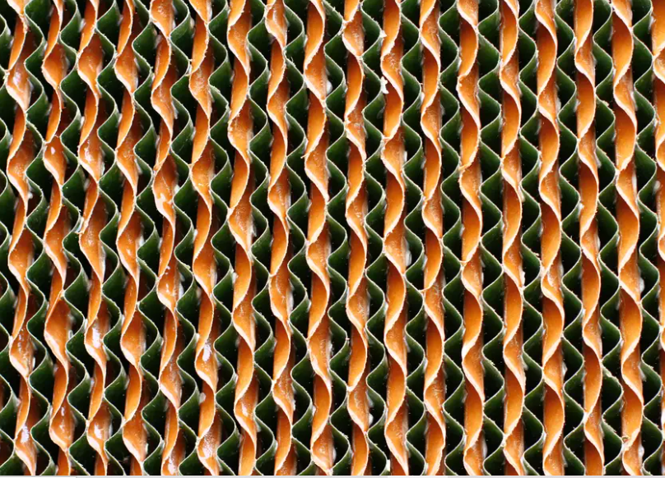
The Sahara Forest Project, Jordan
Core technologies: (1) Saltwater-cooled greenhouses & desalination
Greenhouses utilise saltwater to provide suitable growing conditions for year-round cultivation of vegetables and crops
Water runs down evaporative hedges while solar-powered fans draw hot air through them → saltwater evaporates / cooler and humid environment suited for cultivation
A reverse osmosis desalination unit provides the necessary freshwater water for the greenhouse and outside vegetation
Evaporative hedge, Sahara Forest Project
Notes:
Notes:
- Saltwater-cooled greenhouses utilize saltwater to provide suitable growing conditions for year-round cultivation of high-value vegetable crops in the hot and arid environment of Jordan
- The saltwater is run down honeycombed cardboard pads (also called “evaporative hedge“ see photo) at one end of the greenhouse, while solarpowered fans draw hot desert air through them and into the greenhouse
As the saltwater evaporates into the hot air, the air becomes cooler and more humid, creating a growing environment inside the greenhouse well-suited for the cultivation of vegetable crops
By using saltwater to provide evaporative cooling and humidification, the crops’ water requirements are minimized and yields maximized with a minimal carbon footprint
The water required for cooling and irrigation comes from the Red Sea
A reverse osmosis desalination unit provides the necessary freshwater water for the greenhouse and outside vegetation
Benefits:
The greenhouses are being cooled up to 15 degrees compared with outside temperatures
The water usage significantly lower, approximately 1/10, compared to conventional agricultural practices in the region
The Saltwater-cooled greenhouses allow for year-round production of high-quality crops, even in periods with very high outside temperatures
Facility uses no freshwater from the public system as it produces its own freshwater
Sources:
Sahara Forest Project (2019). Enabling Restorative Growth. Available at: https://www.saharaforestproject.com/wp-content/uploads/2019/12/Folder_liggende-A5_2019_v2_TE.pdf
Image Reference: Shara Fores Project
Photo 1: https://www.saharaforestproject.com/photos/

Slide 11
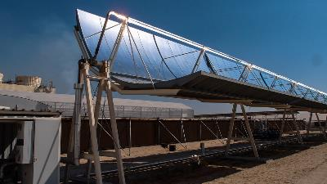
The Sahara Forest Project, Jordan
Core technologies: (2) Solarpower
Project utilises solar-power technologies to produce electricity
Use of seawater for wet-cooling technology
Benefits:
Power provided for installations in the greenhouses
Power for desalination unit which turns seawater in freshwater (for plants, cleaning solar panels)
Additional electricity can be exported
Notes:
Notes:
The SFP utilizes solar power technologies (photovoltaics and concentrated solar power (CSP)) to provide electricity for electrical installations in the SFP-facility
The CSP system is based on wet-cooling technology using seawater from the Red Sea (instead of freshwater)
Wet cooling is significantly more efficient than dry air cooling; it results in the production of 7-10 percent more electricity for the same infrastructure and operational investment
But this is usually not an acceptable option for arid regions like Jordan where water is a very scarce resource
But in the case of the SFP the system is based on a seawater which is not a scarce resource
Benefits:
Power produced for installations in the greenhouses
Also for a reverse osmosis desalination unit which turns saltwater from the Red Sea into the necessary freshwater for the greenhouse and outdoor vegetation
Additional power is exported from the facility
The freshwater needed for cleaning the solar installations (from desert dust) comes from the reverse osmosis desalination unit
Sources:
Sahara Forest Project (2019). Enabling Restorative Growth. Available at: https://www.saharaforestproject.com/wp-content/uploads/2019/12/Folder_liggende-A5_2019_v2_TE.pdf
Image Reference: Shara Fores Project
Photo 1: https://www.saharaforestproject.com/photos/

Slide 12
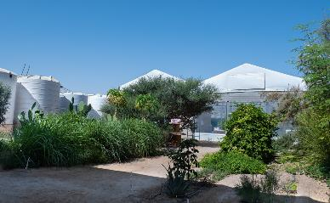
The Sahara Forest Project, Jordan
Core technologies: (3) Technologies for growing vegetation
Outdoor areas are used for revegetation with native desert species and water efficient crops
Benefits:
Improvement of soils
Food as well as fodder for livestock
Carbon sequestration as plants store CO2 from the atmosphere
Revegetation Aqaba, Jordan
Sahara Forest Project
Notes:
Notes:
Outdoor areas adjacent to the greenhouses and solarpower panels are revegetated, meaning that various plants are grown
The external cultivation areas host both native desert species and water efficient food and fodder crops
Outdoor revegetation benefits from the same saltwater-based cooling system installed in the greenhouses: using evaporative hedges to increase cooling and lower plants irrigation requirements [does not seem to be implemented in the Jordan facility yet but was applied and worked in Quatar!]
Water for irrigation comes from the desalination unit
There are a range of benefits, including:
Improvement of soils
Production of food and fodder for livestock
Carbon sequestration as plants store CO2 from the atmosphere into vegetation of barren land
Sources:
Sahara Forest Project (2019). Enabling Restorative Growth. Available at: https://www.saharaforestproject.com/wp-content/uploads/2019/12/Folder_liggende-A5_2019_v2_TE.pdf
Image Reference: Shara Fores Project
Photo 1: https://www.saharaforestproject.com/photos/

Slide 13
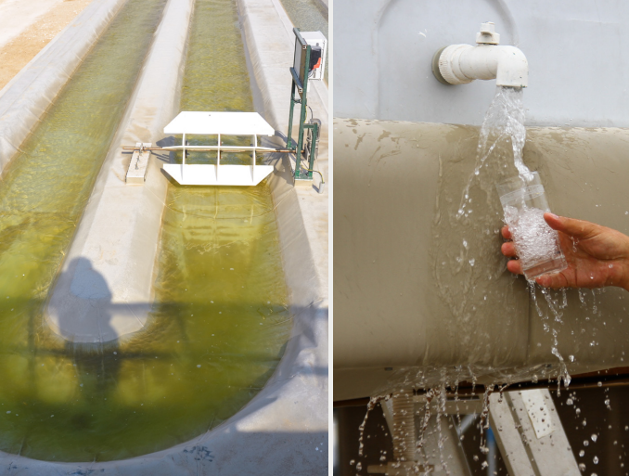
The Sahara Forest Project, Jordan
Extensions
The aim is to create additional business opportunities such as around:
Salt extraction from brine
Traditional desalination
Algae production
Halophyte cultivation
Bioenegy
Algae and freshwater production, Sahara Forest Project
Notes:
Notes:
In addition to the clusters of core technologies, the SFP also aims to create an environment for other businesses opportunities to flourish alongside the existing technologies
These include for instance:
salt extraction from brine
traditional desalination
algae production – as food or bioenergy
halophyte cultivation – halophytes are salt-tolerant plants that grow in soils with high levels of salinity (they could potentially be used as fodder crops or for bio-energy)
bioenergy
Sources:
Sahara Forest Project Website: https://www.saharaforestproject.com/technology-extentions/
Image Reference:
Sahara Forest Project (2019). Enabling Restorative Growth. Available at: https://www.saharaforestproject.com/wp-content/uploads/2019/12/Folder_liggende-A5_2019_v2_TE.pdf

Slide 14
The Sahara Forest Project, Jordan
The Jordan facility in a nutshell:
Up to 130,000 kg vegetables/per year
Up to 20. 000 litres of freshwater/per day
39 KW installed solar power production capacity
3 hectares (equal to the size of 4 football fields)
2 greenhouses – a total of 1350 m2 of growing area
3200 m² outdoor planting space
Salt ponds for salt production
Notes:
Notes:
Summarizing here some key facts about the SFP in Jordan:
Up to 130,000 kg vegetables produced per year (without competing over freshwater resources or energy from the public system)
Up to 20. 000 litres of freshwater production per day
39 KW installed solar power production capacity through PV panels
3 hectares (equal to the size of 4 football fields)
2 greenhouses – a total of 1350 m2 of growing area
3200 m2 outdoor planting space
Salt ponds for salt production
- By bringing together local entrepreneurs, scientists, business and other key players in green innovation, the SFP pilot and Demonstration Center also aims to be platform for research, innovation and training for the local and national community, pursuing sustainable solutions to the food, water and energy challenges.
Sources:
Sahara Forest Project (2019). Enabling Restorative Growth. Available at: https://www.saharaforestproject.com/wp-content/uploads/2019/12/Folder_liggende-A5_2019_v2_TE.pdf

Slide 15
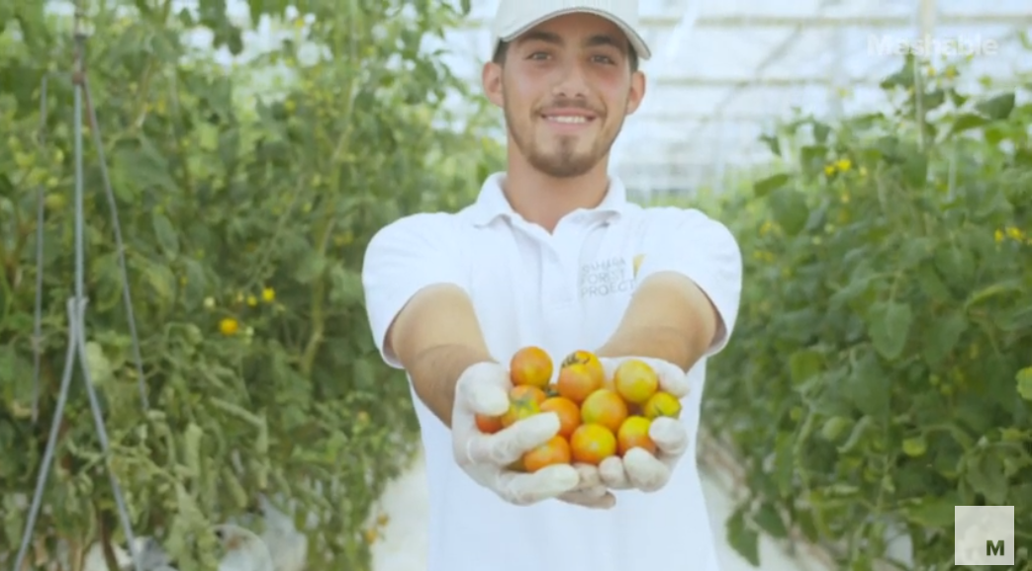
Video of the project
Notes:
Notes:
This is a brief video of the SFP in Jordan (link: https://youtu.be/gMCJXum7QU0)
[the picture on the slide is also linked to the video and can be opened from presentation mode]
Additional videos on the project are available here: https://www.saharaforestproject.com/videos-2/

Slide 16
Thank you for your time!
In cooperation with

