Slide 1







Module III - Case Studies
For cross-policy making and related project design and planning
In cooperation with

Slide 2







Overview of case studies
Region | Scale (regional, national, transboundary) | Sectors (water, agriculture, energy) | Solutions (technical, nature-based, governance)
Europe
Groundwater management in the Hessian Ried, Germany

Slide 3
Groundwater management in the Hessian Ried, Germany
Europe

Slide 4
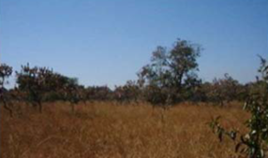
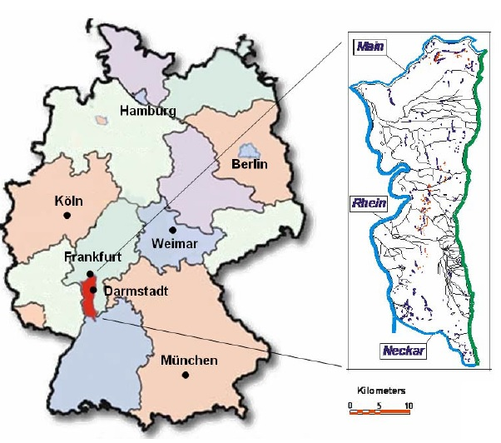
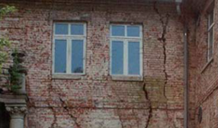
The Hessian Ried
Location of the Hessian Ried
Source: Rueppel & Gutzke, 2004
Notes:
Notes:
Background of the case study area:
The Hessian Ried, located south of Frankfurt, extends over an area of approximately 1,250 km²
The landscape is a part of the Upper Rhine Plain, and prior to human intervention was a swamp area and part of the natural inundation zone of the Rhine River
Through widespread drainage and agricultural utilisation, the landscape was starkly changed
The following user interests are dominant in the area:
Agriculture
Industry / infrastructure
Drinking water use
Nature conservation
Sources:
Rueppel, U. & Gutzke, T. (2004) ‘Groundwater-Monitoring based on dynamic co-operative eGovernment-Processes’, University of Technology Darmstadt

Slide 5
User Conflicts
Have derived from:
  Alteration of natural landscapes to cultivated landscapes
  Pollution inputs from agriculture
  Intensive exploitation of groundwater resources
Conflicts occur in both dry and wet years, and have led to the following:
  Dry years - forest dieback, road damages, failures in agricultural irrigation, settlement cracking in buildings
  Wet years - flooding, inability to properly cleanse the sewer system
Notes:
Notes:
The intensive exploitation refers to the fact that due to the spatial locations of population centres and other geographically-centred points of extraction, the groundwater extraction rates do not match recharge rates over the spatial plain.
In dry years, considerable damages to infrastructure have been caused by low groundwater levels.

Slide 6
Solutions: Nexus Relevant Instruments
FORMAL instrument:
Legally binding instrument
INFORMAL instrument:
Voluntary cooperation
Regulatory law complemented by voluntary cooperation
Stakeholder involvement
Technical expertise
Hessian Ried Groundwater Management Plan with legally binding standards
Hessian Ried Round Table
Cooperation in Water Supply and Agriculture
Vertical
Horizontal
Advantages deriving from the connection of regulative instruments with voluntary informal cooperation practices:
A regulative instrument is made available with binding standards for water management planning
The voluntary cooperation forms provide an instrument which ensures that interest of all actors and sectors as well as regions are represented
Notes:
Notes:
The following instruments are applied to address WEF-Nexus challenges in Hessian Ried:
The Hessian Ried Groundwater Management Plan as legally binding regulatory instrument
The Hessian Ried Groundwater Management Plan was adopted 1999 by the Hessian Government with the aim to avoid damages caused by low groundwater levels.
The Hessian Ried is the only region in the European Union that uses a legally binding groundwater management plan in which the amount of withdrawal water over a spatial area is regulated (through measuring and adhering to a minimum and maximum groundwater levels).
Voluntary cooperation forms:
Through the Hessian Groundwater Management Plan, the Hessian Government has provided a legal regulative instrument with binding standards. As a regulatory law instrument, the Groundwater Management Plan is complemented by voluntary regional cooperation forms (further information can be found on the following slides):
- Hessian Ried Round Table
- Cooperation between water supply and agriculture in the protection of groundwater quality
Voluntary and informal cooperation cannot replace regulatory law (water protection area regulations, water rights), but it can complement it.
Generally, the various actors are willing to cooperate if they see a usefulness in working together. The factors which motivate the different actors to cooperate and work together in the case study “Hessian Ried” can be found on slides with the titles: “Solutions: Round Table” and “Solutions Water Supply and Agriculture”
These voluntary informal cooperation practices establish transparency through comprehensive exchange of information, different stakeholders can voice their opinions equally and in detail, and a consensus can be found.
Sources:
Kluge, 2017 ‘Grundwasser als Quelle der Welternährung in Gefahr‘, Available at: http://www.isoe.de/uploads/media/isoe-kluge-grundwasser-2017.pdf

Slide 7
Solutions: Groundwater Management
Groundwater extraction from Hessian Ried provides a significant contribution to the water supply of the Frankfurt Rhine-Main metropolitan region
Use of water infiltration to ensure sufficient irrigation for agriculture and the raising of the groundwater level in dry years
The Hessian Ried Groundwater Management Plan
    Targeted groundwater levels are defined and an action plan is developed
Notes:
Notes:
This process of water infiltration involves extracting water from the Rhine River, purifying it to drinking water quality over a multistage procedure and then percolating it through infiltration systems as well as using it for agricultural irrigation.
Through the Hessian Ried Groundwater Management Plan, the Hessian government has made an instrument available that contains binding standards for water management planning and for all approval processes. Groundwater extractions and infiltration are managed by the water associations, using benchmarks for mean ground water levels and lower water levels. This adherence is controlled by the responsible water authorities. Objectives of the plan are:
The long-term guarantee of local and regional water supply for the population and for economic activities
Avoiding building damages from groundwater-related settlement of buildings in inhabited areas
Protection of vegetation areas dependent on groundwater levels and rehabilitation of forest and swamp areas already damaged through the sinking of the water table
The groundwater levels are kept within prescribed limits.
The Groundwater Management Plan is a sectoral instrument which attempts to integrate other interests and concerns. In this case study, water management within the management plan is the dominant component, even though other important concerns were also successfully integrated.

Slide 8
Solutions: Monitoring and Enforcing Groundwater Rules
Groundwater protection zones
A process exists to apply for a groundwater extraction permit
    Examined whether natural resources will be impaired
    Binding standards exist for water management planning
Groundwater extractions and infiltration are managed by the water associations. This adherence is controlled by the responsible water authorities
Notes:
Notes:
In general, groundwater monitoring and regulation in Germany are carried out as follows:
Monitoring of groundwater through a network of monitoring stations. This network is ordered by European law and sends data to the European Environmental Agency in Copenhagen, Denmark. Criteria are stated by the EU
Germany has a federal water law and several state water laws. Under the federal water law, extraction from and discharge of pollution into any water body require a permit. The state laws can add abstraction charges to the permit
Permits are used to regulate groundwater level and are thus discussed and regulated in state governments and discussed in state parliaments
Any failure to obtain the permit or misuse of the permit lead to legal actions and very high penalties under the criminal law, up to 50.000 Euro for infringements against the licensing condition
Sources:
David Elshorst, and Amrei Fuder, Clifford Chance, Environmental law and practice in Germany: overview, https://uk.practicallaw.thomsonreuters.com/4-503-0486?transitionType=Default&contextData=(sc.Default)
Regierungspräsidium Darmstadt, (nd), ‘Grundwasserentnahmen’, Available from: https://rp-darmstadt.hessen.de/umwelt/gew%C3%A4sser-und-bodenschutz/grundwasserwassershyversorgung/grundwasserentnahmen

Slide 9
Solutions: Groundwater Management
Wells for drinking water
Infiltration
Rhine River
Odenwald Forest
Groundwater
Source: Heiland, Weiner, & Nemüller, 2017
Notes:
Notes:
This figure visualises the processes of groundwater abstraction and infiltration, and the effects that they have on the groundwater levels.

Slide 10
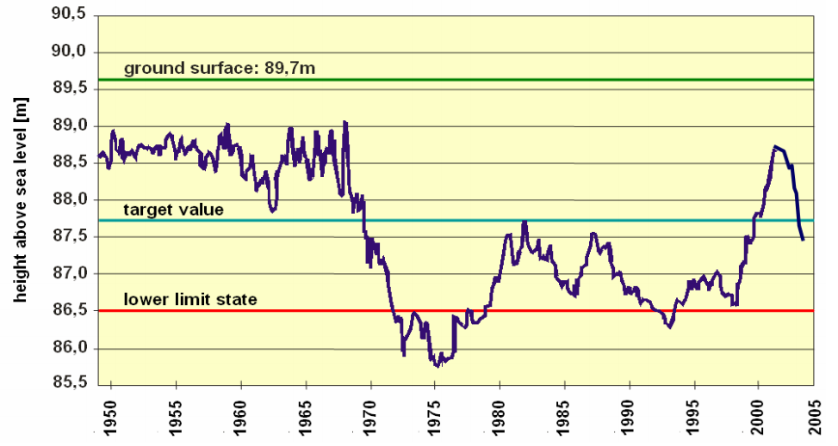
Solutions: Groundwater Management
Measured groundwater levels at a station in the Hessian Ried
Source: Rueppel & Gutzke, 2004
Notes:
Notes:
These measurements show the effectiveness of the corrective measures employed to stop excessive groundwater extractions in the Hessian Ried. It highlights the importance of setting a lower limit state and to introduce rules based on the recorded groundwater levels.
Sources:
Heiland, P., Weiner, S. & Nemüller, J. (2017), ‘Practical planning approaches in the WEF-Nexus-context: Identification of Nexus-relevant processes with practical examples’, Powerpoint Presentation, Bonn, 30 March 2017.
Rueppel, U. & Gutzke, T. (2004) ‘Groundwater-Monitoring based on dynamic co-operative eGovernment-Processes’, University of Technology Darmstadt

Slide 11
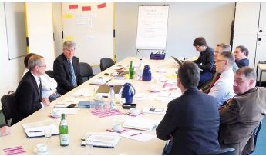
Solutions: Round Table
A round table works on improving the groundwater situation
    The primary objective of the round table discussion was to achieve a sustainable improvement of forest conditions in Hessian Ried
The round table operates under a neutral moderation process
A carefully arranged round table under recognised and neutral management creates trust and enables viable compromises
Round Table Workshop
Source: https://umwelt.hessen.de/sites/default/files/media/hmuelv/abschlussbericht_vom_april_2015.pdf
Notes:
Notes:
Increasing forest damages were a catalyst for this decision. The lowering water table was suspected to have caused these damages, though this point was heavily disputed between the forestry and water sectors. The primary objective of the round table discussion was to achieve a sustainable improvement of forest conditions in Hessian Ried.
The round table is made up of:
Regional government authorities
Representatives of different interests (forestry, water suppliers, environmental associations, nature conservation associations, farmer associations, action groups against waterlogging in houses)
Districts, cities and municipalities
The round table submitted its final report which contains comprehensive measures and actions for matters in which a consensus could be reached between all involved parties. The restricted implementation possibilities due to limited cooperation. On the one hand, a time limit has positive implications for some groups who engage themselves primarily in the conceptual phase, as they are not assigned a continuous task which could be blocked due to capacity reasons. In their time-constrained work, the round table could not conclusively answer the question of financing the implementation of the measures.
Sources:
Photo source: Kummer, B. Ewen, C., Meyer, L., Alt, S. & Gerdes, H. (2015), ‘Abschlussbericht April 2015: Runder Tisch, Verbesserung der Grundwassersituation im Hessischen Ried“, Available from: https://umwelt.hessen.de/sites/default/files/media/hmuelv/abschlussbericht_vom_april_2015.pdf

Slide 12
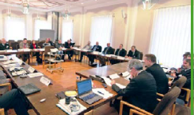
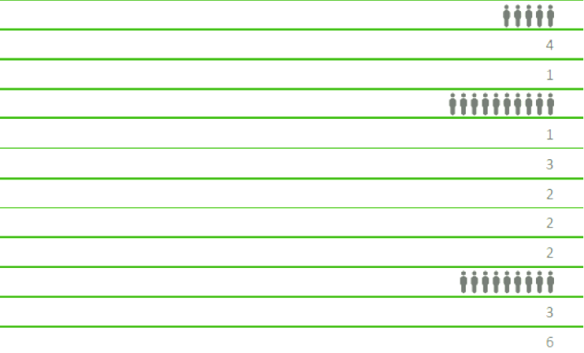
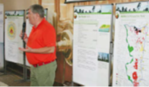
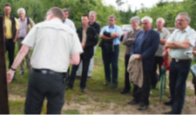
Participation in the Round Table
Round Table Hessian Ried:
Participating stakeholders,
Moderation: Dr. Bernd Kummer
Regional public administration
Ministry of environment
Ministry for economy
Interest groups
Forestry
Water suppliers
Environmental groups
Agricultural associations
Action groups against structural damages
Municipalities
Regional councils
Cities and communities
Source: Kummer, 2015
Notes:
Sources:
Heiland, P., Weiner, S. & Nemüller, J. (2017), ‘Practical planning approaches in the WEF-Nexus-context: Identification of Nexus-relevant processes with practical examples’, Powerpoint Presentation, Bonn, 30 March 2017.

Slide 13
Challenges Encountered
Costly process in terms of time and money for deliberations and negotiations
    The traditional approach of hiring consultants would be less costly
Sustainability of round tables and other problem-based (not management function based) participation configurations
Lack of political will to implement the recommendations elaborated by the Round Table
The interdisciplinary and cross-sectoral complexity of the subject (the need to consider different aspects in identification of the solutions: environmental, technical, legal and financial aspects)
Notes:
Notes:
The major challenges of the case study which were identified by the participants of the Hessian Ried Round Table:
1. The interdisciplinary and cross-sectoral complexity of the subject, caused by the following factors:
The diversity of the involved sectors
Different interests of the involved stakeholders
The need to ensure that recommendations have to meet the requirements of the different disciplines. For example, each recommendation has to be developed following the existing law requirements, hence each recommendation elaborated by the technical experts was verified by legal professionals
2. A major obstacle was the lack of political will to implement the recommendations elaborated by the Round Table.
Sources:
Christoph Ewen, Interview conducted on 28.11.2017

Slide 14

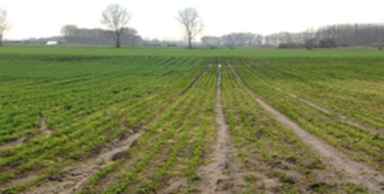
Case Study Challenges: Conflicts and Solutions
Different interests of the forestry sector, communities and agriculture (the need to increase the groundwater level for the forest and the risk of waterlogging for agriculture and settlement areas)
Different interests of the forestry and nature conservation associations (economic aspects and stable forest against biodiversity protection)
Notes:
Notes:
Examples of conflicts of interests and mechanisms to reach compromises and overcome challenges:
Conflict: Differing interest of the forestry sector, communities and agriculture:
The forestry sector is interested in raising of the groundwater level and voted for the implementation of the water infiltration system to increase the ground water level in the forest areas. However, the raising of the groundwater level causes the risk of waterlogging for the agricultural and settlement areas.
Hence, the recommendations for this problem have to include measures which provide sufficient water for forestry as well avoiding the negative effects for communities and the agricultural sector.
Solution:
For the forestry sector: The water infiltration system should be implemented in order to avoid the damages caused by low groundwater levels.
Measures to avoid negative effects on settlements: construction of water wells and extractions when the water table is too high, thus preventing excessively high groundwater levels.
Measures to avoid negative effects on agriculture: redesign the existing system of streams and ditches in order to limit the increasing of the ground level to the forest area.
Conflict: Differing interests of the forestry and nature conservation associations
Interests of the forestry sector: stable forest and economic interests (sale of timber)
Interests of the nature conservation associations: protection of biodiversity
Solution:
The rehabilitation and restoration of the degraded forest should start. However, all the measures and actions should be in accordance with the legal aspects of the nature conservation (especially in bird protection areas and in the protection areas of natural habitats and of wild fauna and flora). Hence, each action should be verified by legal professionals in order to ensure the accordance with the requirements of the environmental law.
Instrument to overcome conflicts: If consensus couldn’t be achieved, external, independent technical experts were asked to elaborate and submit additional technical reports. The reports were presented to the stakeholders and taken into consideration.

Slide 15
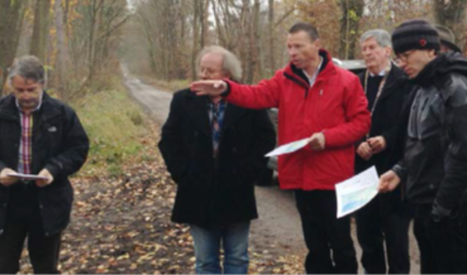
Participation in the Round Table: Why stakeholders want to cooperate
Strong complexity and interconnections between agriculture, forestry, groundwater and human settlements. Any decision in one sector directly affects the others
Based on previous experience, the actors know that they have to cooperate, otherwise decisions and changes can create negative impacts on their sector
Notes:
Notes:
The motivating factors for cooperation are defined based on the information provided by professionals who were responsible for communication throughout the entire process:
All sectors: land, water, human settlements, forest and biodiversity are strongly interconnected in the Hessian Ried. Each action and decision in one sector affects the others. Hence, the stakeholders in the region must cooperate with the other sectors, otherwise they can´t participate in the consensus building and any decision will cause negative effects for their sector
Because of the complexity of the natural conditions in the region, each change causes uncertainty in the affected sectors. Based on previous experience, the involved actors are aware that each change has the potential to cause problems. To avoid disadvantages for their sectors, the stakeholders prefer to cooperate
Some solutions are only possible through dialogue. For example, the water sector can only address the challenge of increasing nitrate pollution in cooperation and dialogue with the agricultural sector

Slide 16
Solutions: Cooperation in Water Supply and Agriculture
Voluntary cooperation used to confront the increasing nitrate pollution
    This includes cooperation with relevant specialists
    Consultation of farmers is also guaranteed
    Declining nitrate levels in the water demonstrated its success
The EU Water Framework Directive established a fundamental paradigm shift
    Threshold values are no longer exclusively formulated with regards to the drinking water quality
    Values are based off a comprehensive approach in protecting groundwater assets and interests
Notes:
Notes:
In Germany, the best practices of agricultural fertilisation are thoroughly regulated in the Fertiliser Ordinance. In water protection areas, the Water Law enables the possibility to make additional rulings that go beyond the existing regulations. However, in numerous instances the protected area regulations were outdated or lacking in specificity, hence the need for voluntary cooperation.
One of the examples of voluntary cooperation is the strong cooperation between water suppliers and the agricultural sector (agricultural cooperation) that aims at reducing nutrient pollution.
Motivation factors for the cooperation:
Generally, the various actors are willing to cooperate if they see a usefulness in working together. In the case study of Hessian Ried, the following motivation factors could be identified:
Water sector: Water supply actors have a deep interest in a safe groundwater supply. Therefore, water supply actors see common interests in cooperation with the agricultural sector in water protection areas.
Agricultural sector: Consultation services offered for the farmers could be identified as motivation factor for cooperation.
The State of Hesse provided financial support to offer consultation services for the farmers. Technical experts help the farmers to develop a targeted, nutritional fertiliser plan that is based on information gathered from their fields and considering the nutritional needs of the cultivated crops and the specific soil conditions of each cultivation area. This should optimise the use of fertilisers and thus reduce the risk of nitrogen leaching.
Benefit for the farmers: Through the recommendations of the technical experts, the farmers can implement new farming technology, reduce the use of chemical fertiliser and improve the quality of the crops offering ecological products.
Consultation of the farmers is guaranteed with start-up funding in the framework (3 years up to 60% funding, and a further 3 years up to 20-30% funding). Afterwards, the water supplier must bear all costs alone.
Positive results coming from this cooperation: Success of the agricultural cooperation was seen in the form of a declining nitrate concentration in the water. This became apparent after several years due to long residence times of the nitrogen in the soil.
Since the EU Water Framework Directive (2012), the State of Hesse has implemented and financed guidance measures that are based on defined areas of action. The balance of management restrictions was no longer undertaken at the level of individual farmers, but rather regulated by a state-wide agricultural environmental programme. The guidance measures should be integrated in the official agricultural services, which is viewed as critical from the side of the water suppliers.
Sources:
Wasserverband Hessisches Ried, Pressemitteilung, 04.04.2014, ‘Landwirte im Hessischen Ried sind sehr interessiert an Gewässerschutzberatung‘ Available at: http://presseservice.pressrelations.de/pressemitteilung/landwirte-im-hessischen-ried-sind-sehr-interessiert-an-gewaesserschutzberatung-561488.html
Wasserverband Hessisches Ried, Pressemitteilung, 30.03.2012 ‘Beginn der Gewässerschutzberatung in den Kooperationsräumen "Südliches Ried" und "Riedsande"‘, Available at: http://www.wasserverband-hessisches-ried.de/html/berichte.html

Slide 17
Nexus Evaluation
A trustworthy cooperation between the different user groups is required
Binding groundwater management plans accomplish planning security for all parties
The monitoring of groundwater levels and groundwater quality is a vital step
Voluntary cooperations position the actors to work together
Configurations that are:
    Based on specialist knowledge
    Neutral to special interests
    Geared to the long-term
The implementation of policies requires dependable political decisions
Notes:
Notes:
From the Nexus perspective, groundwater should be recognised as protected property, independent from its use. Actors involved in water supply generally have a deep interest in a safe groundwater supply. It is therefore clear that in water protection areas, a proactive approach for cooperation with the agricultural sector originates from these water supply actors.
Binding groundwater management plans represent an important regulatory instrument that guarantees the minimum requirements for all concerns and interests. They also allow continual optimisation processes.
The monitoring of groundwater levels:
Enables preservation of evidence and transparency
Allows the active control of groundwater abstractions and infiltration
Is the basis for further impact assessments and risk assessments
Provides actual results which form the basis for negotiations and cooperation as well as improving transparency towards the public
Voluntary cooperations are successful when the various actors see a usefulness in working together beyond their own area of responsibility. The cooperation should be equitably designed.
Dependable political decisions are particularly important for the financing and building of sustainable structures.
At this point, reference can be made to the slide “Nexus Cooperation in Germany” that was presented earlier. The processes implemented in the management of groundwater in the Hessian Ried can be considered within the policy framework for Nexus coordination in Germany.

Slide 18
Thank you for your time!
In cooperation with

