Slide 1







Module II - Institutions, processes and tools for institutionalizing the WEF Nexus
In cooperation with
Notes:
Notes:
As we learned in module 1, it is useful to think and act across sectoral boundaries, as there are so many interlinkages among water, energy and food sectors as well as between these sectors and overarching challenges like climate change
If we do that, we will be able to mitigate or even avoid often costly impacts that arise if we think purely within limited sectoral lines
Even more so, we might be capable to harness additional benefits as there are multiple opportunities for synergies
However, making use of potential benefits of the nexus approach is often complicated if not prevented by a range of challenges – ranging from silo thinking within administrations, lack of knowledge and awareness, missing data, financial structures etc.

Slide 2


What is this module about?
  Learn about how the WEF Nexus approach can be anchored within institutions and processes through:
  Assessment tools that help to analyze WEF sectors and impacts of Nexus interventions
  Governance mechanisms, including institutional structures to facilitate coordination across sectors and different administrative levels as well as policy instruments
  Financial frameworks that enable the implementation of Nexus solutions
Notes:
Notes:
In the previous module we have learned about nexus challenges and some solutions. However, such solutions shouldn’t be one-off events. We have learned that a nexus approach can have an important role in fostering synergies in achieving overall development strategies, or in preventing trace-offs, such as maladaptation to climate change. In order to support that nexus solutions are up-scaled and support sustainable development in the long term, a nexus approach should be mainstreamed into policies and decision making processes. Therefore in this module, we will learn how a WEF Nexus approach can be integrated and anchored within institutions and processes
We will learn about
assessment tools that can help us to analyze WEF sectors and impacts of Nexus interventions as a basis for further decision making
Governance mechanisms, including institutional structures to facilitate coordination across sectors and different administrative levels as well as policy instruments
And lastly, we will learn about financial frameworks that will enable us to implement Nexus projects
It is these three sets of tools and instruments that we think provide important leverage to anchor the principles of WEF Nexus within political, financial and project structures.

Slide 3
Outline
Chapter 2.1: | Assessing the Nexus – Assessment tools for decision support WEF Nexus context analyses Assessing impacts of changes Assessment of specific Nexus interventions Interactive Exercise: selecting Nexus indicators
Chapter 2.2: | Governing the Nexus Horizontal and vertical policy coordination Case studies policy coordination Policy instruments to incentivize resource efficiency Interactive exercise: policy analysis
Chapter 2.3: | Cross-sectoral investment planning and financing Introduction and definitions Demonstrating the economic added value of Nexus solutions Mobilizing finance to implement Nexus solutions Interactive exercise: pitching your Nexus project
Notes:
Notes:
These three key learning objectives are mirrored in three separate chapters of Module II:
Chapter 2.1
In this chapter we will look at how we can assess the Nexus
We will shed light on various assessment tools that can be used to gain a better understanding of an existing Nexus context and how it may change. This can be an important basis for mainstreaming the WEF nexus, for example in policies and strategies
The Chapter will introduce the broad-variety of assessment instruments that exist and the various benefits of these assessments for improving inter-sectoral collaboration, identifying cross-sectoral nexus solutions and for measuring the impacts of different nexus policies and projects.
Chapter 2.2
Nexus mainstreaming has to begin at the governance level which sets the broader framework for mainstreaming the WEF nexus approach
Chapter 2.2 is therefore dedicated to this topic
We will look at 2 broader categories of tools that policy makers have at hand to mainstream the WEF Nexus within their national context
This includes firstly instruments to improve coordination and collaboration across different sectoral lines as well as across different government levels (from national to local) – in form of various institutional entry points for horizontal and vertical policy coordination
Secondly, policy makers can also provide important incentives to institutionalize the WEF-Nexus through policy instruments – e.g. in form of regulatory or financial instruments
We will therefore look at some selected policy instruments that can be employed to incentivize nexus solutions
Chapter 2.3
Lastly, we will take a closer look at another aspect that is crucial to implementing WEF Nexus approaches: cross-sectoral investment planning and financing.
We will look at some of the methods and tools that can help demonstrating the economic added value of Nexus solutions.
Finally, we will gain an overview of which financing frameworks enable implementing Nexus solutions and what financing sources are available to support multisectoral programmes or projects.

Slide 4
Outline
Chapter 2.1: | Assessing the Nexus – Assessment tools for decision support WEF Nexus context analyses Assessing impacts of changes Assessment of specific Nexus interventions Interactive Exercise: selecting Nexus indicators
Chapter 2.2: | Governing the Nexus Horizontal and vertical policy coordination Case studies policy coordination Policy instruments to incentivize resource efficiency Interactive exercise: policy analysis
Chapter 2.3: | Cross-sectoral investment planning and financing Introduction and definitions Demonstrating the economic added value of Nexus solutions Mobilizing finance to implement Nexus solutions Interactive exercise: pitching your Nexus project
Notes:
Notes:
The objective of this session is to
Raise awareness on the fact that understanding of the nexus is the basis for decision-making and requires dialogue between science, policy, and stakeholders.
Understand that assessments can be done with different objectives – for a better understanding of the Nexus context, existing synergies and trade-offs, for predicting impacts of changes in the context on the nexus situation, and last but not least for assessing the impact of nexus projects and interventions.
You will learn about a broad variety of assessment approaches and instruments that exist to assess the WEF Nexus natural resource base as well as related governance frameworks
After a short introduction we will look at approaches for:
WEF Nexus context analyses
Assessing impacts of changes
Assessment of specific nexus interventions

Slide 5
Introduction
Chapter 2.1: Assessing the Nexus – Assessment tools for decision support

Slide 6















Let’s get back to Ms. Sinclair…
Notes:
Notes:
[Storytelling Intro – adjust names to local context]
Let’s get back to Ms. Sinclair.
You remember that she is the head of city administration of Mostanova where she is responsible for electricity supply.
We have learned that her proposal to exploit the potential for solar energy for electricity supply of the city has raised concerns from her colleagues responsible for agriculture and water resources.
At the end, Ms. Sinclair had realized that her idea of bringing solar energy to Mostanova would require many more discussions with her colleagues.
In order to be well prepared for those discussions, Ms. Sinclair would have to know how the three sectors, water energy and food production really impact on each other, how much agricultural land a solar panel field would occupy, to what extent decreasing energy prices would indeed encourage groundwater abstraction. Also she would have to better understand whether the water resources are really under stress, whether there is indeed competition for agricultural land or whether agricultural production in the region is even predicted to increase in order to ensure local food supply for the increasing urban population. In order to really make her arguments she therefore needs to assess the WEF nexus. She needs to better understand the existing resource situation, challenges in each sector, how they are interlinked and regulated by existing policies, so the whole WEF context. She would also have to know how this situation is expected to change due to ongoing developments, such as population growth, industrialisation, or policy goals to mitigate and adapt climate change.
Based on this assessment she might be able to present a convincing solution, such as the combined use of land for agriculture and solar panels as we have seen in the example of so-called Agrivoltaics in Module I – or there might be other solutions, such as stricter regulation of groundwater abstraction. Again, in order to make a convincing case for these solutions, MS Sinclair would have to asses the impacts that such interventions would have on the situation of the three sectors – but also on the population of Mostanova and on sustainability in general. A comprehensive assessment will allow MS Sinclair to demonstrate the potential benefits of her solution - but also help Ms. Sinclair to make sure that her activity doesn’t have other unintended side-effect, such as on ecosystems, local livelihoods etc.
-------
This example from Mostanova brings us straight to the topic of this training which is about the different approaches and tools for assessing the WEF Nexus

Slide 7
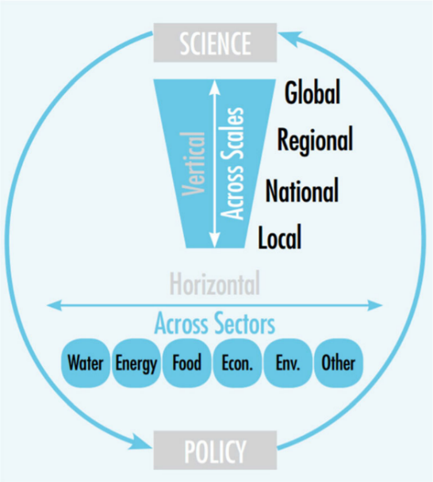
Nexus assessment for decision support - Interconnectedness and Scale
Source: Daher et al., 2017
Notes:
Notes:
Nexus assessments can provide important information on the status and interlinkages across different natural resources and economic sectors – which is the basis for decision making for sustainable development of these sectors
In order to ensure the up-take of knowledge and information in decision making, however, science needs to provide assessments that are also relevant to policy and planning – an policy and decision makers - in turn - need to consult experts and scientific studies to inform decision making processes
This can be supported by accompanying nexus assessments through policy-science and stakeholder dialogues. - to ensure that science meets the needs of decision-makers and to include stakeholder knowledge into the assessments
Together these actors can define relevant questions to support decision making at different scale, from local to global.
Examples of relevant questions at various scales could be
Global Scale: What would be the global impacts on food prices if corn was allocated for ethanol production in major corn producing countries?
Regional Scale: How would increasing agricultural production in the upstream countries of a basin impact on hydropower production downstream?
National Scale: How would promoting renewable energy generation, such as biomass and biogas production, impact on water quantity and quality?
Local Scale: How would sustainable agricultural practices impact water availability and quality?
Sources:
Daher, B., Saad, W., Pierce, S.A., Hülsmann, S. & Mohtar, R.H. (2017), ‘Trade-offs and Decision Support Tools for FEW Nexus-Oriented Management’, Curr Sustainable Renewable Energy Rep, vol. 4, Iss. 3, pp. 153-159.

Slide 8
Various scopes of assessment
Context analysis – what is the current situation in the Nexus sectors and how are they interlinked
Assessing impacts of changes: develop development/policy scenarios and analyse/quantify impacts on sectors and sustainability
Assessment of specific interventions in terms of their efficiency in resource use, social, economic and environmental impacts
Comparison of interventions
Notes:
Notes:
Nexus assessments can be applied with different assessment objectives at scope:
They can assess the current situation in terms of water, energy and food security and how these are interlinked in the specific system at scope – for example to get a general understanding of the existing resource security situation in the country or for assessing the nexus performance of relevant sector – e.g. is the water sectors energy-efficient, is food production water-and energy efficient. A comprehensive context analysis should also look at the existing governance framework and assess for example, whether there are trade-offs in existing strategies e.g. subsidies for renewable energy use in agriculture that would encourage over-pumping of groundwater.
Based on a proper understanding of the context, further assessments can analyse the impact of changes, such as climate change and other global changes, or the impacts of development strategies on the WEF nexus system
Nexus assessments can also look at specific interventions, be it technical solutions or policy instruments, and assess how effective they are in improving the WEF nexus in all its dimensions while also assessing their sustainability in terms of environmental, social and economic aspects – assessments of specific intervention can then help to compare different proposed solutions

Slide 9


Time for some reflection!
What approaches and tools for assessing WEF nexus situations, interlinkages, or impacts are you aware of?
Have any been applied in your own regional context?
Notes:
Notes:
Before we look into different Nexus assessment tools and approach, and their uses to support decision-making, we would like to reflect upon this question in your professional/regional context and ask you to answer the question on this slide [via mentimeter in virtual settings]:
„What approaches and tools for assessing WEF nexus situations, interlinkages, or impacts are you aware of?“
Have any been applied in your own regional context?
Additional information:
The questions to guide the participants might need to be adjusted to their specific backgrounds to help them better understand the possible answers that they could provide.
Collect the answers and , where possible, make connections to input that is still coming or aspects that have already been dealt with in previous chapters

Slide 10
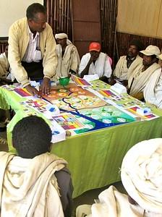
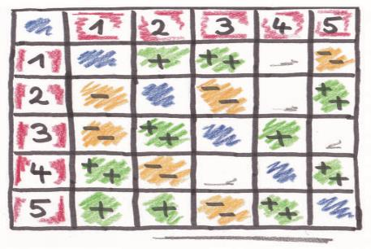
Examples of assessment approaches
  Collaborative/participatory tools (workshops, questionnaires, focus groups, etc.)
  Governance assessment
  Policy coherence assessment
  Indicator frameworks (sectoral/cross sectoral)
  Conceptual visualisation tools/mapping
  Modelling tools
Notes:
Notes:​
​
There are different approaches to assessing WEF nexus systems [make reference to those approaches that have been mentioned in the interaction] – most of them can​
​
Participatory tools are often used to develop a general understanding of the nexus system, to understand the different resource uses and interests of various stakeholders, They also help to validate results from other assessments.​
Legal, policy and institutional frameworks play a strong role in how resources are managed. Therefore it is important to assess the existing governance framework to identify barriers for adopting a nexus approach, such as the (missing) processes hindering a coordinated Nexus planning process.​
Policy coherence assessments can help identify contradicting policy objectives, or missing policies which hinder a sustainable Nexus management.​
​​
Indicator frameworks can be helpful to describe the current nexus situation, especially with regards to resources securities and resources uses. The same indicators can then also help to assess the impacts of alternative development scenarios, or to describe the impact of specific interventions. ​
While visualisation tools help to qualitatively conceptualise the main components and their interlinkages, ​
Modelling tools usually evaluate the weight of each component in a quantitative manner based on Nexus indicators. Models typically use monthly time series for variables such as water, yields, agricultural areas, climate and energy production to simulate determined target variables depending on different inputs. They can be used to assess the sensitive components of a system (where changes in one component cause significant changes in the others) and to simulate future scenarios for decision support in planning. ​
​
​
​

Slide 11
Value of nexus assessments
  Facilitating inter-sectoral dialogue: shared knowledge base for prioritizing issues, identifying synergies and trade-offs
  Joint identification of cross-sectoral nexus solutions e.g. synergetic RE projects, sustainable catchment management, etc. and discussing necessary nexus investments
  Initiating, broadening, revisiting coordination/cooperation frameworks (baskets of benefits)
  Insights on impacts of policies and strategic decisions, e.g. from modeling and scenarios on key questions
Notes:
Notes:
Before we go into more detail of show-casing some relevant assessment approaches and tools for Nexus assessments, I would like to point out that these assessments do not only help to gain a better understanding of the WEF securities – if carried out in collaboration with various actors and stakeholders they further can bring a number of overall benefits ranging from
Facilitating inter-sectoral dialogue: a shared knowledge base can serve as basis for jointly prioritizing issues, identifying synergies and trade-offs
Based on this, it can also help joint identification of cross-sectoral nexus solutions e.g. synergetic RE projects, sustainable catchment management approaches, etc. and discussing necessary nexus investments
Initiating, broadening, revisiting coordination/cooperation frameworks by bringing in additional sectors and highlighting potential synergies that can be achieved through coordination, for example in transboundary basins, where a focus on water issues only often seems to be a zero sum game, but win-win solutions can be identified if one looks at broader scope of resources including energy and land resources
When developing policy instrument and new strategies, assessment can provide insights on impacts of policies and strategic decisions on the WEF Nexus sectors and sustainability. For example from modelling and scenarios on key questions related for example to optimization of resource use (land, water/dams for food and energy production) or to infrastructure planning (hydro, flood & droughts)
Sources:
https://www.youtube.com/watch?v=Y0piDg833Xc&t=9s

Slide 12
WEF Nexus context analyses
Chapter 2.1 Assessing the Nexus – Assessment tools for decision support

Slide 13
Context Analysis – what is the current situation?
Current state of WEF security and pressures on natural resources systems
Interconnections between water, energy and food systems
Socio-economic situation and expected developments, trends and drivers
Planned investments, acquisitions, and large-scale infrastructure
Policy framework: sectoral goals, and policies; coherence and, extent of regulation
Key stakeholders, decision-makers and user groups, existing coordination mechanisms
Notes:
Notes:
A comprehensive context analysis lays the foundation for further analysis. A context analysis includes collecting data on both the status of the ecosystem, its resources and their uses as well as socio-economic and governance aspects. Different tools can be used to assess these aspects.
The context analysis should cover:
Current state of WEF security and pressures on natural resources systems
Interconnections between water, energy and food systems - how much water is used for producing food, including for export etc.
Socio-economic situation and expected developments, trends and drivers – levels of income, main economic activities, expected population growth and economic development, climate change
Policy framework: sectoral goals, policies and strategies; coherence of policies, extent of regulation of uses
Key stakeholders, decision-makers and user groups, conflicting interests and existing coordination mechanisms
Planned investments, acquisitions, and large-scale infrastructure
In the next slides we will look at two assessment approaches that are often used in context analyses, indicators and policy coherence analysis.
Sources:
Flammini, A., Puri, M., Pluschke, L. & Dubois, O (2014), ‘Walking the Nexus Talk: Assessing the Water-Energy-Food Nexus in the Context of the Sustainable Energy for All Initiative’, Food and Agriculture Organization of the United Nations, Rome.

Slide 14
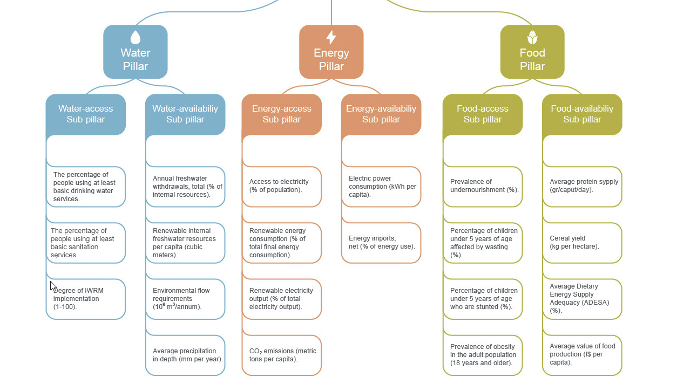
Context analysis
WEF Nexus Index
Source: wefnexusindex.org
Notes:
Notes:
Indicators can support context analysis as well as the assessment of changes with regard to the current state of WEF security and pressures on natural resources systems. The advantage of indicators is that they allow for comparison against a baseline or across different scenarios and regions.
There are a number of sectoral indicators that provide information on the current state of resources security, and availability, such as access to water supply, energy imports, or cereal yields.
The WEF Nexus Index developed by the Water Research Commission South Africa together with IHE Delf, for example provides information on a number of sectoral indicators that describe the sectoral resource securities on a national level. This can help assessing national progress relating to integrated resource management as well as supporting decision making and policy development towards strategic goals.
Besides the sectoral indicators used in the WEF Nexus Index shown here, there are also a number of socio-economic indicators that can be used to describe the socio-economic context in which resource use is taking place, such as number of men and women employed in the agricultural sector,
Sources:
https://wefnexusindex.org/about
The websites provides WEF Nexus index numbers for almost all countries in the world, you may want to take a look at those that are relevant to you.

Slide 15
Context analysis
Examples of cross-sectoral indicators
Total fossil energy consumption in agriculture / agricultural gross production value | e.g. [USD/GJ]
Area under agricultural water management as a % of irrigation potential | %
Share of monitoring sites in agriculture areas that exceed recommended drinking water limits for nitrates, phosphorous and pesiticides in surface water and groundwater | %
Agricultural water productivity | [kg/m³] or [USD/m³]
Water or energy use efficiency in different sectors | e.g. [USD/m³]
Indicator selection should be adapted to context and scope of analysis
Notes:
Notes:
There are fewer examples of cross sectoral indicator frameworks, Examples include
Total fossil energy consumption in agriculture / agricultural gross production value which could be measures in USD per Giga Joule
Area under agricultural water management as a % of irrigation potential
Share of monitoring sites in agriculture areas that exceed recommended drinking water limits for nitrates, phosphorous and pesticides in surface water and groundwater
Agricultural water productivity
Water or energy use efficiency in different sectors
For some of them data is available from existing data bases, such as e.g. World Bank Global Development indicators

Slide 16
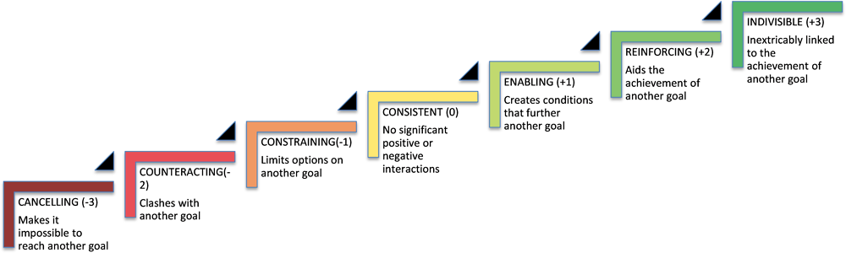
Context analysis
Assessing policy coherence
Scoring system for assessing the interaction of policy objectives (Nilsson et al. 2016)
Source: OECD 2018
Notes:
Notes:
A second important aspect in context analysis is the governance framework, including relevant institutions and policies. In order to assess whether the existing policies are coherent or contradict each other, a scoring system was developed by Nilsson et al in 2016 to assess coherence between the SDGs, which can as well used for assessing coherence of nexus relevant policies.
The Scoring system for assessing the interaction of policy objectives assesses trade-off and synergies with values ranging from -3 which is cancelling, meaning that achieving one goal makes it impossible to reach another goal, to the maximum synergy which is called indivisible, if reaching one goal is inextricably linked to the achievement of another goal.
Examples related to the WEF Nexus would be:
The policy goal to provide access to electricity aids the policy goal to provide water-pumping for irrigation systems, so the coherence between these two goals would be rated as +2 reinforcing
If we look at trade-offs, The goal to achieve improved water efficiency or, for example can limit agricultural irrigation. Or the goal to mitigate climate change can limit the options for energy access. So these pairs of goals would be rated as -1 constraining
Sources:
Nilsson, M., D. Griggs and M. Visbeck (2016), “Map the interactions between Sustainable Development Goals”, Nature, Vol. 584, pp. 320-322, http://dx.doi.org/10.1038/534320a
Image Reference:
OECD 2018: Policy Coherence for Sustainable Development 2018. https://doi.org/10.1787/9789264301061-en

Slide 17
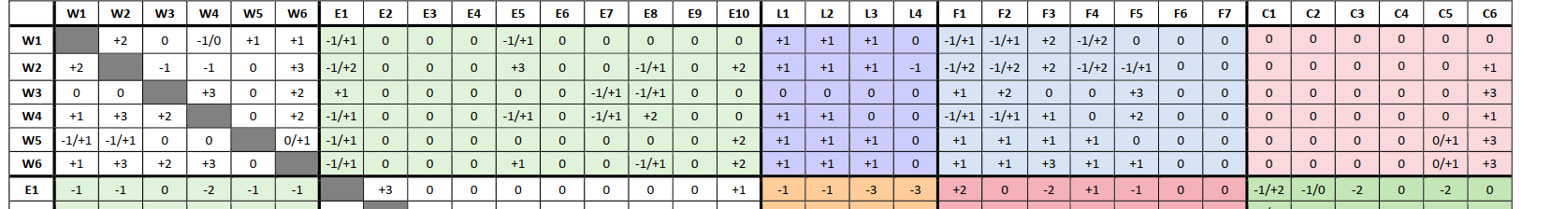
Context analysis
Policy coherence screening matrix
Coherence among policy objectives in the water‐energy-land‐food‐climate (WELFC)‐nexus domains (SIM4NEXUS)
First identify main policy objectives in each sectoral policy (W1-5, E1-10, etc.)
Then estimate what happens to objective x → (affected)
…if we make progress on objective y ↓ (affecting)
based on expert judgement, literature and modelling
Source: Munaretto et al 2017
Notes:
Notes:
This previous scoring system, ranging from cancelling to indivisible was used in the SIM4NExus Policy coherence screening matrix for pairwise assessment of policy objectives included in relevant sectoral policies.
The SIM4NExus projects used it to assess coherence of EU policies. For this, first the main policy objectives are identified for each sectoral strategy, and numbered (e.g. goals W1-5 for the main goals of the water framework directive, etc.) Then, asking what happens to objective x if we make progress on objective y, the goals’ coherence are assessed pairwise.
CLICK
For example, in SIM4NExus they looked at EU water policy objective W2 which was defined as “Ensure sufficient supply of good quality surface water and groundwater for people’s needs, the economy and the environment”, and then asked what happens if we make progress on EU energy policy objective E5 which aims to “Increase hydro‐energy production”.
The assessments were based on expert judgement, literature and modelling as far as possible and in - this case - came to the conclusion that making increasing hydro‐energy production would come along with ensuring sufficient water supply.
Sources:
Munaretto et al 2017: Deliverable D2.1 water-land-energy-food-climate nexus: policies and policy coherence at European and international scale. SIM4NEXUS https://www.sim4nexus.eu/page.php?wert=Projectoverview
Nilsson, M., Zamparutti, T., Petersen, J. E., Nykvist, B., Rudberg, P., & McGuinn, J. (2012). Understanding policy coherence: analytical framework and examples of sector–environment policy interactions in the EU. Environmental policy and governance, 22(6), 395-423.

Slide 18
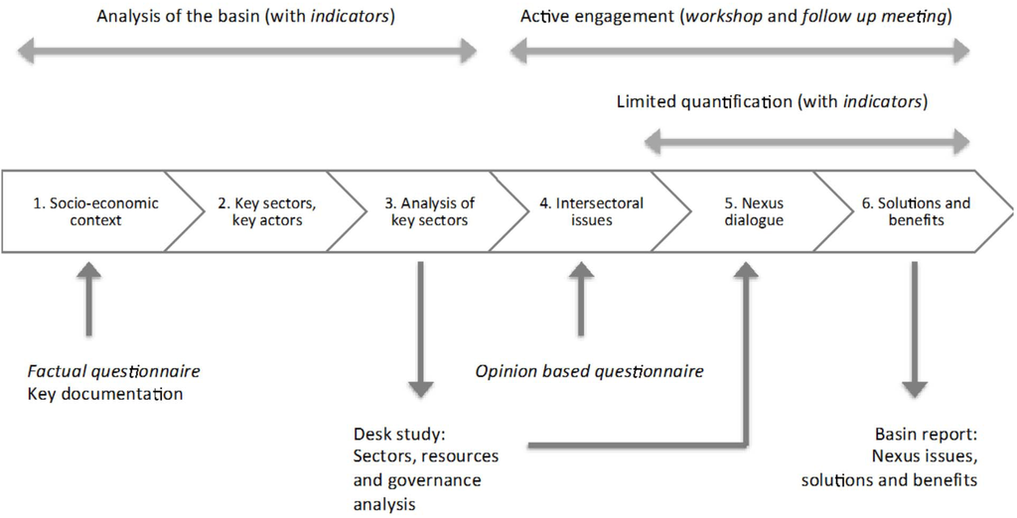
The Transboundary River Basin Nexus Approach (TRBNA)
Source: de Strasser et al., 2016
Notes:
Notes:
An example of a comprehensive framework for context analysis is the Transboundary River Basin Nexus Approach (TRBNA) that was developed under the UNECE Water Convention. It uses indicators and governance analyses to assess the Nexus context in a basin (see step 1-3 in the scheme).
These assessments are complemented by opinion based questionnaires collecting assessments from experts and stakeholders. Based on these different assessment, Stakeholder dialogues are carried out in order to jointly identify solutions.
The TRBNA has been applied in several transboundary basins in Eastern Europe, Central Asia, the Caucasus, and the MENA region to inform, support and promote transboundary cooperation and to assist countries by:
Identifying interconnections (trade-offs and impacts) across sectors and countries as well as incoherencies in governance
Proposing actions to reduce negative impacts, minimise trade-offs and take advantage of existing complementarities and win-win opportunities to incentivise cooperation
Providing evidence of benefits from improved cooperation at the national and transboundary levels
While each TRBNA basin nexus assessment concludes with the identification of possible “nexus solutions” to be implemented, it can only provide directions. These Nexus assessments rather aim to bring stakeholders together, to increase the knowledge base to support decision-making, to promote dialogue between the countries and sectors, and to identify nexus issues and solutions. Implementation of the identified solutions goes beyond the aims of the assessment. Implementation would require the that identified nexus solutions and their related targets and instruments are taken on in the riparian countries themselves and included in national and sectoral strategies and plans. Strong multisectoral planning at transboundary and national level would enhance the effectiveness of implementing the identified nexus solutions.
Sources:
de Strasser, L., Lipponen, A., Howells, M., Stec, S., Bréthaut, C. (2016), ‘A Methodology to Assess the Water Energy Food Ecosystems Nexus in Transboundary River Basins’, Water, vol. 8, Iss. 2, 59. doi:10.3390/w8020059.
For an overview of how the framework was applied in various basins check this story map: https://grid-arendal.maps.arcgis.com/apps/Cascade/index.html?appid=7101ef4dfcfb40e98cdc31b2e9d7da10

Slide 19
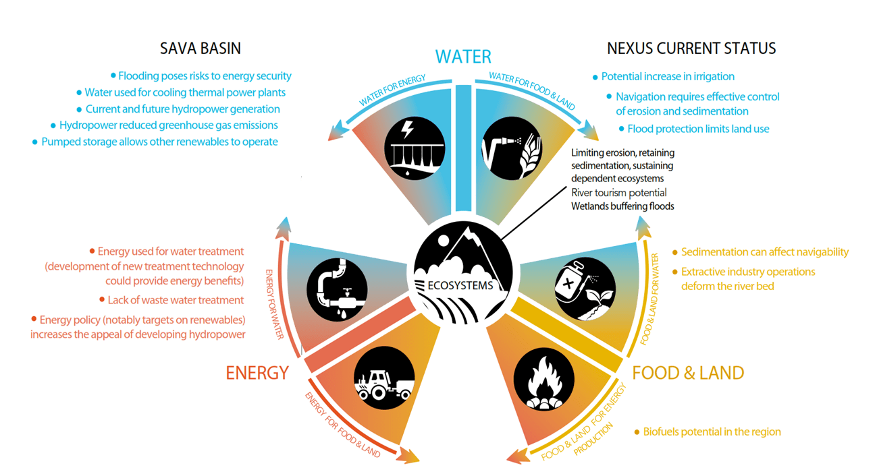
TRBNA in the Sava Basin
Notes:
Notes:
The UNECE Transboundary River Basin Nexus Approach (TRBNA) was implemented for example in the Sava River basin in the Western Balkans, which is home to 8.1 million people covering a total area of 97,713 km². The basin is critical in ensuring energy, water and job security. Its water resources are fundamental for economic development and support significant agricultural production and navigation.
The nexus assessment in the Sava river basin made clear how the resources are intertwined. For instance, energy production in the Sava countries depends heavily on water availability. In dry spells power generation from hydropower plants decrease, while flooding results in the shutdown of thermal plants (as their cooling systems are compromised) and affects the operation of coal mines, posing risks to energy security. And the basin’s resources are under increasing pressure from economic developments and climate change.
The assessment brings important insights for government and local actors and points at the importance of coordination between river basin management planning and national strategies. For instance, the assessment showed that hydropower in the basin can support the integration of other renewables, helping the countries to meet (and even surpass) their targets for renewable energy and climate mitigation, but this development needs to be compatible with river basin management objectives, including the protection of natural infrastructure assets such as floodplains and wetlands. To this end, the assessment suggests a consultation process to review the impacts of national and sectoral development strategies.
Sources:
https://grid-arendal.maps.arcgis.com/apps/Cascade/index.html?appid=7101ef4dfcfb40e98cdc31b2e9d7da10
https://unece.org/sites/default/files/2021-04/ECE_MP.WAT_NONE_4_Eng_Policy-Brief-SAVA-WEB.pdf
https://unece.org/sites/default/files/2021-04/Nexus-SavaRiverBasin_ECE-MP.WAT-NONE-3_WEB_drupal_01.pdf

Slide 20
Assessing impacts of changes
Chapter 2.1 Assessing the Nexus – Assessment tools for decision support

Slide 21
Various scopes of assessment
Context analysis – what is the current situation in the Nexus sectors and how are they interlinked
Assessing impacts of changes: define development/policy scenarios and analyse/quantify their impacts on sectors and sustainability
Assessment of specific interventions in terms of their efficiency in resource use, social, economic and environmental impacts
Comparison of interventions
Notes:
Notes:
We will now look at approaches that can not only assess the current situation but help assessing the impacts of changes to the WEF systems and their context.
This is usually done by firstly defining possible development scenarios or policy scenarios and then analysing their impacts in qualitative or quantitative terms.
Qualitative analyses of scenarios can be done in participatory workshops using visualisation tools or impact matrices.
Quantitative analysis is usually done through modelling.

Slide 22
Visualisation Tool - Nexus Interconnections Diagram
Source: Meza et al., 2015
Notes:
Notes:
Let us first look at an example of a graphical visualisation approach used to provide information on nexus interlinkages that can also be used as a basis for a qualitative participatory analysis.
Meza et al. (2015) presented this conceptual qualitative tool to illustrate the interconnections between the different Nexus components
In this tool Systems or sectors are treated as separate units
Each compartment is divided further into sub-components (e.g. surface and groundwater; renewable and non-renewable energy sources; food products or biofuels)
The relative size of the sub-components can be an indicator of sensitivity so components of a system where changes in one component cause significant changes in the others
Arrows indicate influence or supply/demand from one component to another. The size of the arrows is used to communicate magnitudes of the supply (or demand). If several arrows direct away from the same source, this indicates competition for this source.
This visualisation tool was developed to raise awareness and support stakeholder discussions to provide decision support at the river basin scale but can also be applied to different scales.
Sources:
Meza, F.J., Vicuna, S., Gironás, J., Poblete, D. Suárez, F. & Oertel, M. (2015), ‘Water–food–energy nexus in Chile: the challenges due to global change in different regional contexts’, vol. 40, Nos. 5-6, pp. 839-855. doi: 10.1080/02508060.2015.1087797

Slide 23
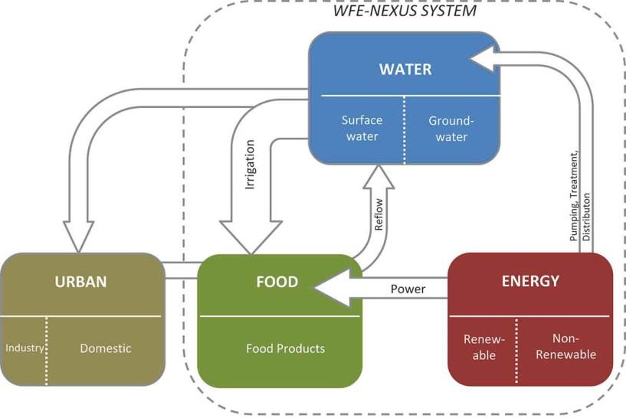
Example: Maipo Basin
Note: The arrows with dotted lines represent projected changes: either the changing thickness of an arrow or the addition of a new arrow.
Hydropower
Meza et al., 2015
Notes:
Notes:
Meza et al. (2015) applied this concept to several river basins in Chile. Here, a brief example of the Nexus interconnections diagram for the Maipo Basin in central Chile is shown.
The basin includes Santiago, Chile’s capital with a population of 6 million. The region has a Mediterranean climate with mean temperatures of 20°C in summer and 10°C in winter. Mean annual precipitation is 280 mm. Snow accumulation occurs above 1,500 m altitude during winter.
The main economic activities in the basin include industry, commerce and services along with an export-oriented agricultural sector.
The figure (without the arrows with dotted lines) depicts the current status of the Nexus in the basin, while the arrows with dotted lines represents the changes to the system in a future scenario with changes and pressures impacting on the system. For instance, it is expected that in the future more energy will be required for pumping, treating and distributing water for cities. Agriculture has to be more efficient in using water in order to reduce the pressure on water resources or the potential of groundwater use needs to be explored. Also, the basin has potential for hydropower generation.
This example shows the potential of this tool to visually assess future management scenarios.
Sources:
Meza, F.J., Vicuna, S., Gironás, J., Poblete, D. Suárez, F. & Oertel, M. (2015), ‘Water–food–energy nexus in Chile: the challenges due to global change in different regional contexts’, vol. 40, Nos. 5-6, pp. 839-855. doi: 10.1080/02508060.2015.1087797
Available at: https://www.researchgate.net/publication/283172261_Water-food-energy_nexus_in_Chile_the_challenges_due_to_global_change_in_different_regional_contexts

Slide 24
Modelling Tools to Assess the WEF Nexus
  Models are used to simulate complex socio-ecological systems
  They help us understand interconnections between drivers (e.g. climate, socioeconomic development) and the individual elements of the WEF Nexus
  Models can simulate future scenarios as decision support for planning
  Uncertainties need to be considered!
Notes:
Notes:
Simulation models are widely used to improve the understanding of the interconnection between the nexus components and drivers of change.
Models can be used to simulate physical processes such as groundwater recharge, rainfall-runoff generation and climate, as well as socio-ecological systems such as food production and water requirements, water and energy demand, reservoir use for energy generation and irrigation.
The downside of complex models is that they usually need significant data input which is not always available. Moreover setting-up, adapting and running models requires considerable skills, including technical and human capacity.
However any model is based on the data and assumptions that are used to build the model.
When basing decisions on the outcomes of models, uncertainties included in the assumptions that form the basis for the models always need to be taken into account!

Slide 25
Approaches of Modelling Tools to assess the WEF Nexus
Fully integrated, multi-resource modelling tools
- interlinkages can be investigated with the use of only a single software
Extended (single system) models
- a sectoral model is complemented with additional components
Single models that are combined through soft-linking
- different models are available for different sectors, e.g., WEAP, LEAP, GAEZ, OSeMOSYS, CropWat, Agent-based models, etc.
Notes:
Notes:
There are different approaches to modelling nexus systems:
fully integrated, multi-resource modelling tools in which interlinkages can be investigated with the use of only a single software
extended (single system) models, where a sectoral model is complemented with additional components
Modelling approaches that combine single models through soft-linking
Indeed there is a large scope of available simulation models to assess the interconnections between the different sectors. These include
WEAP Water Evaluation and Planning system
LEAP Low Emissions Analysis Platform
GAEZ Global Agro-Ecological Zones
OSeMOSYS Open Source energy Modelling System
CropWat developed by FAO to compute crop water requirements
Etc.
The appropriate selection of models to use will depend on: (i) the system to be analysed (which must also consider the spatial and temporal scales); (ii) the expected outcome of the modelling exercise; (iii) available data; and (iv) know-how.

Slide 26
Climate, Land Use, Energy and Water Systems (CLEWs) framework
  Integrated system approach to assess Nexus interconnections with the aim to:
    Understand the systems within their natural or organizational boundaries
    Assess interconnections between different resource sectors to attain insights into trade-offs and potential synergic solutions
    Provide policy relevant information
  Highlights the need for a collaborative approach incl. stakeholders
  Considerable number of applications, spanning different spatial and temporal scales and political contexts
  Requires considerable data and expert involvement
Notes:
Notes:
One example framework that makes use of existing models is the “Climate, Land use, Energy and Water Systems (CLEWs)” framework that has been applied in a number of case studies at different scales from local to national, basin, regional and global.
Initially introduced by the International Atomic Energy Agency to conduct an integrated systems analysis of a biofuel chain, it has been further developed under the leadership of the Swedish Royal Institute of Technology in collaboration with a number of leading international institutions including FAO, IIASA, SEI, UNDESA and UNECE
The aim of the CLEWs framework is to provide an integrated system approach to assess interconnections between different resource sectors, to determine the effect that changes in one sector might have on the others, identify counter-intuitive feedbacks, to provide insights regarding the trade-offs between conflicting uses and help highlight potential synergic solutions to overcome them.
the end goal is informing policy design and planning processes, the assessment of policies, or the elaboration of policy recommendations
It is a module-based approach that can combine the energy model LEAP, water model WEAP and land use model AEZ (Agro-Ecological Zoning).
has been implemented in several case studies such as Mauritius and Burkina Faso, as well as for global resource modelling using the open source energy modelling system (OSeMOSYS).
The tool, however, has extensive data requirements including technical and economic parameters for the energy, water and land use sectors and requires expert involvement.
Sources:
A TEDx talk on CLEWs can be found at: https://www.youtube.com/watch?v=awTs5zH-4G8
Department of Energy Technology (n.d.), ‘CLEWs - Climate, Land, Energy and Water strategies to navigate the nexus’, KTH Royal Institute of Technology, Available from: https://www.kth.se/en/itm/inst/energiteknik/forskning/desa/researchareas/clews-climate-land-energy-and-water-strategies-to-navigate-the-nexus-1.432255
Pereira Ramos et al 2021 The climate, land, energy, and water systems (CLEWs) framework: a retrospective of activities and advances to 2019 Environ. Res. Lett. 16. http://dx.doi.org/10.1088/1748-9326/abd34f. Available at https://www.researchgate.net/publication/347630626_The_Climate_Land_Energy_and_Water_systems_CLEWs_framework_a_retrospective_of_activities_and_advances_to_2019

Slide 27
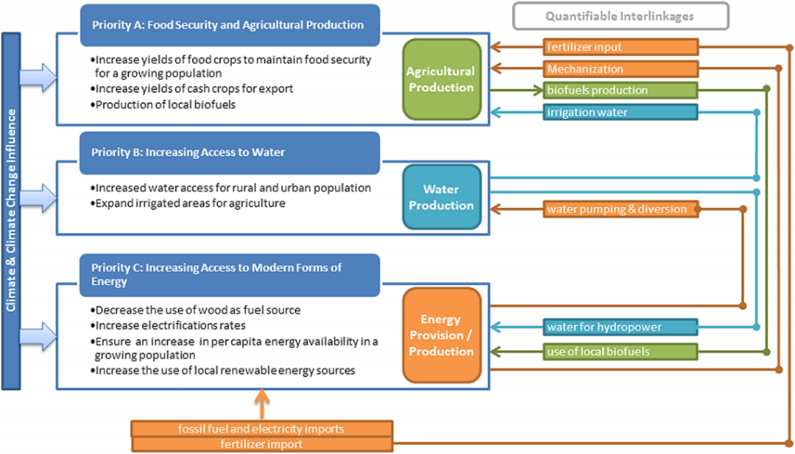
CLEWs: Nexus Challenges in Burkina Faso
Source: Hermann et al., 2012
Notes:
Notes:
The CLEWs approach aims to systematise the interconnections while also considering the impact of climate change. This example presents a diagram developed for Burkina Faso showing the main interconnections between the different resources. The example shown is the qualitative visualisation of the systems, and different tools are needed to quantify these interconnections (shown on the right under the heading “Quantifiable Interlinkages”). For example, a proposed intervention was to diversify energy consumption by considering Jatropha as a biofuel alternative. Using marginal land for this purpose would reduce competition between energy and food production. In order to quantify the energy potential, a GIS analysis could be conducted.
General data about the case study and the country:
Almost 40% of the population in Burkina Faso live with food insecurity and 42% have limited access to safe drinking water. The population increased from 8 million to 17.3 million from 1985 to 2011. Population growth coupled with rapid urbanisation has led to increased stress on water, energy and land resources.
Burkina Faso relies on traditional farming as the pillar of its economy. A fragile natural environment combined with energy, food and cotton price fluctuations can have negative impacts on the country‘s economy. Therefore, there is a strong need to efficiently use the available land resources and assess the interconnections between the sectors. Although the land area under cultivation has increased over the past decades, productivity has decreased over the same time period. The net effect of these two trends is an increase in overall agricultural production, yet this increase is smaller than the population growth rate, thus indicating a potential decrease in food security.
Sources:
Hermann, S., Welsch, M., Segerstrom, R. E., Howells, M. I., Young, C., Alfstad, T., Rogner, H.-H. and Steduto, P. (2012), ‘Climate, land, energy and water (CLEW) interlinkages in Burkina Faso: An analysis of agricultural intensification and bioenergy production’, Natural Resources Forum, vol. 36, Iss. 4, pp. 245–262. doi:10.1111/j.1477-8947.2012.01463.x

Slide 28
Assessment of specific Nexus interventions
Chapter 2.1 Assessing the Nexus – Assessment tools for decision support

Slide 29
Various scopes of assessment
Context analysis – what is the current situation in the Nexus sectors and how are they interlinked
Assessing impacts of changes: develop development/policy scenarios and analyse/quantify impacts on sectors and sustainability
Assessment of specific interventions in terms of their efficiency in resource use, social, economic and environmental impacts
Comparison of interventions

Slide 30
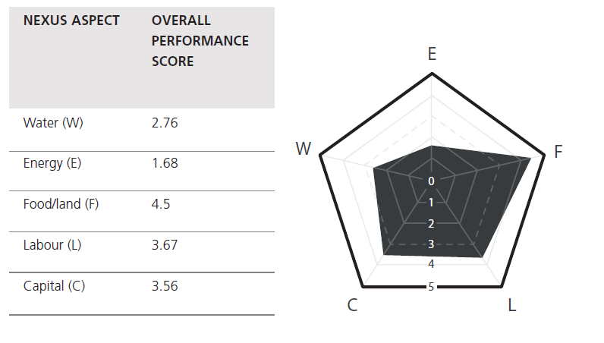
FAO Nexus Rapid Appraisal Tool: Example
Intervention: On-grid wind energy for water desalination for agriculture
Source: Flammini et al., 2014
Notes:
Notes:
The FAO Nexus Rapid Appraisal tool uses indicators to assess different interventions. Based on different indicators sectoral performance scores are calculated in five categories : Water (W), Energy (E), Food/Land (F), Labour (L) and Capital (C). With 1 representing low performance and 5 high performance with regard to the specific nexus aspect.
The scores are visualised in a spider chart
A high score indicates that the intervention has a high impact on the respective Nexus component, while a score close to 1 means the impact is low. 0 means that the intervention was not assessed for that particular Nexus component. The area of the polygon is a measure of the overall performance of the intervention. The smaller the size of the polygon, the smaller the impact of the intervention on the Nexus aspects.
This figure shows the example of a real intervention to better depict the method. The results indicate that the specific intervention “On-grid wind energy for water desalination for agriculture” has a very low impact on energy resources (it is generating renewable energy and energy is used efficiently), a low impact on water resources (it is using no freshwater and the treated water is transformed efficiently into food), a high impact on food/land (in this case because the area occupied by the plant was considered, and land use is not efficient) and it is using labour and capital quite efficiently. All these ‘efficiency considerations’ are assessed from a Nexus resource perspective, meaning how much of the specific resource is needed per unit of one or more of the other resources (e.g. how much energy per unit of water, how much money per unit of water, how much labour per unit of energy, etc.). The highest impact, according to the diagram, is on food/land.
The overall performance of the intervention is combined into one single index, which corresponds to the area of the polygon on the spider chart. For example, in this case the overall performance is 25.6.
Sources:
Flammini, A., Puri, M., Pluschke, L. & Dubois, O (2014), ‘Walking the Nexus Talk: Assessing the Water-Energy-Food Nexus in the Context of the Sustainable Energy for All Initiative’, Food and Agriculture Organization of the United Nations, Rome.

Slide 31
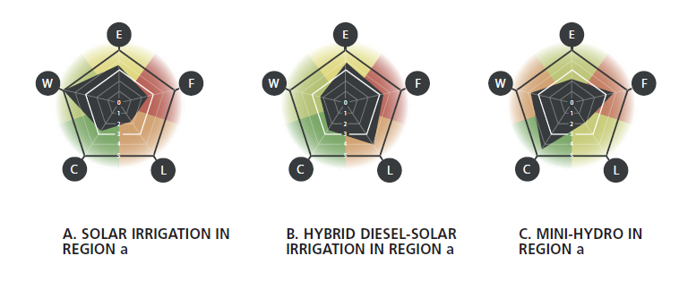
Nexus Rapid Appraisal Tool: Comparison
Source: Flammini et al., 2014
Notes:
Notes:
With this method, different interventions can be easily compared to support decision-making. In this example, three examples of interventions and their respective impacts on Nexus aspects are presented. This assessment does not suggest which interventions are better than others in absolute terms, but it does highlight the trade-offs and for which aspects the intervention is adding pressure to the different components of the system.
Sources:
Flammini, A., Puri, M., Pluschke, L. & Dubois, O (2014), ‘Walking the Nexus Talk: Assessing the Water-Energy-Food Nexus in the Context of the Sustainable Energy for All Initiative’, Food and Agriculture Organization of the United Nations, Rome.

Slide 32





The NRD Nexus Indicators (1)
 | Governance
 | Livelihoods
 | Water
 | Energy
 | Food
Aim and concept
comprehensive list of indicators for assessing the impacts of Nexus projects
combines WEF Nexus and sustainable livelihoods approaches
Indicator pillars: Water, Energy, Food, Livelihoods – and Governance
Ecosystems included in resource pillars
Notes:
Notes:
Within the framework of Nexus Regional Dialogues Programme, a comprehensive list of indicators was developed for assessing the impacts of Nexus projects.
The structure of the indicator list is based on an integrated nexus-livelihoods framework, which combines WEF Nexus and sustainable livelihoods approaches and
provides a tool for assessing environmental livelihood security.
In addition to the four pillars Water, Energy, Food and Livelihoods, the indicator table features Governance as a specific category, since – as we have just learned, governance plays a
crucial role in institutionalising the WEF Nexus approach. These indicators shall help to measure impact of projects aiming to improve the enabling environment for a Nexus approach.
The important role of ecosystems is reflected in each of the resources pillars.

Slide 33
The NRD Nexus Indicators (2) - Examples
Pillar | Category | Sub-Category | Performance Metric | SDG Targets
Governance | n/a | Regulatory Instruments | Number of regulatory instruments that support the WEF Nexus action | 15.6, 15.1,12.7, 12.2, 9.1
Livelihoods | Energy for Livelihoods | Access to electricity | % of population with access to modern fuel for cooking and heating | 7.a.1
Water | Energy for Water | Abstraction | % of energy from renewables used for water pumping | 15.1, 15.3
Energy | Livelihoods for Energy | Labour | Number of jobs created in the energy sector due to the transition to renewable energy | 6.3, 15.1
Food | Water for Food | Livestock | % of water resources available for livestock at farm-level | 6.4
Notes:
Notes:
On this slide you see a selection of indicator examples for the NRD framework.
As you see, for each of the main pillars – apart from governance – the indicators are further divided into categories that refer to the interconnectedness of the Nexus pillars, such as Energy for Livelihoods, Water for Food etc.
Then the indicators are further refined into sub-categories describing different aspects of each category, such as regulatory instruments as one aspect of governance, abstraction as one aspect where energy is used for water supply, etc.
Then for each Sub-category the indicator list includes one or more indicators that can be used to measure the impact of an intervention or nexus project.
The Indicator list also makes reference to relevant SDG targets that the respective indicator would contribute to

Slide 34
The NRD Nexus Indicators (3) – how it is applied
Select most suitable indicators for the respective project - consider relevance of indicator vs. ease of measurement
Projects including technical measures should utilise indicators from each of the categories Livelihood, Water, Energy and Food
Projects conducting mostly non-technical measures should utilise indicators from the category Governance.
The number of indicators will depend on the aim of the assessment (comprehensive vs. project monitoring)
Based on selected indicators establish baseline
Notes:
Notes:
For the evaluation of a project, depending on the nature of the project, an appropriate selection of indicators should be selected.
When selecting indicators , one needs to consider indicators that are the most relevant for the project and indicators that are easily measurable
Projects including technical measures should utilise indicators from each of the categories Livelihood, Water, Energy and Food, projects conducting mostly non-technical measures should utilise indicators from the category Governance.
If the aim of the assessment is to do a comprehensive assessments of the impacts of a project, a larger number of indicators should be selected,. If the aim is rather to monitor project impact, some key performance indicators can be selected to demonstrate the impact of the project.
After choosing suitable indicators, a baseline needs to be established against which impacts or progress are then to be measured.

Slide 35

Q & A on tools and approaches for assessing the Nexus
Any questions on Chapter 2.1?
Notes:
Notes:
Before we move on to an interactive exercise that we prepared, we would like to take some time to answer any questions you might have on approaches and tools for assessing the Nexus

Slide 36
Interactive Exercise: Selecting Nexus indicators
Chapter 2.1 Assessing the Nexus – Assessment tools for decision support
Notes:
Notes:
We now move to the more interactive part of the training. You are now asked to engage in an exercise where you can discuss relevant indicators for assessing nexus challenges and projects.

Slide 37
Selecting nexus indicators
  Objective: reflect on suitable indicators to assess the impacts of different types of nexus projects and discuss potential challenges in defining indicators and finding relevant data.
  What to do: Split into groups of 3-5 persons and read the work instructions on the handout.
  Timeframe: You have 30 min. for reading the instructions and discussion within the group, followed by 5 min presentation of each group in the plenum.
Notes:
Notes:
See instructions in handout.

Slide 38
Alternative Role Play: The multi-purpose dam
Chapter 2.1 Assessing the Nexus – Assessment tools for decision support

Slide 39
The multi-purpose dam
  Objective: To develop indicators that integrate the point of view of other sectors.
  What to do: Split into 4 large groups by sector and 1 group for the Office of the Presidency and read the work instructions on the handout.
  Timeframe: You have 45 min. for reading the instructions and discussion within the group, followed by 15 min. presentation of each group. Further 30 min. are given to go to the next sector and discuss your indicators. Within 20 min. the indicators are collated on 4 tables and presented. In the end, 10 min. are given for the final plenary discussion.
Notes:
Notes:
See instructions in handout.

Slide 40
Thank you for your time!
In cooperation with

