Slide 1
Module I - Introduction to the Water-Energy-Food Security (WEF) Nexus
In cooperation with
Notes:
This learning unit aims at introducing to the WEF Nexus and their associated securities and is designed to be taught to professionals from a variety of academic and employment backgrounds.

Slide 2
Outline
Chapter 1.1: | Background to the Water-Energy-Food (WEF) Nexus Introduction to the WEF Nexus Interactive Exercise: your experience with sectoral interlinkages
Chapter 1.2: | Water-Energy-Food Interactions Water, energy and food security and trade-offs
Chapter 1.3: | Water-Energy-Food Nexus Solutions WEF Nexus synergies and solutions Interactive Exercise: finding solutions for trade-offs and using synergies
Notes:
Notes:
The learning unit is divided into three chapters:
Chapter 1 provides the background including justification, key characteristics and implementation questions of the WEF Nexus; and also touch upon the link between the WEF Nexus and bigger political processes such as the SDGs, NDCs
Group exercise where we will ask participants to reflect on sectoral interconnections and possible trade-offs they perceive in their own regional/national context
Chapter 2 looks into the interactions in more detail, referring to issues of bilateral interactions (Water-Food; Water-Energy; Energy-Food) as well as trilateral interactions as well as
Chapter 3 highlights potential synergies and solutions – in general as well as along several examples
In the end there will be an interactive group exercise which builds on the first – but now looking into possible solutions and synergies that could be identified

Slide 3
Outline
Chapter 1.1: | Background to the Water-Energy-Food (WEF) Nexus Introduction to the WEF Nexus Interactive Exercise: your experience with sectoral interlinkages
Chapter 1.2: | Water-Energy-Food Interactions Water, energy and food security and trade-offs
Chapter 1.3: | Water-Energy-Food Nexus Solutions WEF Nexus synergies and solutions Interactive Exercise: finding solutions for trade-offs and using synergies
Notes:
Notes:
The learning unit is divided into three chapters:
Chapter 1 provides the background including justification, key characteristics and implementation questions of the WEF Nexus; and also touch upon the link between the WEF Nexus and bigger political processes such as the SDGs, NDCs
Group exercise where we will ask participants to reflect on sectoral interconnections and possible trade-offs they perceive in their own regional/national context
Chapter 2 looks into the interactions in more detail, referring to issues of bilateral interactions (Water-Food; Water-Energy; Energy-Food) as well as trilateral interactions as well as
Chapter 3 highlights potential synergies and solutions – in general as well as along several examples
In the end there will be an interactive group exercise which builds on the first – but now looking into possible solutions and synergies that could be identified

Slide 4
WEF Nexus synergies and solutions
Chapter 1.3: Water-Energy-Food Nexus Solutions
Notes:
Notes:
Now that we discussed the interlinkages between the WEF sectors and outlined the potential trade-offs that can arise when we address resource challenges in one sector we also want to shed light on solutions that help us avoid these negative externalities
Even more so, as mentioned in the first session, the Nexus approach also aims to make use of synergies

Slide 5
WEF Nexus Solution Categories
Technical and Engineering
Multi-purpose infrastructure
Integrated waste(water) management
Governance
Policy and financial frameworks
Regulatory instruments (impact assessments, wastewater standards)
Economic instruments (taxes, subsidies)
Planning Procedures
Integrated infrastructure planning
Policy coordination
Strategic policy planning
Nature-based Solutions
- Constructed wetlands
Catchment management
Notes:
Notes:
There are different categories of solution approaches that are displayed on this slide
Technical and Engineering:
Some of the technical and engineering solutions we have already discussed in the first part of the presentations, e.g. multi-purpose infrastructure like multi-purpose dams or solar-powered irrigation, integrated wastewater management and reuse, an agriphotovoltaics
Generally: technical solutions that try to avoid or minimize trade-offs and opitimize resource-use by providing benefits across multiple sectors
[some examples are included in PPT 1.1 – therefore no examples are presented in the following slides. Depending on the set-up of the training, they could be copied in here]
Nature-based solutions:
Some typical examples here are constructed wetlands and catchment management
Governance:
There is a broad portfolio of governance instruments that can be employed to address WEF nexus challenges
We will look at two broader categories and some examples in more detail: policy & financial frameworks and planning procedures

Slide 6
WEF Nexus Solution Categories
Technical and Engineering
Multi-purpose infrastructure
Integrated waste(water) management
Governance
Policy and financial frameworks
Regulatory instruments (impact assessments, wastewater standards)
Economic instruments (taxes, subsidies)
Planning Procedures
Integrated infrastructure planning
Policy coordination
Strategic policy planning
Nature-based Solutions
- Constructed wetlands
Catchment management
Notes:
Notes:
Let‘s look at NbS first.

Slide 7
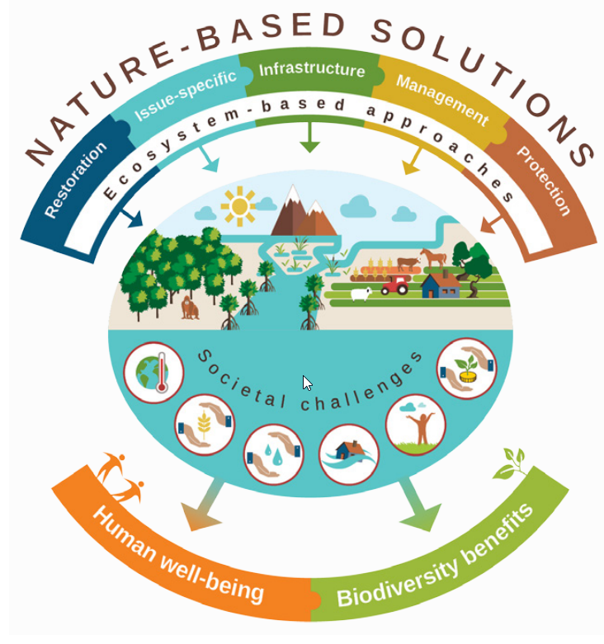
Nature-based Solutions
Nature-based Solutions (NbS) are actions to:
Protect, sustainably manage and restore ecosystems
Address societal challenges
Provide human well-being and biodiversity benefits
The umbrella term of NbS also encompasses different approaches to address climate change, e.g. Ecosystem-based Adaptation (EbA).
Source: IUCN, 2016
Notes:
Notes:
Nature-based Solutions (NbS)
can be defined as actions to protect, sustainably manage, and restore natural or modified ecosystems to address societal challenges, while simultaneously providing human well-being and biodiversity benefits. Societal challenges addressed by NBS climate change, food security, water security, flood risks or clean air. NBS is an umbrella term, which encompasses different approaches of working with nature,
When addressing climate change, often NbS are specified as :
Ecosystem-based Adaptation (EbA),
Ecosystem-based Disaster Risk Reduction (Eco-DRR)
Ecosystem-based Mitigation (EbM)
Sources:
GIZ (2019), ‘Emerging lessons for mainstreaming Ecosystem-based Adaptation: Strategic entry points and processes’. Authors: Lili Ilieva and Thora Amend. Deutsche Gesellschaft für Internationale Zusammenarbeit (GIZ) GmbH, Bonn.

Slide 8
NbS to address WEF Nexus challenges
Water, energy, and food are often interlinked through the ecosystems they are embedded in
NbS protect, sustainably manage, and restore natural or modified ecosystems and therefore offer opportunities to address the related interlinked water, energy, and food security challenges in synergy.
Examples
Healthy forests, wetlands, and floodplains filter sediments and other components and thus improve water quality while reducing the need for energy-intensive water treatment
Sustainable agricultural practices can conserve water and improve its quality, reduce soil erosion and the need for energy-intensive inorganic fertilizers.
Source: GIZ, 2016
Notes:
water, energy, and food are often interlinked through the ecosystems they are embedded in
NbS build on ecosystem functions, they protect, sustainably manage, and restore natural or modified ecosystems and therefore offer opportunities address water energy and food security challenges in synergy
Examples
Healthy forests, wetlands, and floodplains for example filter sediments, toxins, and nutrients and improve water quality while reducing the need for energy-intensive water treatment
Sustainable agricultural practices (e.g. organic agriculture, eco-agriculture, agroforestry, agricultural parks and other types of multi-functional agricultural landscapes) can conserve water and improve its quality, improve quality and safety of food, reduce soil erosion and the need for energy-intensive inorganic fertilizers, and mitigate climate change through reducing greenhouse gas emissions

Slide 9
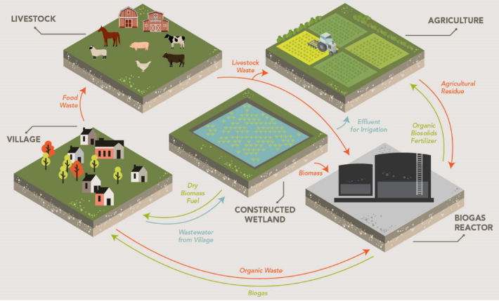
NbS Example – constructed wetlands
Wastewater treatment by passage of water through man-made wetlands
Nutrients remain in the effluent – beneficial use of reclaimed water in agriculture for food production
Biomass grown in wetlands can be harvested as biofuel, e.g. biogas for cooking – reducing GHG emissions
The potential for constructed wetlands to influence WEF interactions at village and municipal scale
Source: Avellan et al., 2017
Notes:
Notes:
One example for NBS is constructed wetlands which simultaneously serve multiple purposes.
Traditionally, wetlands are used for water pollution control / wastewater treatment
As most conventional treatment systems, they are intended to reduce organic matter and pathogens to a minimum,
At the same time nutrients like nitrogen or phosphorus largely remain in the effluent – the filtered water provided by wetlands is therefore of beneficial use for agricultural production
In addition, wetlands are productive ecosystems that are capable of producing large quantities of biomass – that can be harvested and turned into biofuels and used for cooking
Additional information (WWAP 2018):
Domestic wastewater is made up of three basic components: water, carbon and nutrients. These are useful components for various purposes such as growing food or producing bio-energy.
Since humans produce about 4.5 kg of nitrogen and 0.6 kg of phosphorus per person per year, the effluent leaving constructed wetlands can have relatively high levels of these nutrients, making it a highly suitable source of water for irrigation.
Constructed wetlands are also among the world’s most productive ecosystems, capable of producing relatively large quantities of biomass, depending on the type of plant used (most commonly either Phragmites australis or Typha spp.) and the climate of the location. This biomass can be harvested at regular intervals to be used as biofuel. The caloric value of most of these plants is also similar to traditional combustion fuels such as Acacia spp. Even less explored is their potential for biogas production, which shows some promising initial research results. In particular, when using A. donax, also known as giant reed, methane yields surpass that of corn or sorghum in some cases. It is estimated that about 12% of the cooking fuel needs of a 60-person village in sub-Saharan Africa can be supplied from the biomass of a constructed wetland.
Using these NBS can thus serve multiple purposes and indirectly impact other aspects, such as increased forest conservation through a reduced reliance on wood fuels and enhanced energy security.
Sources:
Avellan, C.T., Ardakanian, R. and P. Gremillion (2017). The role of constructed wetlands for biomass production within water-soil-waste nexus. In: Water Sci Technol (2017) 75 (10): 2237–2245. Available at: https://iwaponline.com/wst/article/75/10/2237/29902/The-role-of-constructed-wetlands-for-biomass
WWAP (United Nations World Water Assessment Programme)/UN-Water. 2018. The United Nations World Water Development Report 2018: Nature-Based Solutions for Water. Paris, UNESCO.
and full source: https://iwaponline.com/wst/article/75/10/2237/29902/The-role-of-constructed-wetlands-for-biomass

Slide 10
NbS Example – catchment management
Tana River Basin in Kenya
provides 95% of the drinking water for Nairobi
generates 70% of the country’s hydropower
irrigates about 645 km2 of farmland
Erosion due to agriculture on steep slopes impacts hydropower and drinking water supply through siltation
Upper Tana-Nairobi Water Fund: funding for sustainable land management in the catchment (terracing, reforestation, farm management) with benefits for agricultural production, energy and water supply)
Increased carbon storage and climate resilience
Source: Nick Hall in Abell et al., 2017
Notes:
Notes:
Another NBS solution example are catchment management approaches
Example Tana River in Kenya:
Provides 95% of the drinking water for Nairobi, generates 70% of the country’s hydropower and irrigates about 645 km2 of farmland
Basin is characterized by steep hillsides and areas adjacent to rivers have been converted to agriculture which in combination has resulted in erosion and high silt levels in the water
This siltation has reduced the capacity of hydropower reservoirs and increased the costs of water treatment for Nairobi
To address this problem the Upper Tana-Nairobi Water Fund was launched in 2015
Water funds are founded on the principle that it is cheaper to prevent water problems at the source than it is to address them further downstream
The fund provides funding for a range of upstream interventions, such as terracing, reforestation and improved farm management with benefits for the WEF sectors hydropower, water supply and also agricultural production
Additionally these interventions also help climate change adaptation: increased carbon storage in soils and stronger resilience to climate change
Additional information:
The Upper Tana River Basin is of critical importance to the Kenyan economy. Covering an area of approximately 1.7 million hectares, the Upper Tana supplies 95 percent of Nairobi’s drinking water, sustains important aquatic biodiversity, drives agricultural activities that feed millions of Kenyans and provides half of the country’s hydropower output. The basin has experienced high population growth and declining sustainability of agriculture, resulting in the conversion of forest to cropland and decreasing land per capita. Smallholder farms are the largest upstream water user in aggregate of Upper Tana Basin water. Hydropower generation is the second largest upstream user of water, though the water is returned to the river. The unchecked expansion of farming, quarrying and dirt road construction across the Upper Tana over the last 40 years has led to land degradation. Consequently, elevated sediment loads are entering the river system, impacting the delivery of water to Nairobi water users and reducing the storage capacity of reservoirs. In response to these challenges, the Upper Tana-Nairobi Water Fund was launched to implement a holistic set of source water protection activities with the objectives of increasing water yields, reducing sediment, and promoting sustainable food production and increased household incomes in farming communities across the project areas. In order to mobilize funding, a comprehensive analysis integrated investment planning techniques with watershed modeling tools to prioritize where to work. Nonmonetized benefits, including pollinator habitat and carbon storage, were identified and the overall cost-to-benefit analysis concluded that, even by conservative estimates, the selected watershed interventions could ultimately deliver a two-toone return on investment over a 30-year timeframe. By recognizing the multiple embedded values of a healthy watershed, and involving the key stakeholder groups, the water fund was able to design a collective action program whereby investing together made the most financial sense. Many of these projected benefits are already being measured through demonstration interventions.
Source:
Abell, R., et al. (2017). Beyond the Source: The Environmental, Economic and Community Benefits of Source Water Protection. The Nature Conservancy, Arlington, VA, USA. Available at: https://www.nature.org/content/dam/tnc/nature/en/documents/Beyond_The_Source_Full_Report_FinalV4.pdf

Slide 11
WEF Nexus Solution Categories
Technical and Engineering
Multi-purpose infrastructure
Integrated waste(water) management
Governance
Policy and financial frameworks
Regulatory instruments (impact assessments, wastewater standards)
Economic instruments (taxes, subsidies)
Planning Procedures
Integrated infrastructure planning
Policy coordination
Strategic policy planning
Nature-based Solutions
- Constructed wetlands
Catchment management
Notes:
Notes:
Let’s look at Governance aspects in the following slides.

Slide 12
Governance Solutions
Policy and financial frameworks
Type/ Example |  | Description
Regulatory instruments | Impact assessments | Systematize environmental and social impact assessment across WEF-sectors for all new infrastructure
 | Wastewater treatment and reuse standards | Specify regulations for wastewater treatment and reuse (e.g. in agriculture or urban use)
Economic instruments | Water user charges | Levied by public authorities for services provided for water supply and treatment to incentivize efficient water use for food and energy production
 | Subsidies | Linking subsidies to the efficient use of resources (e.g. link agricultural subsidies to efficient use of water and energy resources, environmental impacts)
Notes:
Notes:
Now let's move to some solutions within the governance context
First, there are tools that can be located within policy and financial framework conditions
Regulatory instruments:
Impact assessments can be employed that systematically capture impacts of an interventions on other sectors
Also various forms of standards such as wastewater treatment and reuse standards can be employed that create incentives to use resources efficiently and/or reusing resources
Economic instruments:
2 examples of economic instruments include water user charges and subsidies that can equally incentivise efficient resource use
Water user charges:
Usually levied by public authorities for services provided for water supply and treatment can provide important incentives for using water more efficiently, for instance in the agricultural sector or in energy production; they can also be useful to set incentives for industry to reuse water resources
Subsidies:
finally also subsidies can be an important governance tool if you link subsidies to the efficient use of resources (e.g. link agricultural subsidies to efficient use of water and energy resources, environmental impacts)
Subsidies are of course very controversial and in reality today often have negative impacts on other sectors
Focus here should be on subsidies that support an efficient use of resources
Sources:
OECD (2008), ‘Promoting Sustainable Consumption: Good Practices in OECD Countries’, available at: https://www.oecd.org/greengrowth/40317373.pdf
Waskom et al. (2014), ‘U.S. Perspective on the Water-Energy-Food Nexus’, Colorado Water Institute Completion Report No. 116, available at: https://watercenter.colostate.edu/wp-content/uploads/sites/33/2020/03/IS116.pdf

Slide 13
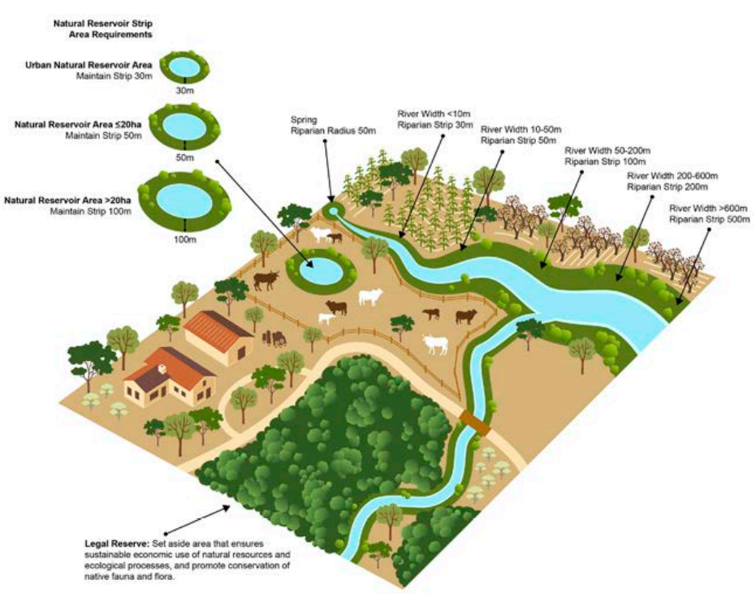
Governance Solutions
Figure: Areas of permanent protection and legal reserve under the Rural Environmental registry
Brazil – Agricultural subsidies
Since 2008 all subsidies provided to farmers are linked to fulfilling environmental criteria
Agricultural subsistence tool: mainly rural credits that aim to improve productivity and manage risks
To receive subsidized credits farmers have to fulfill requirements of the rural environmental registry (CAR)
Source: WWF, 2016
Notes:
Notes:
Another example presented here are agricultural subsidies in Brazil
Since 2008 all subsidies provided to farmers are linked to fulfilling environmental criteria
The main agricultural subsistence tool are rural credits that aim to improve productivity and manage risks
To receive subsidized credits farmers have to fulfill requirements of the rural environmental registry (CAR)
So to get these government-subsidized credits landowners have to implement certain measures, including to maintain a certain percentage of their farm as forest area and also preserve certain areas permanently - these include river and pond margins and also slope areas
Interesting example how agricultural subsidies can be used to pursue objectives of environmental conservation, protecting water resources and also contribute to lowering GHG emissions
Sources:
Climate Policy Initiative (2020-12-10), ‘Where Does Brazil Stand With the Implementation of the Forest Code? A Snapshot of the CAR and the PRA in Brazil’s States – 2020 Edition’, available at: https://www.climatepolicyinitiative.org/publication/where-are-we-at-implementing-the-forest-code-an-x-ray-of-the-car-and-the-pra-in-brazilian-states/
Da Silva Medina, G. (2019). Where are governments leading their agricultural sectors? Comparative lessons from agri-environmental measures promoted in the U.S., Europe and Brazil. Estudos Sociedade e Agricultura, vol. 27, no. 1, pp. 5-23, 2019. Available at: https://www.redalyc.org/journal/5999/599962753001/html/
UN Environment Programme (2021-09-14), ‘Why agricultural support must be reformed to work with nature’, available at: https://www.unep.org/news-and-stories/story/why-agricultural-support-must-be-reformed-work-nature
Image reference:
WWF (2016). Brazil’s new Forest Code: A guide for decision-makers in supply chains and governments.

Slide 14
Governance Solutions
Planning Approaches
Type/ Example |  | Description
Policy coordination | Cross-departmental working groups | Permanent or issue-specific groups working across horizonal and vertical (in federal states) lines to discuss different WEF perspectives
 | Expert and public consultations | Through e.g. hearings, dialogue events to ensure that all relevant interlinkages are identified and increase legitimacy
Strategic policy planning | Cross-sectoral strategies | Coordination of policies at a strategic, higher authority level (e.g. sustainability strategy)
Notes:
Notes:
Another sphere of governance instruments comprise planning procedures/approaches
Policy coordination:
Example for policy coordination approaches have been mentioned in the first presentation
These comprise organisational structures and procedures which are capable of guaranteeing consultations and coordination between different sectoral unities and interest groups
E.g. cross-ministerial or departmental working groups that enable collaboration in in dealings with policies or various forms of stakeholder participation
Stakeholder participation (e.g. inclusion of experts) ensures that all relevant interlinkages are identified (that policy makers might not be aware of) and to ensure legitimacy of the process – the latter will also likely help to increase acceptance of governance solutions
Strategic Planning:
While policy coordination today is the more dominant form of policy planning across sectors (in cases where this exists) there are also forms that are here labeled as strategic policy planning
Strategic plannings are types of cross-sectoral policy planning that outline long-term policy goals that go beyond one specific sector and are therefore also developed through a broader process that includes multiple sectors and also broader stakeholder consultation
The advantage from a nexus perspective here is that perspectives from across different sectors are included in the policy planning process from the beginning and that potential trade-offs but also synergies are identified at an early stage
The challenge is that strategic planning usually takes much longer and is a more complex process as it involves a much largen number of stakeholders with varying and sometimes opposing objectives, values etc.
Sources:
Blumstein, S., Kramer, A. and A. Carius (2017). Coordination of Sectoral Interests in the Nexus Between Water, Energy and Agriculture. Mechanisms and Interests in Germany. Available at: https://www.adelphi.de/en/system/files/mediathek/bilder/Nexus%20in%20Germany_03.pdf

Slide 15
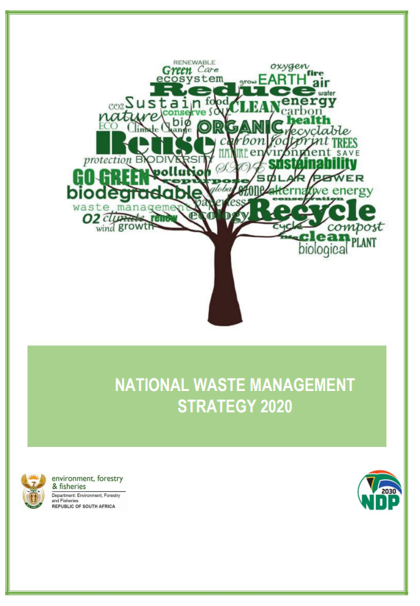
Governance Solutions
South African National Waste Management Strategy 2020
Developed under lead of Department of Forestry and Fisheries and the Environment (DFFE) with broad cooperation of other sectors including energy and land/food
Addresses key interlinkages with other WEF sectors:
promotion of energy recovery from sewage and organic waste
Prevention of food waste is key pillar for strategy to minimize waste
Notes:
Notes:
One example of such a strategic planning process is outlined in this slide - South African National Waste Management Strategy 2020
Developed under lead of Department of Forestry and Fisheries and the Environment (DFFE) with broad cooperation of other sectors including energy and land/food
It sets out by outlining overarching development goals it wants reach or contribute to with the strategy and also outlines key principles
And then outlines the strategic approach to reach these goals – and this approach is a cross-sectoral one including amongst others, waste sector but also food/agricultural sector, energy sector, and of course also considers environmental issues
Addresses key interlinkages between WEF sectors:
Outlines objectives and measures to promote energy recovery from sewage and organic waste
Activities to prevent food waste which is a is key pillar in the strategy to minimize waste
Promotes products and packaging that reduce waste or encourage reuse, repair and preparation for recycling – to minimize resource use including water and energy resources
Sources:
DFFE (2020). National Waste Management Strategy 2020. Available at: https://www.dffe.gov.za/sites/default/files/docs/2020nationalwaste_managementstrategy1.pdf

Slide 16
Interactive Exercise: Reflections on Nexus solutions
Chapter 1.3: Water-Energy-Food Nexus Solutions

Slide 17
Reflections on Nexus solutions
Objective: Identify nexus solutions as well as key variables
What to do: Split into groups of 3-5 persons and read the work instructions on the handout
Timeframe: 20 min. for the discussion within the group
Notes:
Notes:
See instructions in handout.

Slide 18
Discussion on Solutions
Compare your results with the other groups in a plenary discussion.
Where could you observe similarities or differences?
What did surprise you?
Notes:
Notes:
Discussion of solutions based on those that were presented in exercise 1.3 – reflection on these based on input that was just provided
See instructions in handout:
Compare your results with the other groups in a plenary discussion.
Where could you observe similarities or differences?
What did you surprise?

Slide 19
Summary of chapter 1.3: Water-Energy-Food Nexus Solutions
There are different types of WEF Nexus solutions to secure resource availability:
Technical and engineering: avoid trade-offs and optimize resource-use
Nature-based solutions: protect, sustainably manage and restore ecosystems
Governance: include policies, frameworks and planning approaches
Notes:
Notes:
There are different types of WEF Nexus solutions to secure resource availability.
Technical and engineering: avoid trade-offs and optimize resource-use
Nature-based solutions: protect, sustainably manage and restore ecosystems
Governance: include policies, frameworks and planning approaches

Slide 20
Thank you for your time!
In cooperation with

