Slide 1
Module I - Introduction to the Water-Energy-Food Security (WEF) Nexus
In cooperation with
Notes:
Notes:
This learning unit aims at introducing to the WEF Nexus and their associated securities and is designed to be taught to professionals from a variety of academic and employment backgrounds.

Slide 2
Let me introduce to you Ms. Sinclair…
Notes:
Notes:
[Storytelling Intro – adjust names to local context]
Let me introduce to you Ms. Sinclair. She lives in the city of Mostanova where is the head of city administration, responsible for electricity supply.
Mostanova is a medium-sized city of 300,000 inhabitants which has been continuously growing over the past years.
While this is a positive development for the city, Mostanova may face problems to provide the growing population and industry with sufficient amounts of electricity. For several reasons, the city is relatively disconnected from the national grid and so far, receives most of its electricity from one local coal-fired power station.
Ms. Sinclair has many years of experiences in the energy sector. Early on she realizes that the city has to become active to ensure that it will be able to supply sufficient amounts of electricity in the coming years.
She is a passionate proponent of renewable energies and sees a lot of potential for solar energy in the city – which enjoys approximately 250 days of sunlight/year. Her team also calculates that solar energy could significantly decrease energy costs in the city.
So, her mission is clear: Increase solar energy production.
She knows she needs to support from the city council to go ahead with her plans so she organizes an extraordinary council meeting where she invites colleagues from all other city departments along with some experts from the energy sector.
However, the discussion quickly reveals that her colleagues are not as convinced and enthusiastic about the proposal as she anticipated.
Ms Sinclair is disappointed but carefully listens to the arguments of her colleagues.
Her colleague from the department of agriculture, Mr. Liard, is furious when he hears Ms. Sinclair talk about 3 suitable locations for solar parks that her team had already identified.
With a slight anger in his voice, Mr. Liard outlines that two of the proposed locations are currently farm land which, as he emphasizes, is already scarce to come by in the area. Farmers, he continues, have complained for years about the process of reallocating farmland for other purposes – such as streets as well as some local industries.
He said that one of the largest farm companies in the region is already considering to close down. This would have serious impacts on local food supply and food costs and also result in loss of jobs. Food production, he concludes, should be prioritised!
Other concerns are raised by her colleagues from the water department. They outline that decreasing energy prices could lead to an increase in groundwater abstraction that is used by local farmers for irrigating their fields during the summer months.
They had observed a slight decrease of groundwater levels over the past 5 years. Providing lower-cost energy to farmers without a functioning water licensing and monitoring system, could potentially accelerate the process and lead to challenges for local water supply.
Much to Ms. Sinclair‘s delight one colleague at least was very supportive of her idea: Mr. Green, the special representative of Mostanova for climate change mitigation and adaptation.
He was delighted and emphasized that the proposed approach could help to significantly reduce GHG emissions and the city‘s carbon footprint. To further support his argument, he explained that the project could likely benefit from national public funds that had been made available by the recent government to support the expansion of renewable energies.
At the end, Ms. Sinclair realized that not all was bad but that to realize her idea of bringing solar energy to Mostanova would require many more discussions and a lot of coordination with her colleagues.
-------
This example from Mostanova brings us straight to the topic of this training which is about the interlinkages – also referred to as „nexus“ – between energy, water and food production. The negative impacts that unilateral approach in one sector can have on the others. But also, the synergies that could potentially be harnessed when coordinating activities across sectors.

Slide 3
Outline
Chapter 1.1: | Background to the Water-Energy-Food (WEF) Nexus Introduction to the WEF Nexus Interactive Exercise: your experience with sectoral interlinkages
Chapter 1.2: | Water-Energy-Food Interactions Water, energy and food security and trade-offs
Chapter 1.3: | Water-Energy-Food Nexus Solutions WEF Nexus synergies and solutions Interactive Exercise: finding solutions for trade-offs and using synergies
Notes:
Notes:
The learning unit is divided into three chapters:
Chapter 1 provides the background including justification, key characteristics and implementation questions of the WEF Nexus; and also touch upon the link between the WEF Nexus and bigger political processes such as the SDGs, NDCs
Group exercise where we will ask participants to reflect on sectoral interconnections and possible trade-offs they perceive in their own regional/national context
Chapter 2 looks into the interactions in more detail, referring to issues of bilateral interactions (Water-Food; Water-Energy; Energy-Food) as well as trilateral interactions as well as
Chapter 3 highlights potential synergies and solutions – in general as well as along several examples
In the end there will be an interactive group exercise which builds on the first – but now looking into possible solutions and synergies that could be identified

Slide 4
Outline
Chapter 1.1: | Background to the Water-Energy-Food (WEF) Nexus Introduction to the WEF Nexus Interactive Exercise: your experience with sectoral interlinkages
Chapter 1.2: | Water-Energy-Food Interactions Water, energy and food security and trade-offs
Chapter 1.3: | Water-Energy-Food Nexus Solutions WEF Nexus synergies and solutions Interactive Exercise: finding solutions for trade-offs and using synergies
Notes:
Notes:
The learning unit is divided into three chapters:
Chapter 1 provides the background including justification, key characteristics and implementation questions of the WEF Nexus; and also touch upon the link between the WEF Nexus and bigger political processes such as the SDGs, NDCs
Group exercise where we will ask participants to reflect on sectoral interconnections and possible trade-offs they perceive in their own regional/national context
Chapter 2 looks into the interactions in more detail, referring to issues of bilateral interactions (Water-Food; Water-Energy; Energy-Food) as well as trilateral interactions as well as
Chapter 3 highlights potential synergies and solutions – in general as well as along several examples
In the end there will be an interactive group exercise which builds on the first – but now looking into possible solutions and synergies that could be identified

Slide 5
Introduction to the Water-Energy-Food Nexus
Chapter 1.1: Background to the Water-Energy-Food (WEF) Nexus

Slide 6
We want to get to know you and your background!
From which country are you joining this online training today?
In which of the Nexus sectors lies your main professional expertise?
Have you previously participated in a WEF Nexus training?
What are your expectation on the training? What would you like to learn about?
Notes:
Notes:
Before we start with the training we would like to get to know you better and learn about your specific background in the WEF Nexus
We therefore prepared some questions we would like you to answer.
To participate, you need your smartphone, laptop or any other web-enabled devise [provide link and QR-code to access survey if using one of the online tools mentioned below]
Questions:
Which of the NRD Regions are you from? [LAC, Niger, SADC, MENA, CA]
In which of the Nexus sectors lies your main professional expertise? [water, energy, food, ecosystems, multiple]
Have you previously participated in a WEF Nexus training?
What are your expectation on the training? What would you like to learn about?
Sources:
This survey can be realized with either menti (www.mentimeter.com), slido (www.slido.com) or any other online tool suitable for online surveys.

Slide 7
Why Nexus and how does it differ from IWRM?
Commonalities | IWRM | Nexus
Improve resource use and sustainable development | Water focused | Equal weight for all sectors
Considering trade-offs and synergies between sectors | Water management perspective | Systems perspective
Consult stakeholders coming from different sectors
Notes:
[optional slide for training audiences with strong IWRM background]
Notes:
While the terminology of “nexus” might be relatively new, the idea behind it is not
It is very closely related to existing concepts, such as IWRM
Commonalities:
Both concepts share the objective to improve resource uses and support sustainable development
Both start from the observation that segmented sectoral planning and decision-making often leads to negative externalities, unsustainable development pathways and inefficiencies in resource allocations
Both therefore promote greater co-ordination between related sectors and identifying consequences of decision making in one sector for other sectors and also to find potential synergies
Both underpin work on the Green Economy and Green Growth
So why do we need yet another concept if IWRM already covers everything?
There are some benefits the Nexus approach offers that go beyond IWRM
The main one being that the IWRM approach has a clear water leadership role – it looks at interactions between sectors from a water perspective, trying to find ways to manage water in a sustainable and efficient way
While this includes the interrelation with other sectors, the leadership always comes from water /always starts from the perspective of the water resource
The WEF-Nexus approach on the other side always starts by looking at the whole system and inter-relationships to understand where actions need to be taken to improve resource sustainability – only then it starts to formulate actions (which can be water-centric or not). It ensures resource security; IWRM just manages demands.
The Nexus is hence a concept that appears much more relevant from the perspective of other sectors and is likely to make discussions between actors of different sectors easier as they are more on an equal footing → Governance (IWRM): “good governance” principle ; Governance (Nexus): “integrated policy solutions”
The nexus approach also covers interconnections that would not be captured by IWRM at all: For example, relations between food and energy. It thus integrates the perspectives of all resources in policy objectives
Scale: IWRM in riverbasins ; Nexus at multiple scales
Sources:
Grigg (2019). IWRM and the Nexus Approach: Versatile Concepts for Water Resources Education. Journal of Contemporary Water Research & Education, 16(1)
Available at: https://onlinelibrary.wiley.com/doi/full/10.1111/j.1936-704X.2019.03299.x
Nexus Concept // The Nexus Approach vs. IWRM – Gaining Conceptual Clarity: https://www.water-energy-food.org/news/nexus-concept-the-nexus-approach-vs-iwrm-gaining-conceptual-clarity

Slide 8
Why Nexus and how does it differ from IWRM?
E
Commonalities
Improve resource use and sustainable development
Considering trade-offs and synergies between sectors
Consult stakeholders coming from different sectors
W
E
W
F
Other sectors
F
Notes:
[optional slide for training audiences with strong IWRM background]
Notes:
While the terminology of “nexus” might be relatively new, the idea behind it is not
It is very closely related to existing concepts, such as IWRM
Commonalities:
Both concepts share the objective to improve resource uses and support sustainable development
Both start from the observation that segmented sectoral planning and decision-making often leads to negative externalities, unsustainable development pathways and inefficiencies in resource allocations
Both therefore promote greater co-ordination between related sectors and identifying consequences of decision making in one sector for other sectors and also to find potential synergies
Both underpin work on the Green Economy and Green Growth
So why do we need yet another concept if IWRM already covers everything?
There are some benefits the Nexus approach offers that go beyond IWRM
The main one being that the IWRM approach has a clear water leadership role – it looks at interactions between sectors from a water perspective, trying to find ways to manage water in a sustainable and efficient way
While this includes the interrelation with other sectors, the leadership always comes from water /always starts from the perspective of the water resource
The WEF-Nexus approach on the other side always starts by looking at the whole system and inter-relationships to understand where actions need to be taken to improve resource sustainability – only then it starts to formulate actions (which can be water-centric or not). It ensures resource security; IWRM just manages demands.
The Nexus is hence a concept that appears much more relevant from the perspective of other sectors and is likely to make discussions between actors of different sectors easier as they are more on an equal footing → Governance (IWRM): “good governance” principle ; Governance (Nexus): “integrated policy solutions”
The nexus approach also covers interconnections that would not be captured by IWRM at all: For example, relations between food and energy. It thus integrates the perspectives of all resources in policy objectives
Scale: IWRM in riverbasins ; Nexus at multiple scales
Sources:
Grigg (2019). IWRM and the Nexus Approach: Versatile Concepts for Water Resources Education. Journal of Contemporary Water Research & Education, 16(1)
Available at: https://onlinelibrary.wiley.com/doi/full/10.1111/j.1936-704X.2019.03299.x
Nexus Concept // The Nexus Approach vs. IWRM – Gaining Conceptual Clarity: https://www.water-energy-food.org/news/nexus-concept-the-nexus-approach-vs-iwrm-gaining-conceptual-clarity

Slide 9
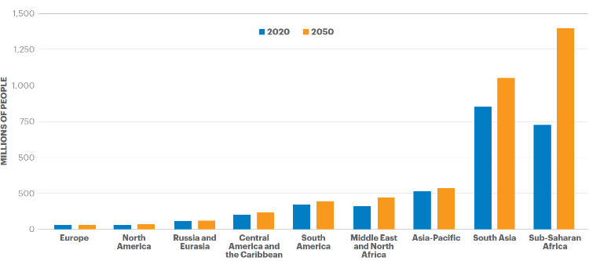
Achieving WEF development goals in a dynamic world
Present
Unmet demands!
2.0 billion people have no access to safe drinking water (2020)
0.8 billion people have no electricity (2021)
2.4 billion people are food insecure (2020)
Future
Increasing demands!
Due to population growth, economic development and changing consumption patterns
The uncertainties of global change increase difficulty in meeting demands
Figure: Food-insecure people by region, 2020 and 2050 projections
Source: IEP, 2021
Notes:
Notes:
At present, a significant percentage of the global population are a long way from attaining water, energy or food security.
For example, 2.0 billion people have no access to safely managed drinking water
0.8 billion people have no access to electricity – this is about the number of people living in Europe (so imagine whole Europe in the dark)
And 2.4 billion have not enough food – so roughly a third of the global population go hungry regularly, especially in South Asia and Sub-Sahara Africa
It becomes very clear that we need to intensify our efforts in order to bring water, energy and food security to these people in the coming decades!!
At the same time, the world population is likely to increase to over 8.5 billion by 2030 and to 9.5 or even 10 billion by 2050.
In addition, economic development and consumption patterns are likely to change, leading to even higher water, energy and food demands per capita.
We therefore face the combined challenge of compensating for the unmet current demands and meeting additional future demands.
Global change, including climate change, adds uncertainty to the future availability and demand of natural resources.
Additional information:
Definitions on the service level of drinking water:
Safely managed: drinking water from an improved source; accessible on premises; available when needed; free from fecal and priority chemical contamination
Basic: drinking water from an improved source; collection time less than 30 minutes (including queuing)
Limited: drinking water from an improved source; collection time more than 3ß minutes (including queuing)
Unimproved: drinking water from an unprotected dug well/ spring
Surface water: drinking water directly from a river/ dam/ lake/ pond/ stream/ (irrigation) canal
Conceptual differences between food insecurity and undernourishment:
Food insecurity: refers to access to food (access can be difficult/uncertain/intermittent)
Undernourishment: person’s/group’s actual intake of food is insufficient to meet their dietary energy requirements
Further data on food:
Future food demands: In 2050 the global food demand will increase by 50 per cent. Thus, 3.4 billion people are expected to be food insecure. Two-thirds of the people who will be additionally food insecure are located in sub-Saharan Africa, followed by South Asia in second place.
Further data on access to drinking water:
Of the 2.8 billion people mentioned on slide: 0.4 billion people depend on unimproved drinking water services and 0.1 billion people on surface water. [The remaining percentages account to 1.2 billion people with basic water services and 0.3 billion people depending on limited drinking water services.]
Sources:
International Energy Agency. (September 24, 2021). Number of people without access to electricity worldwide from 2000 to 2021, by region (in millions) [Graph]. In Statista. Retrieved November 08, 2021, Available from https://www.statista.com/statistics/829803/number-of-people-without-access-to-electricity-by-region/
Institute for Economics and Peace (2021), ‘ECOLOGICAL THREAT REPORT 2021. UNDERSTANDING ECOLOGICAL THREATS, RESILIENCE AND PEACE’, Available from: https://reliefweb.int/report/world/ecological-threat-report-2021-understanding-ecological-threats-resilience-and-peace
OECD-FAO (2021), ‘ Agricultural Outlook 2021-2030‘, Available from: https://www.fao.org/3/cb5332en/cb5332en.pdf
World Health Organization (WHO) and the United Nations Children’s Fund (UNICEF) (2021), ‘Progress on household drinking water, sanitation and hygiene 2000-2020: Five years into the SDGs. Geneva’, Available from: https://www.unicef.de/informieren/materialien/report-sanitation-and-hygiene/250940

Slide 10
Single-mindedly pursuing individual goals may interfere with other goals
Example: Increasing electricity production
More abstraction of water for cooling
Less water for other sectors and the environment
Less water security
Source: U.S. Department of Energy, 2006
Notes:
Notes:
So demands for energy, water and food will require an intensification in resources use.
But doing so for one of these sectors is likely to impact other sectors as well – and these interactions are often negative if not actively addressed!
In other words: the increase of one security domain often has trade-offs with another security domain
This slide provides the first example.
The first example refers to increasing electricity demands: As energy production based on fossil fuels is water intensive (cooling requirements), the increased energy production will require more abstraction of water for cooling. This will result in less water that can be used for other sectors and the environment → hence may lead to the decrease of water security
The second example refers to the potential impact of intensified agricultural production: More food production often requires increases in the use of land and fertilizers. This may lead to competition over land for other needs such as the growth of biofuels. In addition, the positive effect on food security may be compromised by reduced water security as the downstream water is unfit for certain purposes due to water quality deterioration.
These trade-offs are the reason why a Nexus approach is needed: in order to systematically address what is often hidden or not being considered in planning and management, given that a “silo” approach (i.e. single mindedly pursuing individual goals) has no means to consider these types of externalities.
Sources:
U.S. Department of Energy (2006), ‘Energy Demands on Water Resources’, Report to Congress on the Interdependence of Energy and Water

Slide 11
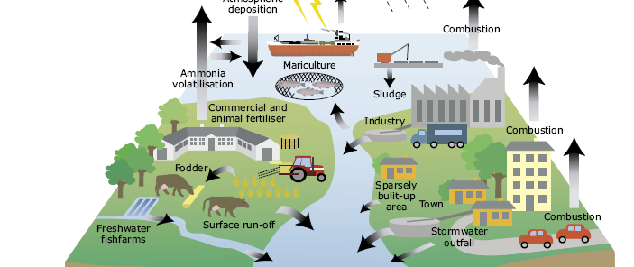
Single-mindedly pursuing individual goals may interfere with other goals
Example: Intensifying agricultural production
More land used for growing food
Competition over land resources (e.g. biofuels vs. crops as food)
More use of fertilisers
Contamination of water resources
Less water security downstream
→ Need for a systematic WEF Nexus approach!
Source: LaB, 2010
Notes:
Notes:
This slide provides the second example.
The second example refers to the potential impact of intensified agricultural production: More food production often requires increases in the use of land and fertilizers. This may lead to competition over land for other needs such as the growth of biofuels. In addition, the positive effect on food security may be compromised by reduced water security as the downstream water is unfit for certain purposes due to water quality deterioration.
These trade-offs are the reason why a Nexus approach is needed: in order to systematically address what is often hidden or not being considered in planning and management, given that a “silo” approach (i.e. single mindedly pursuing individual goals) has no means to consider these types of externalities.
Sources:
LaB (2010), ‘Fertilizers and their Impact on Watershed Ecology’, Available from: http://lab.visual-logic.com/2010/02/864/

Slide 12
Time for a quick quiz game! How closely are the WEF sectors interrelated globally?
How much water does agriculture withdraw (as a % of total global freshwater withdrawals)?
How much water does the energy sector withdraw (as a % of total global freshwater withdrawals)?
How much energy do agriculture & food chain account for (as a % of global energy demand)?
Notes:
Notes:
Before we get on now with defining concretely what a Nexus approach is, now is time for a quick quiz game!
To participate, you need your smartphone, laptop or any other web-enabled devise [provide link and QR-code to access survey if using one of the online tools mentioned below]
We would like you to think about how closely the WEF sectors are interrelated. Therefore, please answer the following questions:
Questions:
How much water does agriculture withdraw (as a % of total global freshwater withdrawals)? [Multiple choice options: <50%, 50-65%, 65-80% (X), >80%]
How much water does the energy sector withdraw (as a % of total global freshwater withdrawals)? [Multiple choice options: <20% (X), 20-50%, >50%)
How much energy do agriculture & food chain account for (as a% of global energy demand)? [Multiple choice options: <30%, 30-50% (X), 50-70%, >70%]
Sources:
This survey can be realized with either menti (www.mentimeter.com), slido (www.slido.com) or any other online tool suitable for online surveys.

Slide 13
The WEF sectors are closely related
Examples of interconnections:
Agriculture accounts for 70% of total global freshwater withdrawals
The energy sector accounts for about 10- 15% of the global freshwater withdrawal
Agriculture & food chain account for 33% of global energy demand
GWP, 2019
Notes:
Notes:
And here are the solutions:
Agriculture accounts for approx. 70% of global freshwater withdrawals;
The energy sector accounts for about 10% to 15% of the global freshwater withdrawal
And food production consumes about a third of all energy produced
Sources:
Food and Agriculture Organization (2014), ‘The Water-Energy-Food Nexus - A new approach in support of food security and sustainable agriculture’, Food and Agriculture Organization of the United Nations, pp.1–11.
Merrey, D. (2015) ‘Critical Roles of Water in Achieving the Proposed SDGs: a Nexus Perspective (Water-Energy-Food-Climate Change)’, [PowerPoint presentation], Available at: https://sustainabledevelopment.un.org/content/documents/130191.3%20MERREY-Critical%20role%20of%20water-SDGs-Nexus_revised2.pdf
United Nations (2021), ‘United Nations World Water Development Report 2021: Valuing Water‘, Available from: https://unesdoc.unesco.org/ark:/48223/pf0000375724
United Nations University (UNU) (2013), ‘Water Security & the Global Water Agenda: A UN-Water Analytical Brief’, Hamilton.
Image Reference:
Global Water Partnership (2019), ‘The Nexus approach’, Available from: https://www.gwp.org/en/GWP-Mediterranean/WE-ACT/Programmes-per-theme/Water-Food-Energy-Nexus/the-nexus-approach-an-introduction/

Slide 14
What is the WEF Nexus approach?
The WEF Nexus provides a holistic and integrated approach in order to secure access to water, energy and food in the long term.
– Global Nexus Secretariat, 2020
Notes:
Notes:
Now that we have shed some light on the interdependencies between water, energy and food security
This is where the Nexus approach comes in:
The overall aim of the WEF Nexus approach is to secure the long-term accessibility to the declining resources of water, energy and food.
Acknowledging the interconnectedness the WEF Nexus promotes a holistic and integrated perspective.
and strives to put the sectoral needs on an equal footing.
Thus, the WEF Nexus is an approach for managing conflicts and identifying synergies while preserving the human wellbeing as well as healthy ecosystems.
Sources:
Global Nexus Secretariat (GNS) (2020), ‘Global Water, Energy and Food Nexus Principles: The Nexus Regional Dialogues Programme’, Available from: https://uploads.water-energy-food.org/legacy/nexus_principles_final_version_30-06-2020.pdf

Slide 15
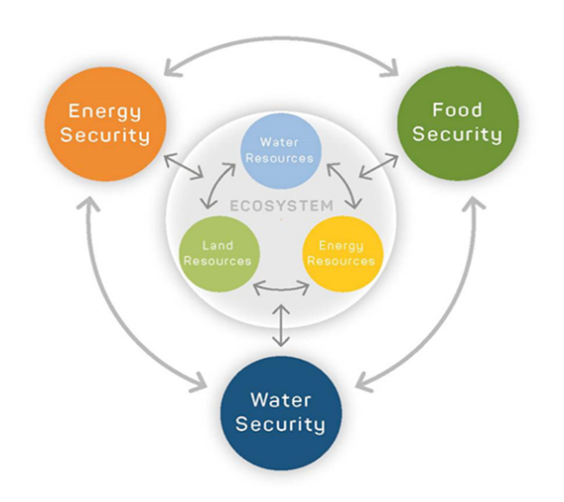
WEF Nexus from the ecosystem perspective
Ecosystems take a central role in this WEF Nexus concept
But there are numerous other frameworks (check out resources at: https://www.water-energy-food.org/)
GIZ, 2016
Notes:
Notes:
The “original” Nexus concept (Hoff, 2011) looked at the security of water supply, food and energy from a water perspective: water was placed in the centre of the Nexus. Since then, the concept developed further
The concept presented in the graphic here (GIZ, 2016) is a more integrated approach, where the ecosystem is located at the centre.
This is to highlight the central role of ecosystems : The three ‘supply securities’ of water, energy and food depend on ecosystems. The resources land, water and energy (atmosphere) are part of this ecosystem and must be used and protected in a balanced manner.
There are numerous other Nexus frameworks guiding the assessment of the complex Nexus related interconnections, for example putting more focus on climate change or livelihoods – have a look at the WEF Security Resource Platform.
Sources:
GIZ (2016), ‘Water, Energy & food Nexus in a Nutshell’, Available from: www.water-energy-food.org/fileadmin/user_upload/files/2016/documents/nexus-secretariat/nexus-dialogues/Water-Energy-Food_Nexus-Dialogue-Programme_Phase1_2016-18.pdf

Slide 16
What does the WEF Nexus approach provide?
Key components
A framework to determine trade-offs and synergies
Promotion of policy coherence and multi-sectoral cooperation
A tool to achieve sustainable development
Notes:
Notes:
Key components that the WEF Nexus provides:
a framework can (1) determine trade-offs and synergies between the sectors and (2) reconcile the multiple (conflicting) interests and needs.
It promotes coherence and multi-sectoral and inclusive cooperation.
And it provides a tool to achieve sustainable development.
Like this it allows to identify, Nexus solutions to reduce these trade-offs and create synergies to enhance efficiency of the entire system through developing smart policies, innovative technological solutions
While we have already addressed some of the trade-offs within the WEF Nexus, in the next slides I will present some examples of potential synergies
Sources:
Global Nexus Secretariat (GNS) (2020), ‘Global Water, Energy and Food Nexus Principles: The Nexus Regional Dialogues Programme’, Available from: https://uploads.water-energy-food.org/legacy/nexus_principles_final_version_30-06-2020.pdf

Slide 17
Benefits of Nexus approach
Reducing sectoral trade-offs
Avoid or limit negative externalities
Enhancing resource efficiency
Solutions designed to address multiple challenges simultaneously
Political benefits
Increased political legitimacy, political stability
Leverage synergies towards overarching development goals
Notes:
Notes:
What are the specific benefits a Nexus approach provides?
The potential benefits from a Nexus approach are multiple
As outlined before, one major issue is to identify and reduce sectoral trade-offs: as described in the slides before it is not uncommon for activities in one sectoral area to cause major problems in another area
For instance, the expansion of water supply for food production can affect water quality for drinking water supply or availability of water for other uses
However, the WEF Nexus concept is not only an analytical tool to identify trade-offs, but also a tool to materialize cross-sectoral synergies.
Enhanced efficiency: following a Nexus approach helps making more efficient use of limited resources while minimizing environmental impact.
Nexus solutions are designed to address multiple challenges simultaneously.
For instance, multipurpose dams that address the challenges of flooding, use water for hydropower generation and irrigation simultaneously → also expands the natural resource base and hence contributes to meeting growing demands.
Following a Nexus approach, operating and maintenance costs can be reduced significantly, while input such as financial and human resources are applied in an efficient way. Integration across jurisdictions and sectors creates opportunities to optimize resources and develop co-benefits.
Political benefits: following a Nexus approach can also help increasing political legitimacy and therefore aiming for political stability, as decision-makers from more than one sector get involved and bring in their views when making a decision on a project.
Using these different synergies can also help to better reach global development goals like the Sustainable Development Goals (SDGs) or the goals related to addressing climate change.
Let us now describe some of these benefits along some specific examples …

Slide 18
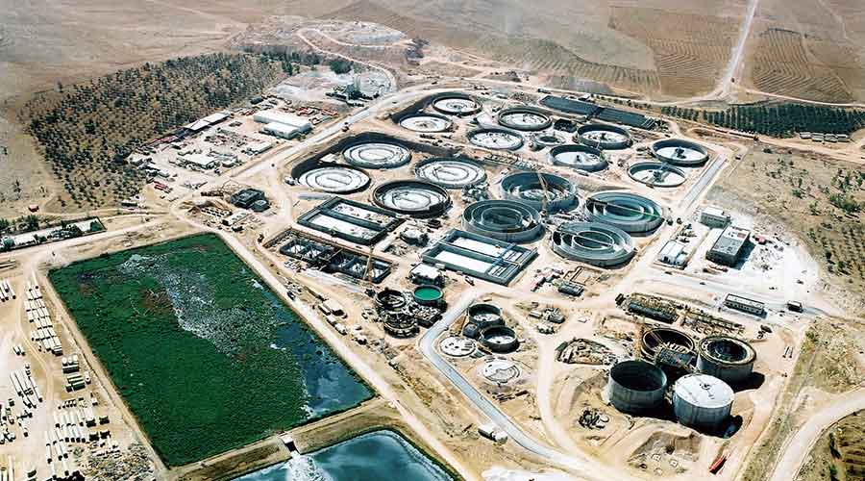
Synergies
Wastewater for energy and food production in Jordan
As-Samra wastewater treatment plant
Treats 365,000m³of wastewater/day
Benefits:
Produce clean water for population and agriculture (use of effluent)
Use waste to produce energy for plant operation (biogas)
Source: Consolidated Contractors Company
Notes:
Notes:
One nexus case study making use of WEF nexus synergies is the example presented here.
Case study Jordan:
Jordan is one of the world‘s most water scarce countries
Already today there are competing demands over limited water resources for drinking water/household consumption and agriculture – that are likely to grow with increasing numbers of population and increasingly drier climate
Water sector is also very energy-intensive, requiring approx. 15% of the countries total energy consumption
As-Samra wastewater treatment plant:
In this context, an interesting technical solution that address the water, energy and food component is the As-Samra wastewater treatment project
Constructed in 2008 and expanded and renewed in 2012 the plant today treats an average of 365,000m³of wastewater/day from the population of Amman and Zarqa while the effluent produced by the plant is used for agricultural irrigation (approx. 10% of water consumption in agriculture in Jordan come from this plant)
Most of the energy used for wastewater treatment (about 80%) is provided by biogas and hydraulic energy. The former is produced from the wastewater sludge that is converted to biogas through anaerobic digestion.
The plant hence also contributes to energy efficiency.
WEF-relevance:
Plant helps to improve resource efficiency and expand overall availability of water for households and agriculture
Reduced the energy requirements
Addresses climate change as it reduces CO2 emissions
Sources:
LAS, ‘The Water-Energy-Food Nexus in the Arab Region: Nexus Technology and Innovation Case Studies’, available at: https://uploads.water-energy-food.org/legacy/policy_briefs_6_english.pdf
Suez ‘As Samra Wastewater Treatment Plant‘, available at: file:///C:/Users/schul/Downloads/As%20Samra_R-ER-020-EN_1510_web.pdf
Water Technology, ‘As-Samra Wastewater Treatment Plant, Jordan’, available at: https://www.water-technology.net/projects/as-samra-wastewater-treatment-plant-jordan/
Image Reference:
https://www.ccc.net/project/as-samra-wastewater-treatment-plant/

Slide 19
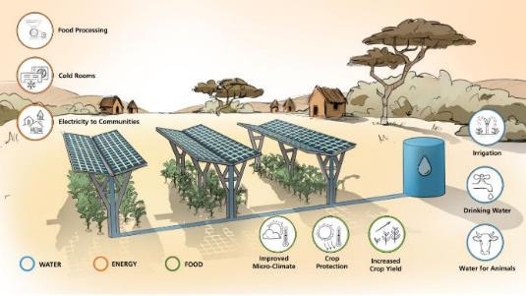
Synergies
Agrivoltaics in Mali and Gambia: sustainable electricity by integrated WEF systems
Integrated triple land-use system
Includes components for food production, energy generation and water harvesting
Benefits:
increase land use efficiency
improve agricultural conditions
decrease water requirements
Figure: Schematic diagram of a triple land use through agrivoltaics
© Fraunhofer ISE
Notes:
Notes:
The second example outlines a local Nexus approach at the farm-level: an Agrivoltaic project in Mali and Gambia
Project conducted by Frauenhofer ISE (08/2020 - 07/2023), partners from Germany, Mali and The Gambia are involved
It is a research and development pilot project that aims to proof the technical and also economic viability of an integrated triple land-use system
The idea is to use the same plot of land for three purposes: food production, generation of solar energy and water harvesting (solar panels collect rainwater that is then collected in a rainwater tank)
Project aims to:
Use synergies between these three components in various ways: 1) decrease competition between land use for energy and food production, 2) improve food production as many plants in semi-arid regions grow better under the shadow of the solar panels, 3) decrease water requirements for agricultural production
Contribute to a more ecological and economic sustainable development → double land use of agrivoltaics is extended by the range of water management
Rainwater harvesting and storage via the installed solar panels should balance seasonal fluctuations in precipitation which affect the farming possibilities
Energy can be used for pumping groundwater for drinking water supply, or for cooling of produce
Sources:
Client II, ‘Video: Project presentation APV-MaGa‘, available at: https://www.bmbf-client.de/publikationen/video-project-presentation-apv-maga
Frauenhofer ISE (2021), ‘APV-MaGa – Agrivoltaics for Mali and Gambia: Sustainable Electricity Production by Integrated Food, Energy and Water Systems’, Available from: APV-MaGa – Agri-Photovoltaik für Mali und Gambia: Nachhaltige Stromproduktion durch integrierte Nahrungsmittel-, Energie- und Wassersysteme - Fraunhofer ISE
Frauenhofer (2019), ‘Agrivoltaics – solar panels on top, potatoes down below‘, Available from: https://www.en-former.com/en/agrivoltaics/

Slide 20
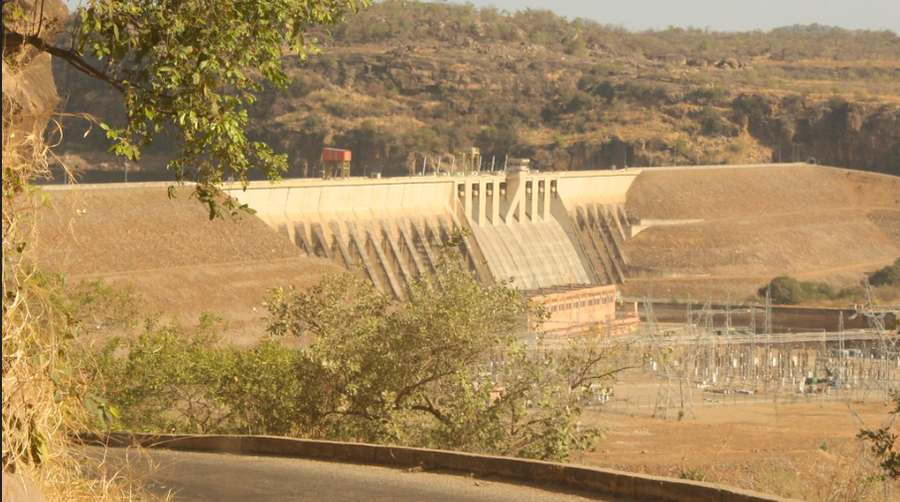
Synergies
Manantali multi-purpose dam – Mali, Senegal, Mauretania
Manantali is jointly owned and operated by three countries
Benefits:
Water storage for multiple purposes (irrigation, hydropower, and (potentially) to allow navigation)
Easier access to int. funding (support of development strategies/scale, contribution to GHG mitigation)
Source: Benoît Rivard/Flickr CC BY-NC-ND 2.0
Notes:
Notes:
Manantali Dam is located at the Bafing River in Mali 90km upstream from Bafoulabe and is part of the integrated development strategy for the Senegal basin
Manantali is a multi-purpose dam that is jointly owned and operated by three countries – coordinated by the regional “Organisation pour la Mise en Valeur du Fleuve Sénégal” (OMVS)
200 MW power plant generates electricity for Senegal, Mali and Mauretania
Reservoir provides water for irrigation of 130,000 ha of agricultural land
Water regulation component for navigation was originally planned but not realized
Benefits:
Water is stored in the dam for multiple purposes: irrigation and hydropower – and potentially in the future also to allow navigation
Multipurpose projects are more attractive for international financial assistance as they often fit well into national and regional development plans such as for food production or flood mitigation. They can also complement strategies for climate change adaptation if they have a hydropower component.
Additional information for the trainer:
Actual implementation of land that is now irrigated: original plan was 225,00 ha but that has never been reached; navigation component has to date not been implemented
Significant environmental problems need to be mentioned. They are slowly being addressed.
Sources:
Agriwaterpedia (2016). Multipurpose dams. Available at: https://wocatpedia.net/wiki/Multi-purpose_dams
Dombrowsky, I. and O. Hensengerth (2018). Governing the Water-Energy-Food-Nexus Related to Hydropower on Shared Rivers – The Role of Regional Organizations. Front. Environ. Sci., published 18 December 2018. Available at: https://doi.org/10.3389/fenvs.2018.00153
Kramer, A., Hensengerth O., Mertens, A. and A. Carius (2012). Assessment of RBO-Level Mechanisms for Sustainable Hydropower Development and Management. Vientiane, October 2012. Available at: rbo_mechanisms_sustainablehydropower_report_mrc-giz.pdf (adelphi.de)
OECD (2017). Multi-purpose Water Infrastructure. Recommendations to maximise economic benefits. Available at: https://www.oecd.org/env/outreach/MPWI_Perspectives_Final_WEB.pdf

Slide 21
The Sustainable Development Goals
Source: UN, 2015
Notes:
Notes:
The Nexus approach is also relevant for reaching global development goals and supporting policy processes – such as those around the Sustainable Development Goals (SDGs)
There are a total of 17 goals, and the WEF Nexus approach focuses on the goal 2 (food), 6 (water) and 7 (energy)
However, progress towards most of the other SDGs is directly related to the sustainable use of the resources land, food, water and energy
Sources:
FAO (2018). Policy Brief #9. Water-Energy-Food Nexus for the review of SDG 7. Available at: https://sustainabledevelopment.un.org/content/documents/17483PB_9_Draft.pdf
United Nations General Assembly (2015), ‘Transforming our world: the 2030 Agenda for Sustainable Development’, Resolution adopted by the General Assembly on 25 September 2015.

Slide 22
Nexus approach: Enabler for reaching the SDGs
The WEF Nexus is a central pillar of the Agenda 2030
Supports the identification of potential trade-offs & considers these in the policy-making process
Helps to leverage synergies by supporting solutions that benefit the implementation of SDG‘s
Trade-offs will be minimized or prevented
Formulation of policies and creation of incentive structures to favor such solutions
Notes:
Notes:
A Nexus approach can therefore act as an important enabler for different stakeholders in achieving the SDGs → WEF Nexus is therefore a central pillar of the Agenda 2030
Explicitly taking a WEF Nexus approach can help implementing the SDGs in the following ways:
Support identification of potential trade-offs at the policy-design stage (e.g. targets related to food security, bioenergy) and consider these in policy-making processes → hence ensure that trade-offs are made transparent and will be minimized/prevented
Help leverage synergies in achieving overarching goals by supporting identification and implementation of solutions that benefit implementation of multiple SDGs → formulate policies and create incentive structures that favor such solutions

Slide 23
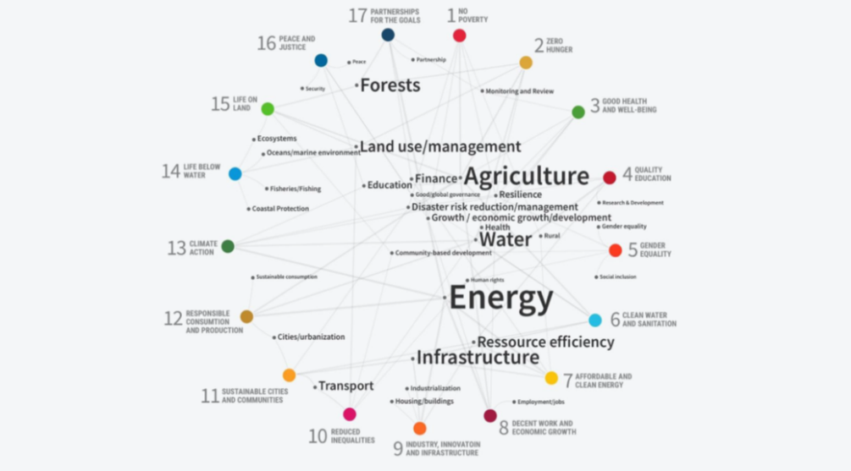
Understanding the links between SDGs
Source: SEI, 2017
Notes:
Notes:
This figure demonstrates how the SDGs are related to each other, with many of the 17 SDGs linked to land use / agriculture, water and energy, highlighting them as crucial issues.
A crucial question which can be answered by the WEF Nexus approach is: how much does attaining one goal means in terms of trade-offs or synergies for another goal?
Sources:
GWSP, 2014, http://wef-conference.gwsp.org/fileadmin/documents_news/understanding_the_nexus.pdf
Merrey, D. (2015) ‘Critical Roles of Water in Achieving the Proposed SDGs: a Nexus Perspective (Water-Energy-Food-Climate Change)’,
https://sustainabledevelopment.un.org/content/documents/130191.3%20MERREY-Critical%20role%20of%20water-SDGs-Nexus_revised2.pdf
Stockholm Environment Institute (SEI) (2017), ‘Exploring connections between the Paris Agreement and the 2030 Agenda for Sustainable Development’, Policy Brief, Stockholm.
UNGA (United Nations General Assembly) (2015). Transforming Our World: The 2030 Agenda for sustainable development. Draft resolution referred to the United Nations summit for the adoption of the post-2015 development agenda by the General Assembly at its sixty-ninth session. UN Doc. A/70/L.1 of 18 September.

Slide 24
Nexus approach: support development and monitoring of the SDGs
The WEF Nexus is fundamental for the development and subsequent monitoring of the SDG‘s and the Agenda 2030
The SDG‘s call for inclusive development building on the WEF sectors
The Nexus approach highlights the interdependencies of the WEF sectors
„Sustainable thinking“ is the key driving force behind undertaking the Nexus approach
The sustainable achievement of WEF security lays the foundation for economic development, social welfare and ecological integrity
Notes:
Notes:
The WEF Nexus has become central to discussions and a fundamental topic regarding the development and subsequent monitoring of the SDGs and the “Agenda 2030“
The SDGs call for governments to prepare new targets and action for sustainable water use, energy use and agricultural practices for promoting inclusive development
The Nexus approach highlights the interdependencies of water, energy and food security and the natural resources that underpin security of water, soil and land
“Sustainable thinking” is the key driving force behind undertaking the Nexus approach → interdependent sectors should work in a more integrated manner to achieve the “future we want”
The importance of the WEF Nexus concept has been fundamentally supported and anchored by the Rio+20 summit
Although the importance assigned to specific goals may differ among countries, a sustainable achievement of water, energy and food security seems fundamental for economic development, social welfare and ecological integrity

Slide 25
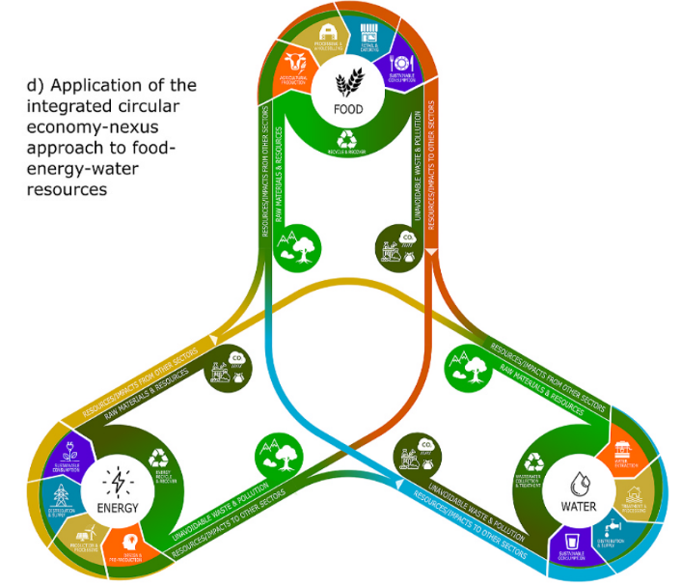
Nexus interlinkages with other concepts and resulting global policy processes
Disaster risk reduction: Sendai Framework
Climate Change: Paris Agreement and resulting Nationally Determined Contributions (NDCs)
Circular Economy
Figure: Application of the integrated circular economy-nexus approach to food-energy-water resources
Source: Parsa et al., 2021
Notes:
Notes:
The Nexus approach can help address sustainable development challenges also beyond the SDGs, linking to the following other concepts and resulting policy processes:
Disaster risk reduction: Reducing water-related hazard, for example, will provide synergies regarding the production risk in agriculture. Therefore, a Nexus approach can help address the Sendai Framework, which refers to managing risks related to natural hazards that impact water, food and energy security alike.
There are in particular close interlinkages between the WEF Nexus and climate change – hence with the implementation of the Paris Agreement (Hoff, 2011). The Paris Agreement refers to actions towards climate change mitigation and adaptation. Many Nationally Determined Contributions (NDCs) need to be scrutinised regarding their potential impacts on either water, energy and food security – and may relate to trade-offs or synergies.
Circular Economy: “adopting a nexus approach in a CE context can ensure that the CE paradigm does not fall short of the sustainability expectations, and does not lead to shifting the burden to other sectors.” and integrating CE in a Nexus approach “can be useful for a more accurate understanding and analysis of the Nexus complexities.” (Parsa et al., 2021) → Therefore, a Nexus approach can help avoiding trade-offs in a CE context and integrating CE in a Nexus approach can help understanding better in more detail how the WEF resources impact each other. Example: Reuse of sludge in the wastewater treatment sector.
→ Showing the links between a planned research project and the achievement of several policy objectives at national and/or global level may be important to demonstrate the relevance of a project.
Sources:
FAO (2018). Policy Brief #9. Water-Energy-Food Nexus for the review of SDG 7. Available at: https://sustainabledevelopment.un.org/content/documents/17483PB_9_Draft.pdf
Hoff, H. (2011). Understanding the Nexus. Background Paper for the Bonn2011 Conference: The Water, Energy and Food Security Nexus. Stockholm Environment Institute, Stockholm. Available at: https://mediamanager.sei.org/documents/Publications/SEI-Paper-Hoff-UnderstandingTheNexus-2011.pdf
Parsa et al. (2021): Intersection, interrelation or interdependence? The relationship between circular economy and nexus approach. Journal of Cleaner Production, Volume 313, 2021. Available at: https://www.sciencedirect.com/science/article/pii/S0959652621020126

Slide 26
Governance Challenges of Nexus Implementation
Government structures organized in silos, lack of coordination (horizontally and vertically)
Lack of up-to-date data on status of WEF sectors that can be used for decision-making
Deficiencies in knowledge about complex Nexus interlinkages
Lack of transdisciplinary science
Lack of (knowledge of) applicable assessment tools
Notes:
Notes:
Making use of potential benefits of the nexus approach is often complicated if not prevented by governance challenges
Existing silo structure of governments: Governments around the world are typically organized in sectoral ministries and set policies separately for each individual sector. For instance, you often find seperate strategies for water, energy and food that do not take into account the objectives and measures taken by the other sector → sometimes even conflicting; this is not only the case for the national but also regional and local gov. levels
Cross-sectoral coordination is often lacking: Different ministries, department and agencies within a government system often lack platforms and processes to interact. There are multiple reasons for that, including limited lack of awareness of interlinkages, limited incentives to coordinate with other departments, limited human resources, power imbalances, but also fact that different administrative unites (just like academic disciplines) use different indicators and metrics
Lack of knowledge about Nexus tools (and their application): such as modelling tools, scenario-development, or participatory processes
Sources:
FAO (2018). Policy Brief #9. Water-Energy-Food Nexus for the review of SDG 7. Available at: https://sustainabledevelopment.un.org/content/documents/17483PB_9_Draft.pdf
Purwanto, A., Susnik, J. Suryadi F.X. and C. de Fraiture (2021). Water-Energy-Food Nexus: Critical Review , Practical Applications, and Prospects for Furture Research. Sustainability 2021,13, 1919. Available at: https://doi.org/10.3390/su13041919

Slide 27
Possible measures for Nexus implementation
Introduce legislation and norms that stipulate a Nexus approach
Coordinated institutions (ministries, agencies, etc.)
Engage other institutions with cross-sectoral competence
TOWARDS NEXUS IMPLEMENTATION
Build joint committees and informal working groups
Cross-sectoral knowledge base for policy-making
Strengthen interfaces within a given institution
Notes:
Notes:
A fundamental problem is that each goal (water, energy and food security) is represented and promoted by different institutions (often ministries or authorities), thus an underlying problem for Nexus implementation is the existing sectoral governance system. Therefore, new approaches are required in order to integrate between sectors. Key questions here are who undertakes this integration and how is it achieved?
This figure provides some ideas. For example:
Coordinated institutions: while there are few examples of creating a separate WEF ministry, there are a number of examples of two sectors being joined; this can help to facilitate coordination between two sectors. In many countries the ministries of water and energy are for instance combined.
Build joint committees and informal working groups: These can be established at various local, national and also regional levels. For example, in the Southern African Development Community (SADC), the regional Secretariat has established a WEF Working Group to improve coordination between the different units of the Secretariat that are responsible for WEF sectors.
Strengthen interfaces: Develop competence within a sectorial institution to build interfaces with neighboring sectors and institutions
Cross-sectoral knowledge base for policy-making: Collect cross-sectoral information and data that help to better understand the interlinkages between sectors
Engage other institutions with cross-sectoral competence: E.g. transboundary River Basin Organizations (RBOs) bring upstream and downstream actors together that often represent different sectoral interests; in some instances (e.g. Niger/NBA), they have also evaluated projects based on multi-sectoral benefits they provide; in other cases (e.g. Sava) they have provided a platform for implementing nexus assessments
Introduce legislation/and norms that stipulate a nexus approach: This is a very complex topic that comprises numerous options ….Governments can support Nexus activities by harmonising public policies, creating awareness for Nexus issues, quantifying and addressing trade-offs between water, energy or food security, creating incentives to develop aligned strategies and providing investments for projects which prove to contribute to achieve a Nexus-oriented development goal.
Methods for Nexus implementation are discussed in more detail in Chapter 2.
Sources:
Deutsches Institut für Entwicklungspolitik (DIE), 2012, A Nexus Approach for Humans and Nature?, Global Water News No. 14. Available from: http://www.gwsp.org/fileadmin/documents_news/Interview_Scholz.pdf
Weitz, N., Nilsson, M. & Davis, M. ‘A Nexus Approach to the Post-2015 Agenda: Formulating Integrated Water, Energy, and Food SDGs’ SAIS Review of International Affairs, vol. 34, No. 2, Summer-Fall 2014, pp. 37-50

Slide 28
Q & A on Introduction to the WEF Nexus
Any questions on Chapter 1?
Notes:
Notes:
At this point, we would like to take some time to answer any questions you might have on Chapter 1.1.

Slide 29
Interactive Exercise: Your experiences with sectoral interlinkages
Chapter 1.1: Background to the Water-Energy-Food (WEF) Nexus
Notes:
Notes:
We now move to the more interactive part of the training. You are now asked to engage in an exercise where you can share your own experiences on interlinkages between the WEF sectors.

Slide 30
Nexus analysis in your regional context
Objective: Identify challenges in the water, energy and food sector as well as sectoral interlinkages.
What to do: Split into groups of 3-5 persons and read the work instructions on the handout.
Timeframe: You have 20 min. for the discussion within the group, followed by 5 min presentation in the plenum.
Notes:
Notes:
See instructions in handout.

Slide 31
Summary of chapter 1.1: Background to the Water-Energy-Food (WEF) Nexus
The Water-Energy-Food security Nexus is a concept which looks at interconnections which are usually overlooked, yet are very important
The WEF Nexus concept is about harnessing synergies and addressing trade-offs
It is also linked to other concepts (e.g. SDGs, Sendai Framework for disaster risk reduction, NDCs of the Paris Agreement, circular economy)
The next section will focus in more detail on the interactions between water, energy and food sectors
Notes:
Notes:
The Water-Energy-Food security Nexus is a concept which looks at interconnections which are usually overlooked, yet are very important
The WEF Nexus concept is about harnessing synergies and addressing trade-offs
It is also linked to other concepts (e.g. SDGs, Sendai Framework for disaster risk reduction, NDCs of the Paris Agreement, circular economy)
The next section will focus in more detail on the interactions between water, energy and food sectors

Slide 32
Thank you for your time!
In cooperation with

